Slide 1

The Yen Legacy
The Yen Legacy

Slide 2
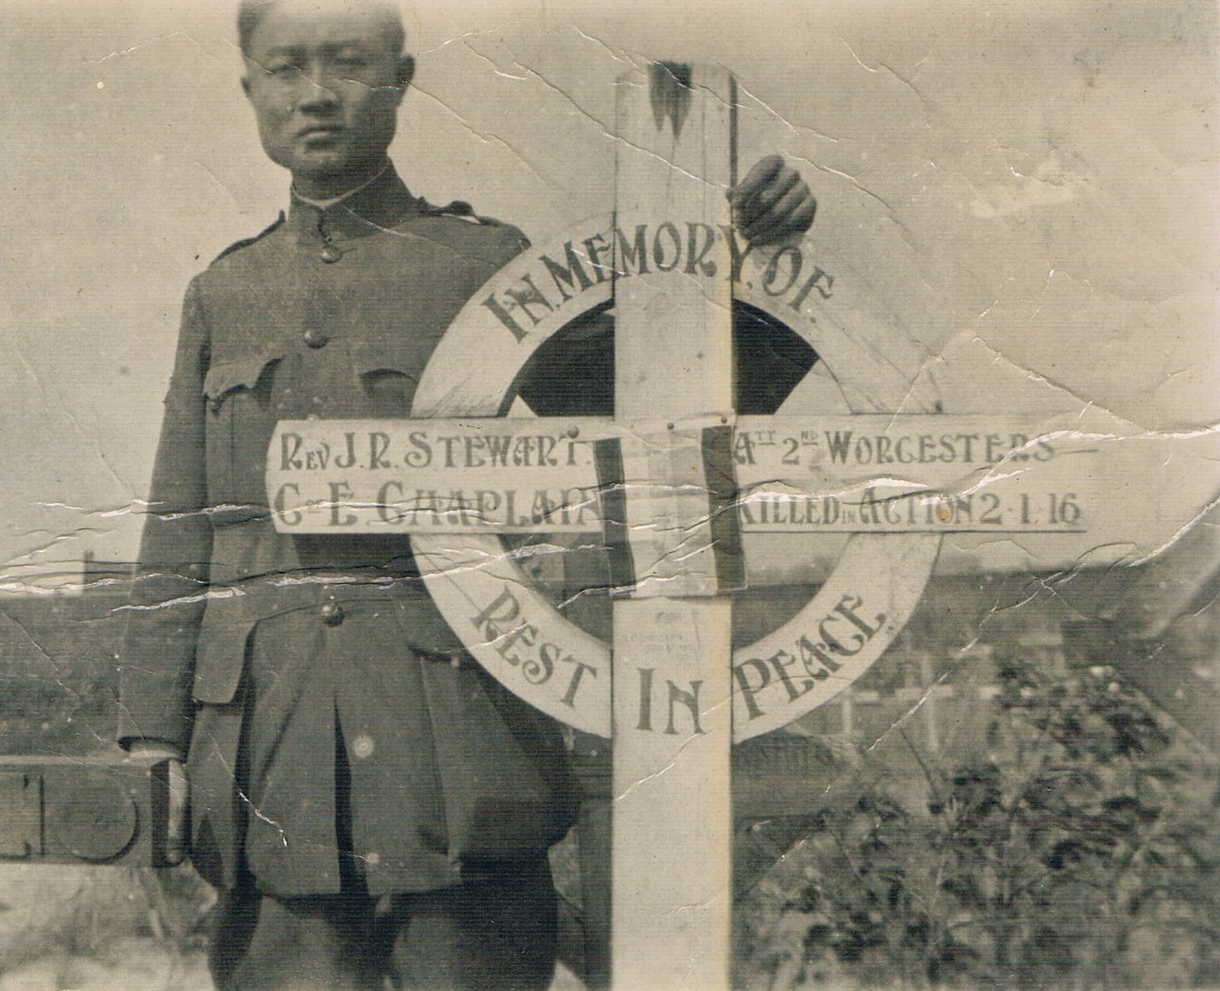
At the grave of his friend and comrade Rev JR Stewart, killed in action in France in 1916

Slide 3
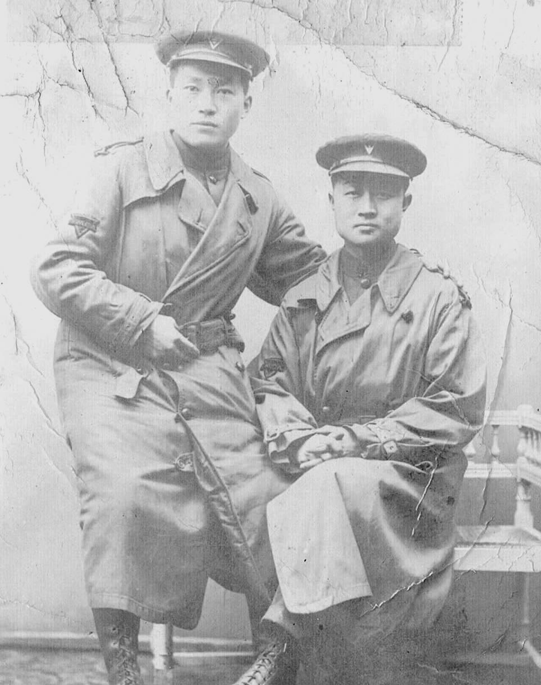
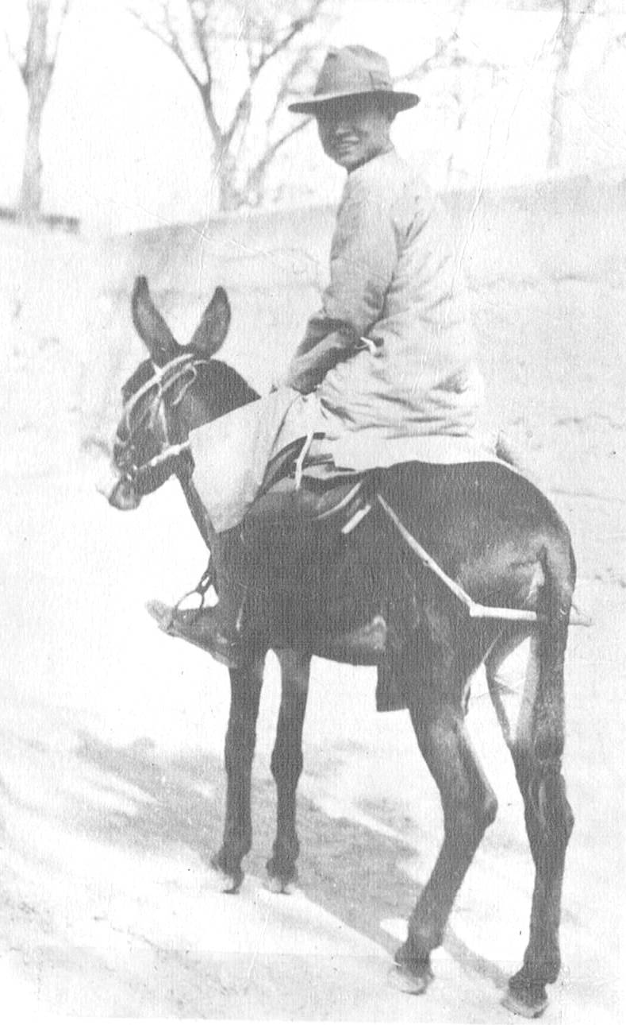
France, 1918
On the way to a remote village in China, 1923

Slide 4
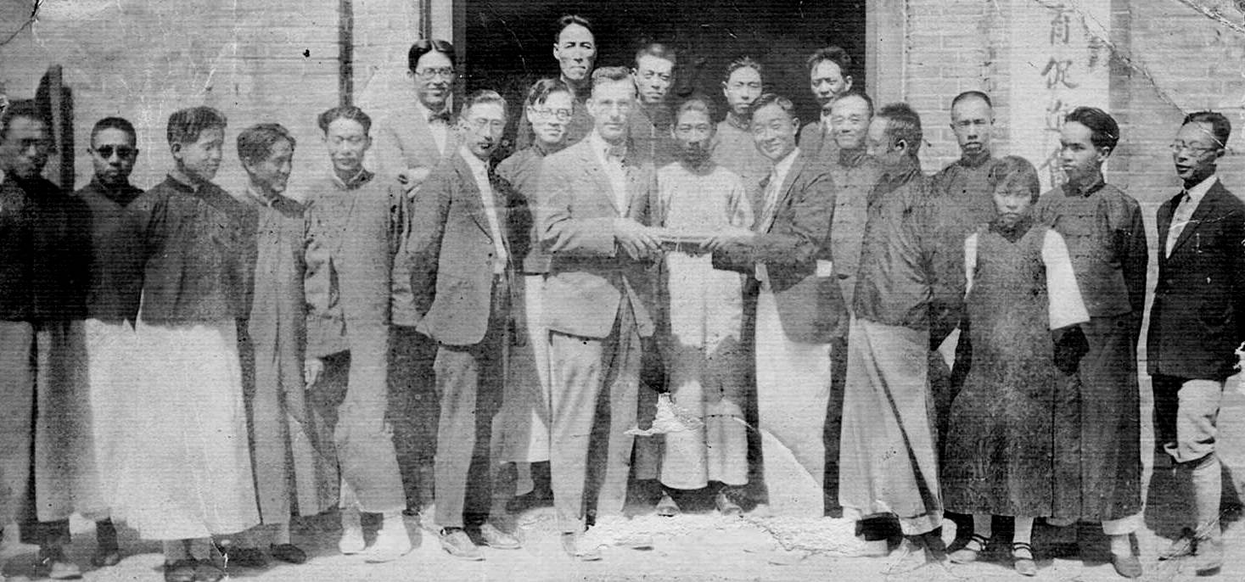
With Mass Education Movement (MEM) colleagues in China, c.1925

Slide 5
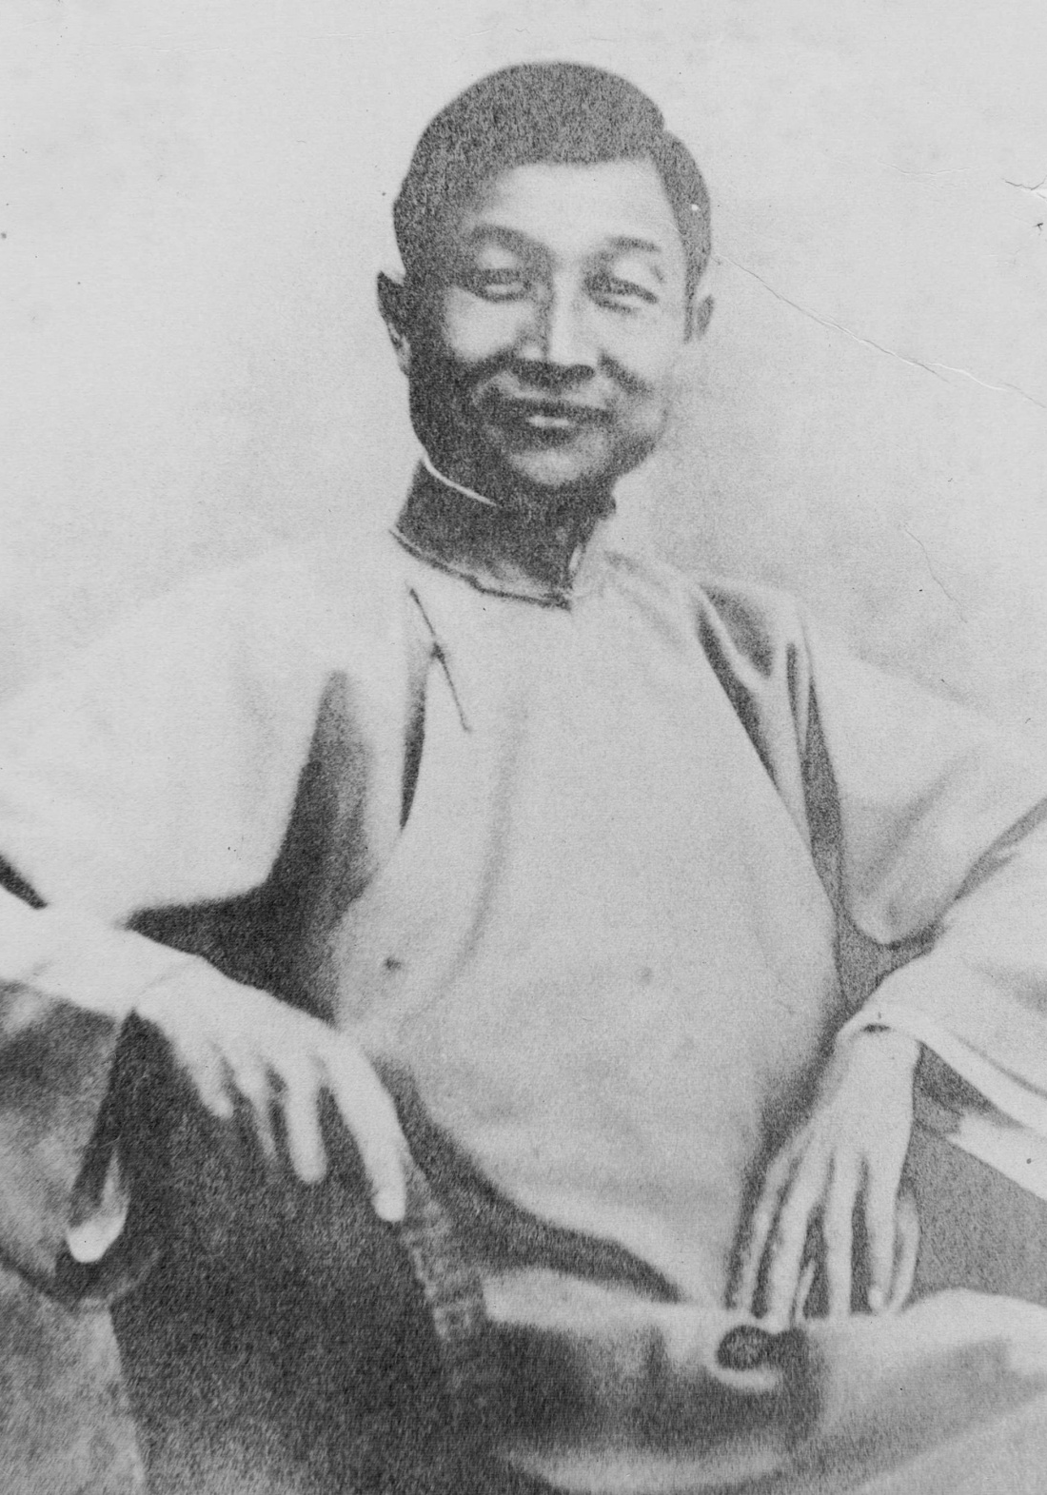
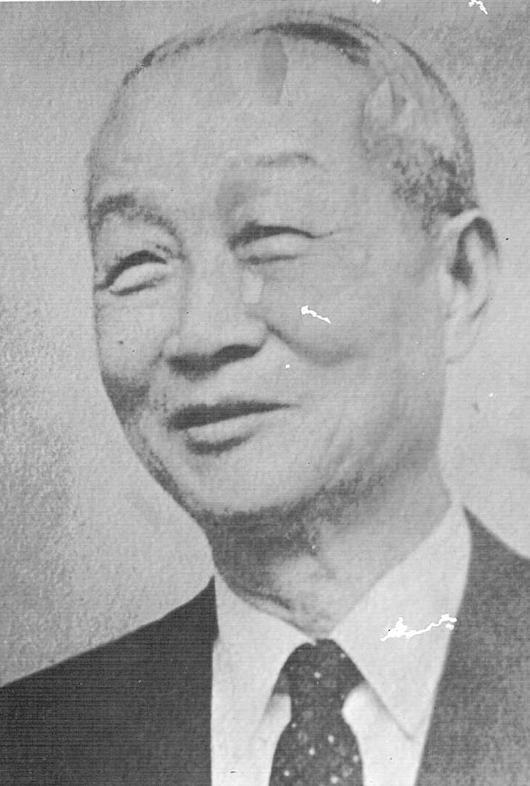
Portraits of James Yen
1933
1947

Slide 6
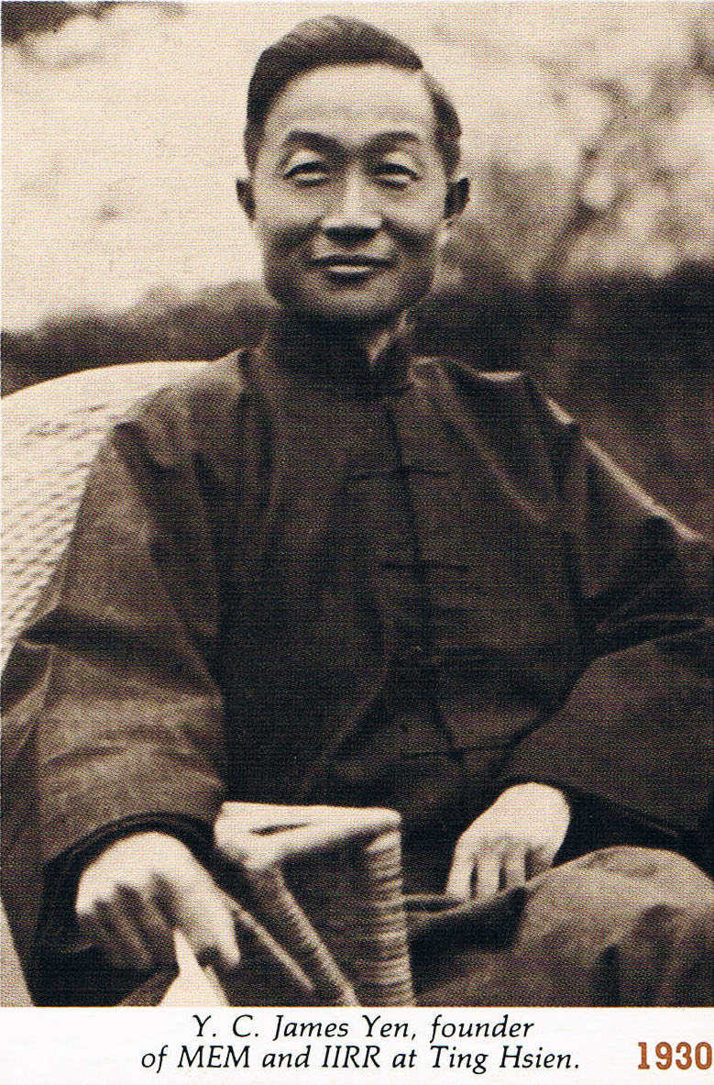
James Yen, founder of MEM and IIRR, at Ting Hsien, 1930

Slide 7
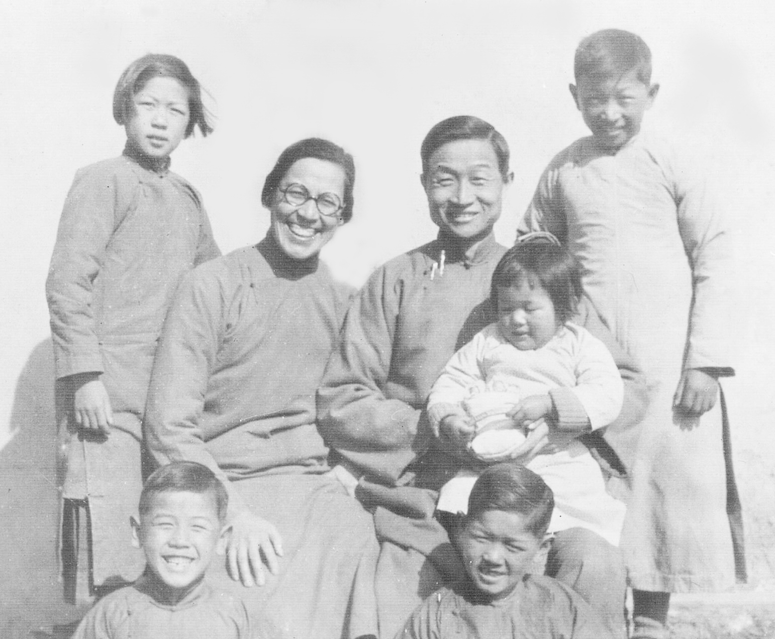
James and Alice Yen with village children, China, c.1927

Slide 8
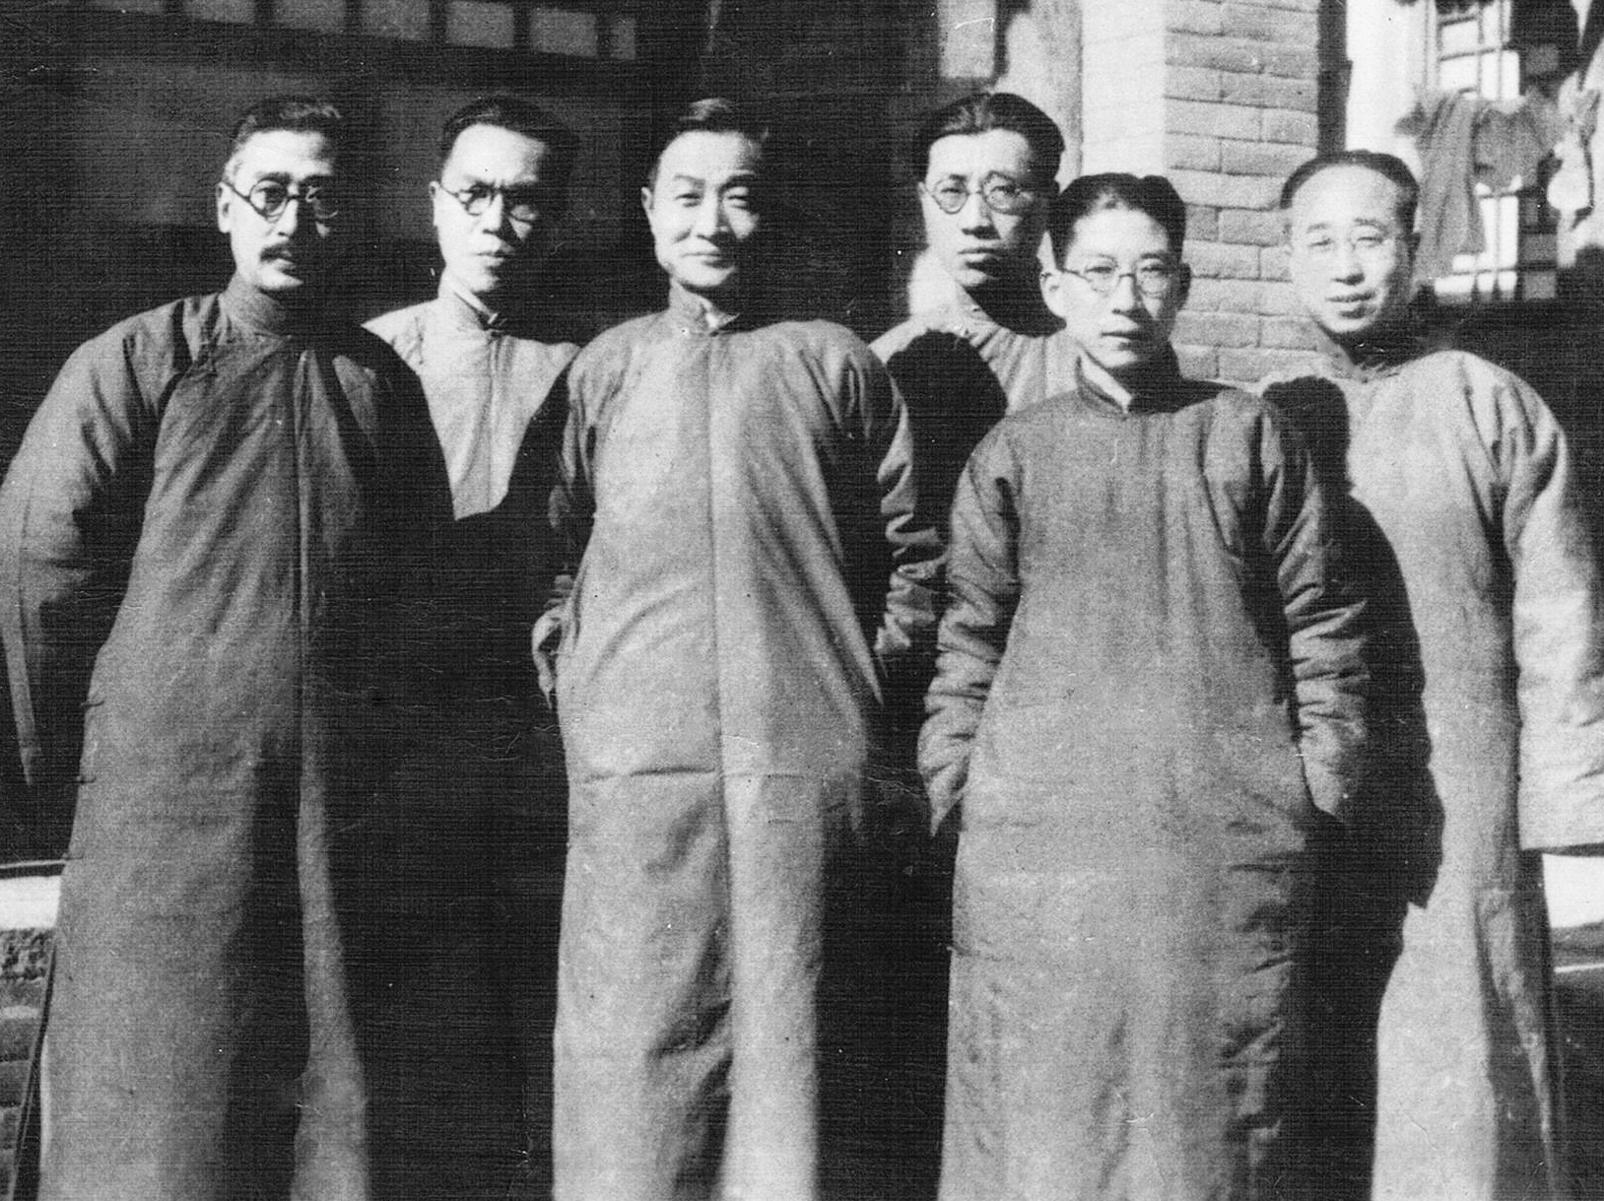
James Yen with MEM colleagues at Ting Hsien, c.1930

Slide 9
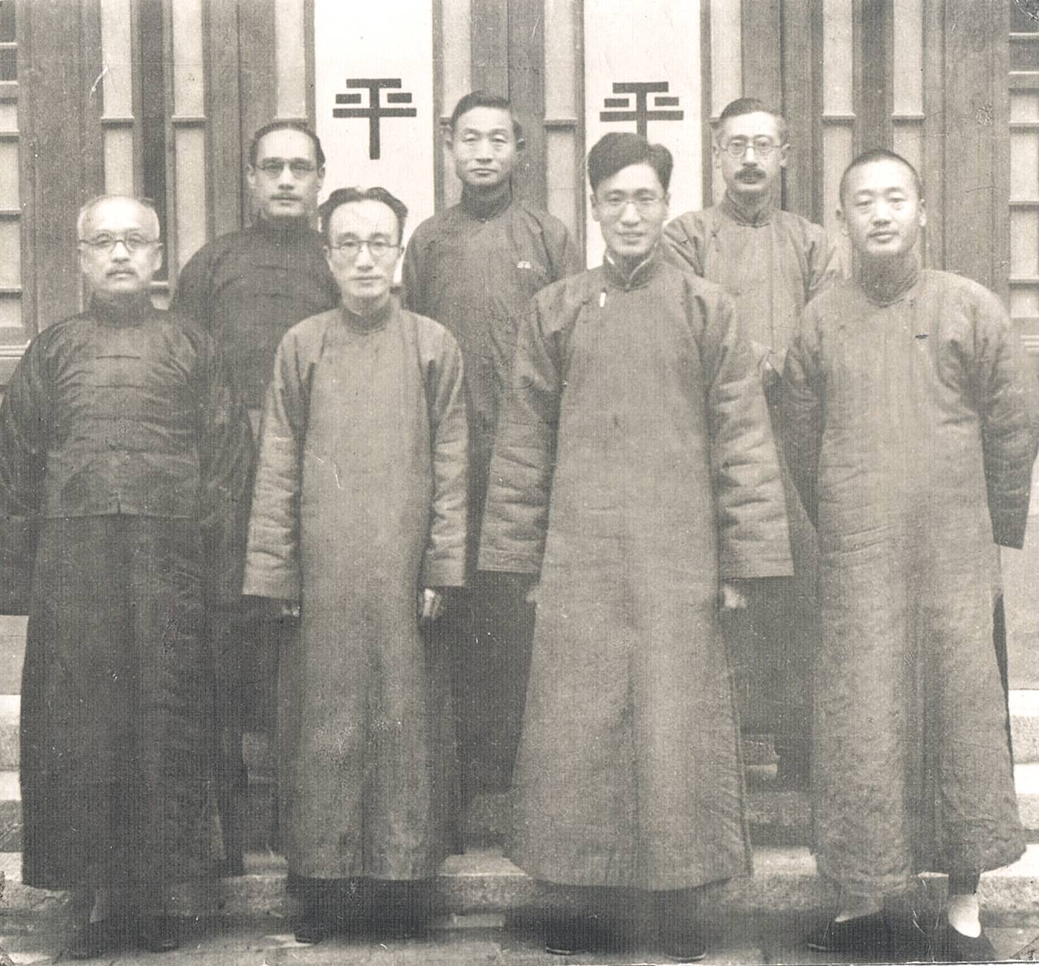
James Yen (center back row) and colleagues of the Mass Education Movement in China, c.1930

Slide 10
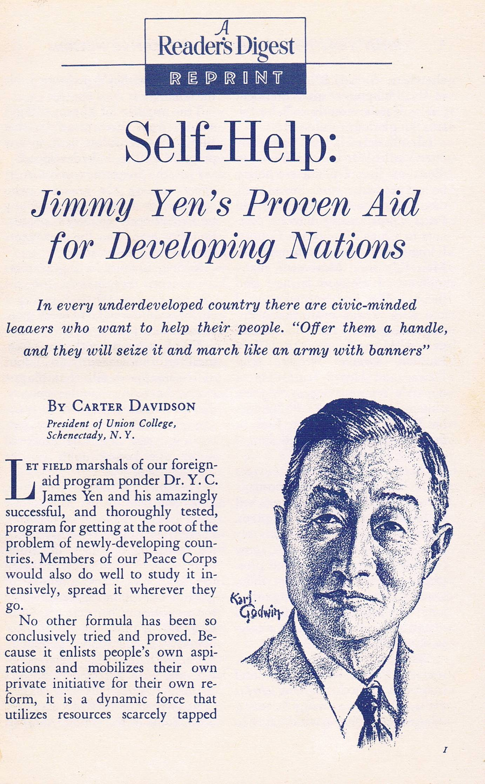
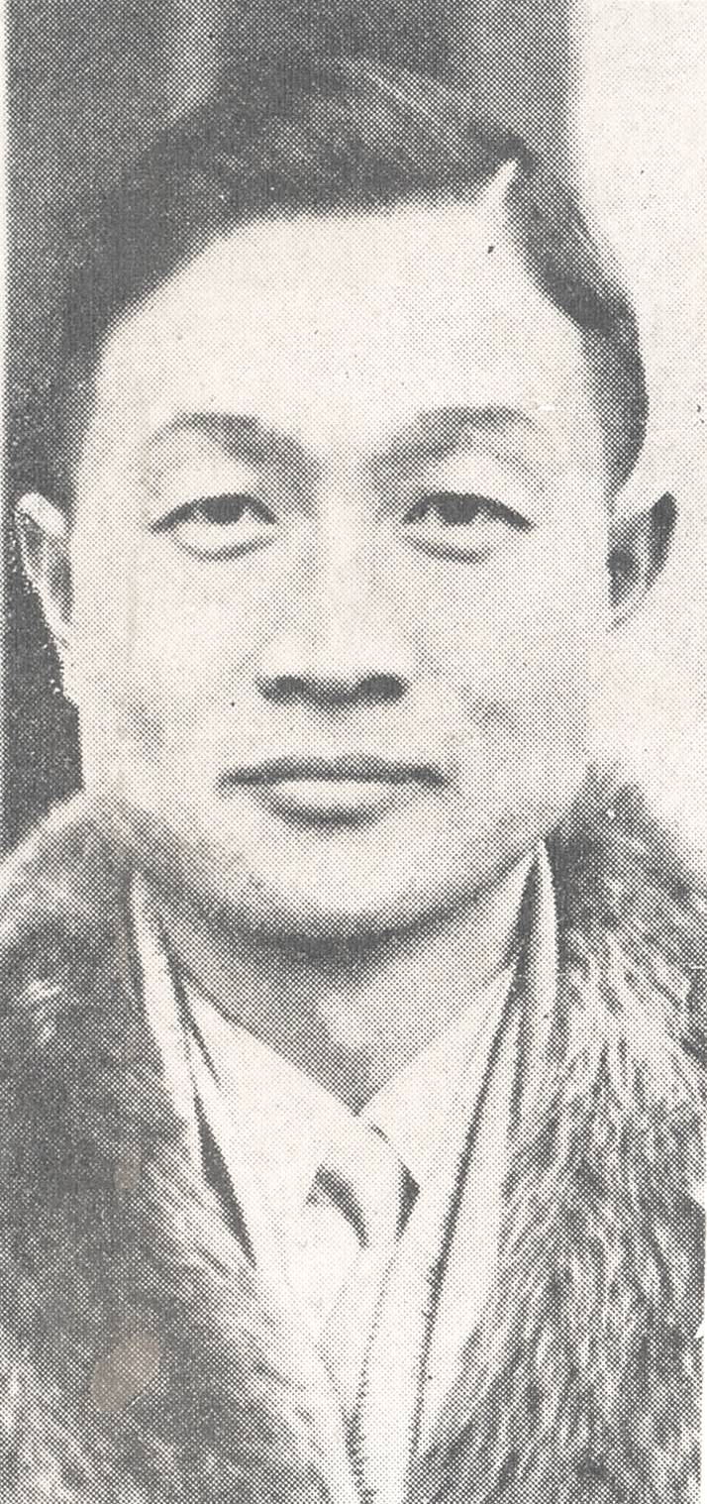

Slide 11
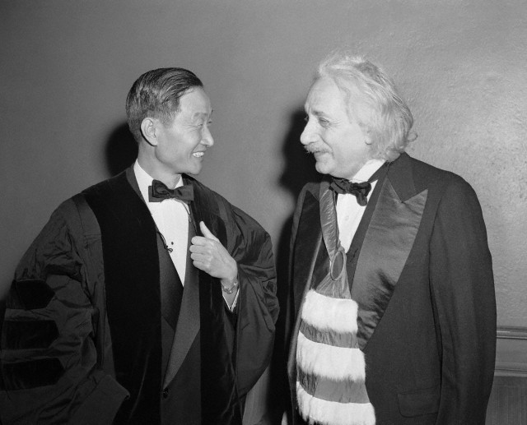
James Yen and Albert Einstein when both were honored with the Copernican Citation, New York, 24 May 1943.

Slide 12
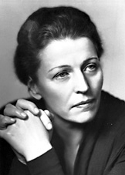
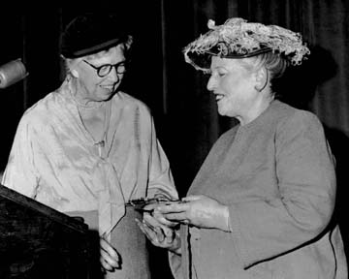
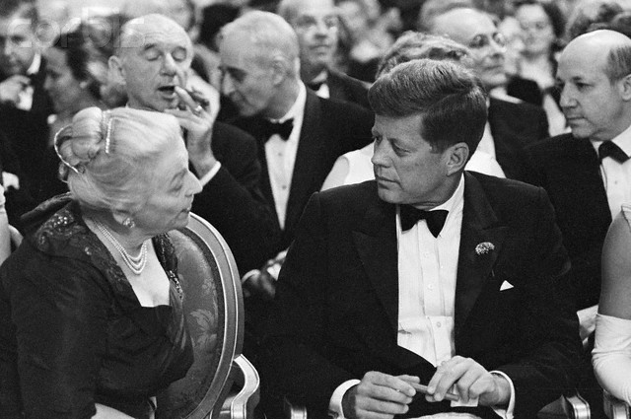
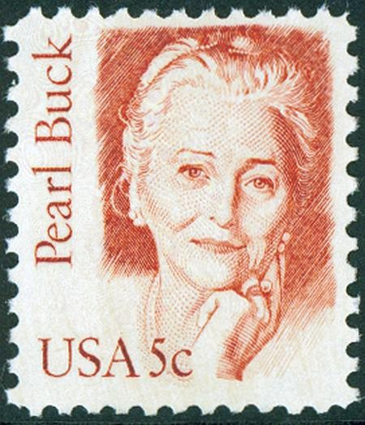
James Yen’s close friend Pearl Buck, who won the 1938 Nobel Prize for Literature
With Eleanor Roosevelt
With John Kennedy

Slide 13
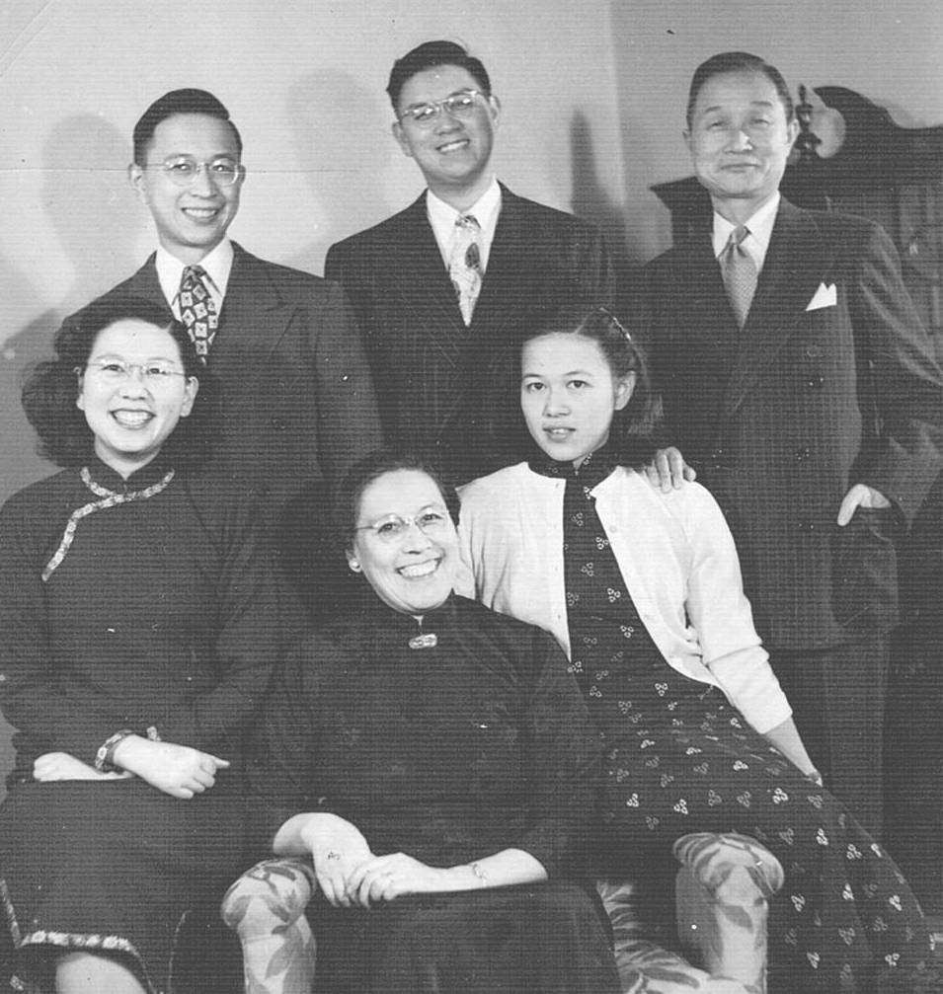
Family portrait, c.1950

Slide 14
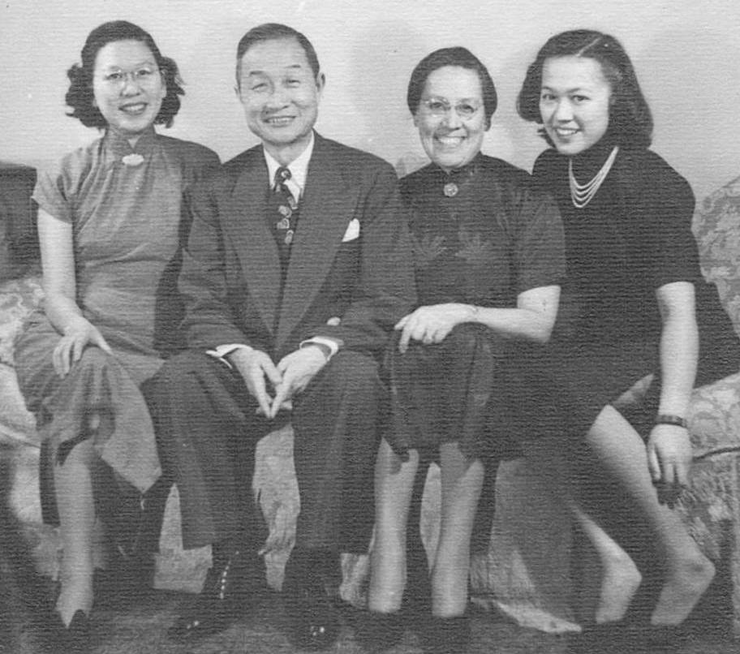
The Yens in New York with daughters Grace and Alice Junior, c.1950

Slide 15
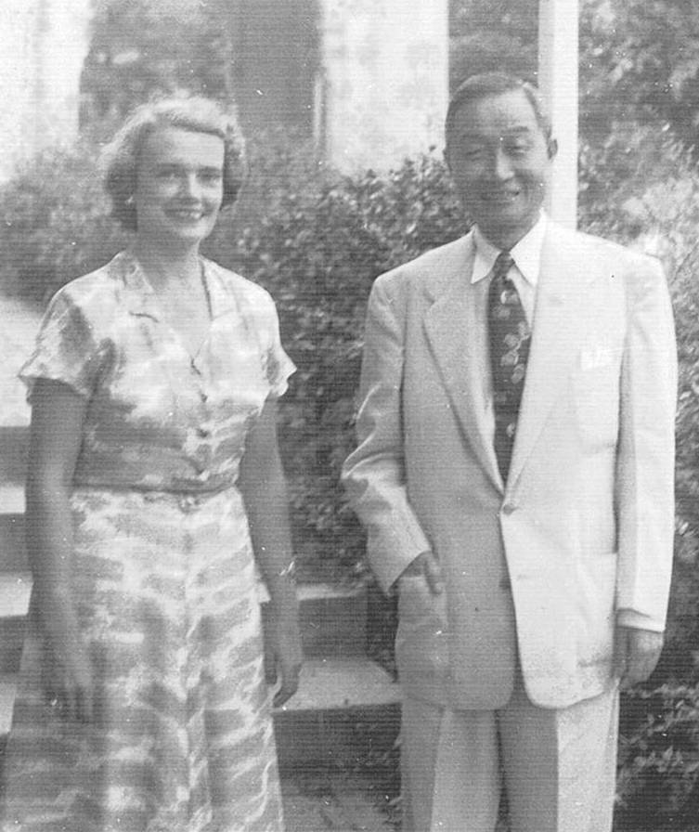
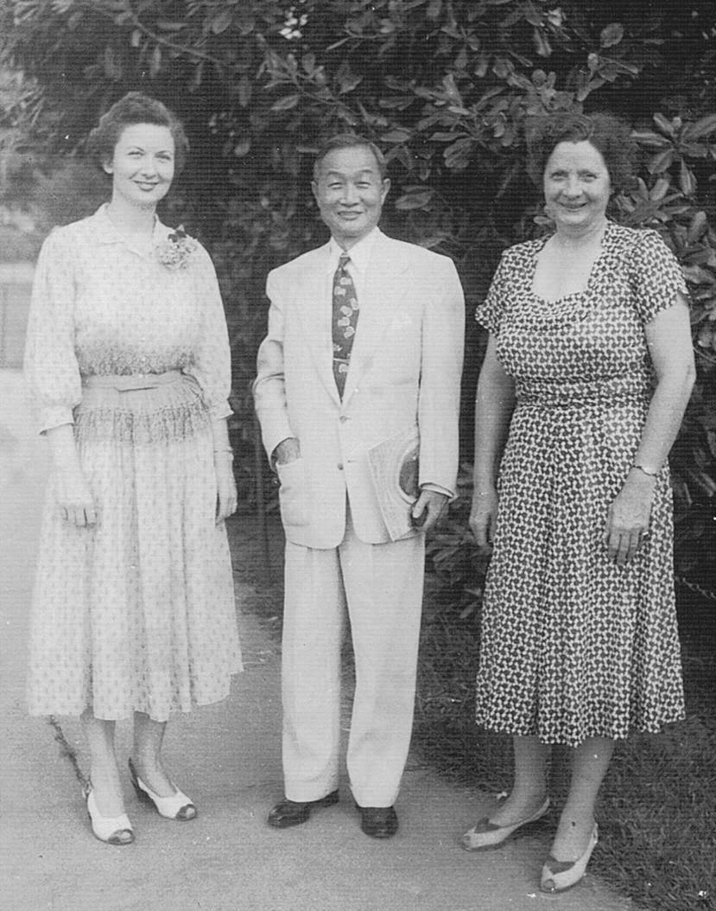
At Duke University, Raleigh, North Carolina, c.1950
With Dr Eunice Tyler
With Ida Friday and Dr Lucy Morgan

Slide 16
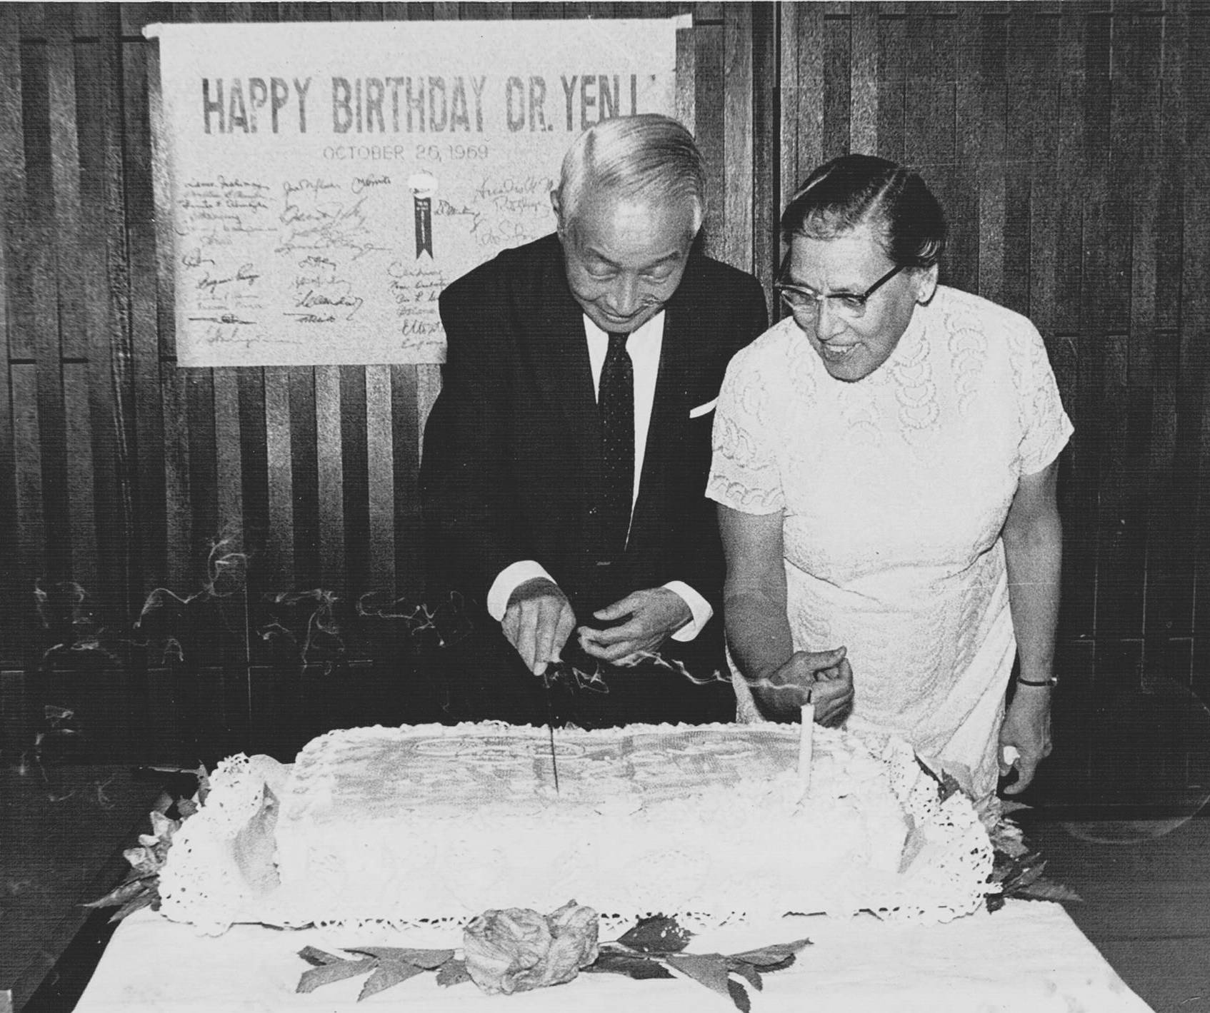
Dr Yen’s 66th birthday, 1959

Slide 17
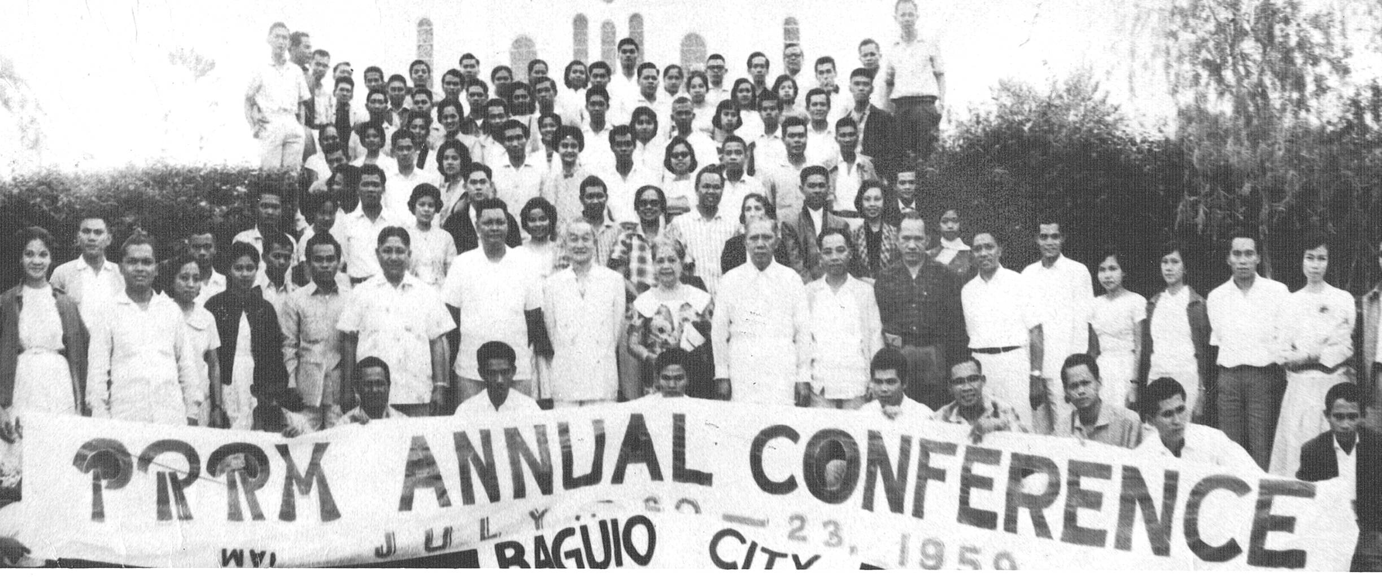
Attending Philippine Rural Reconstruction Movement Annual Conference at Baguio, July 1959

Slide 18
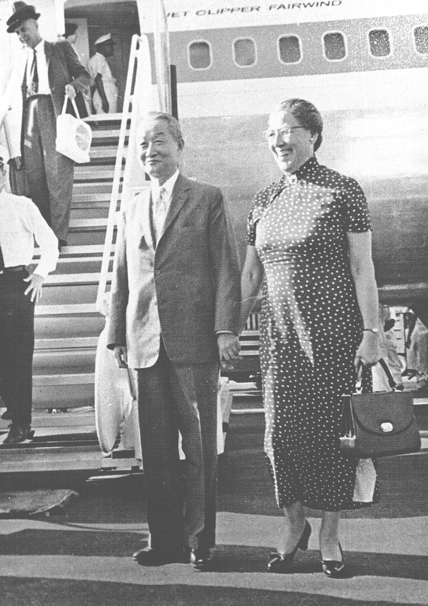
Arriving in Manila to receive Magsaysay Award for International Understanding, August 1960

Slide 19
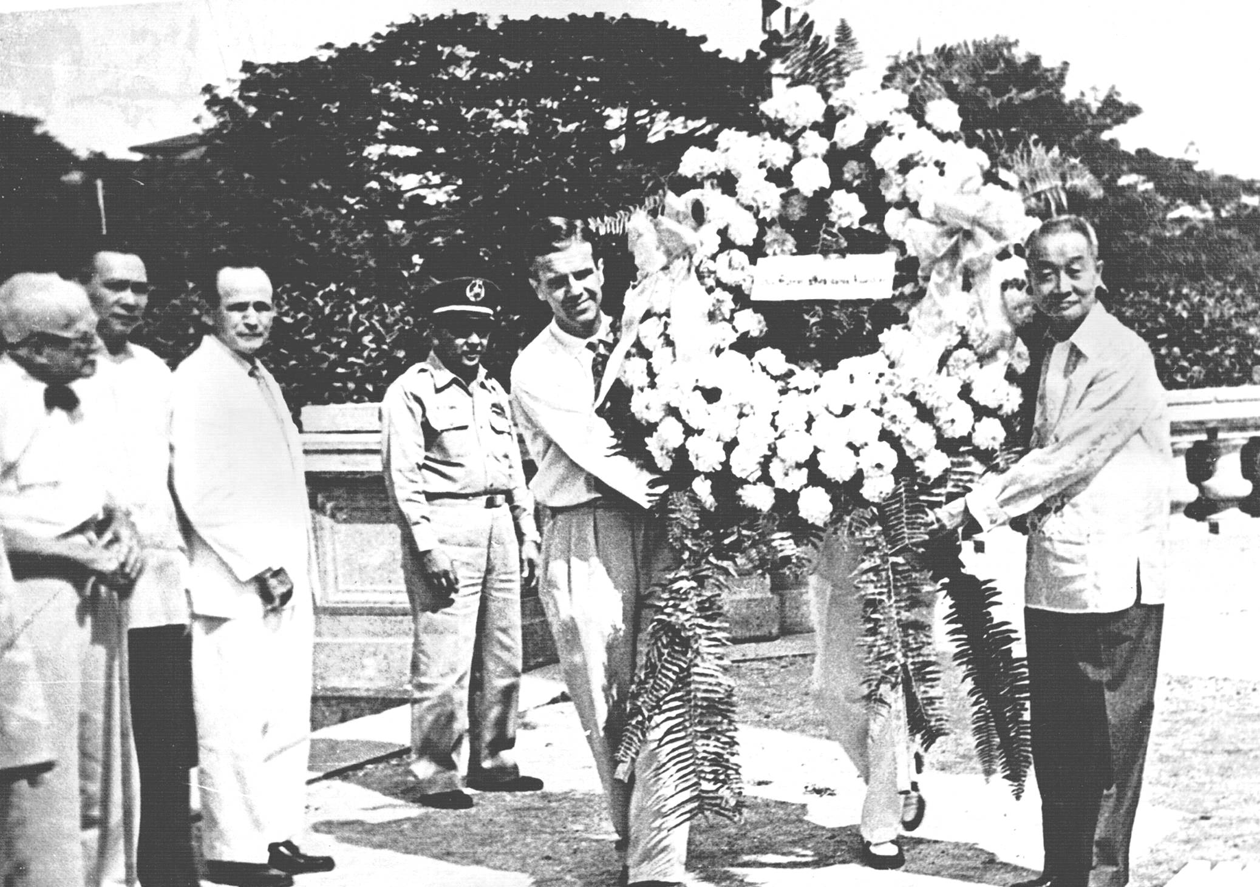
Laying a wreath at Rizal Park prior to Magsaysay Award ceremony, August 1960

Slide 20
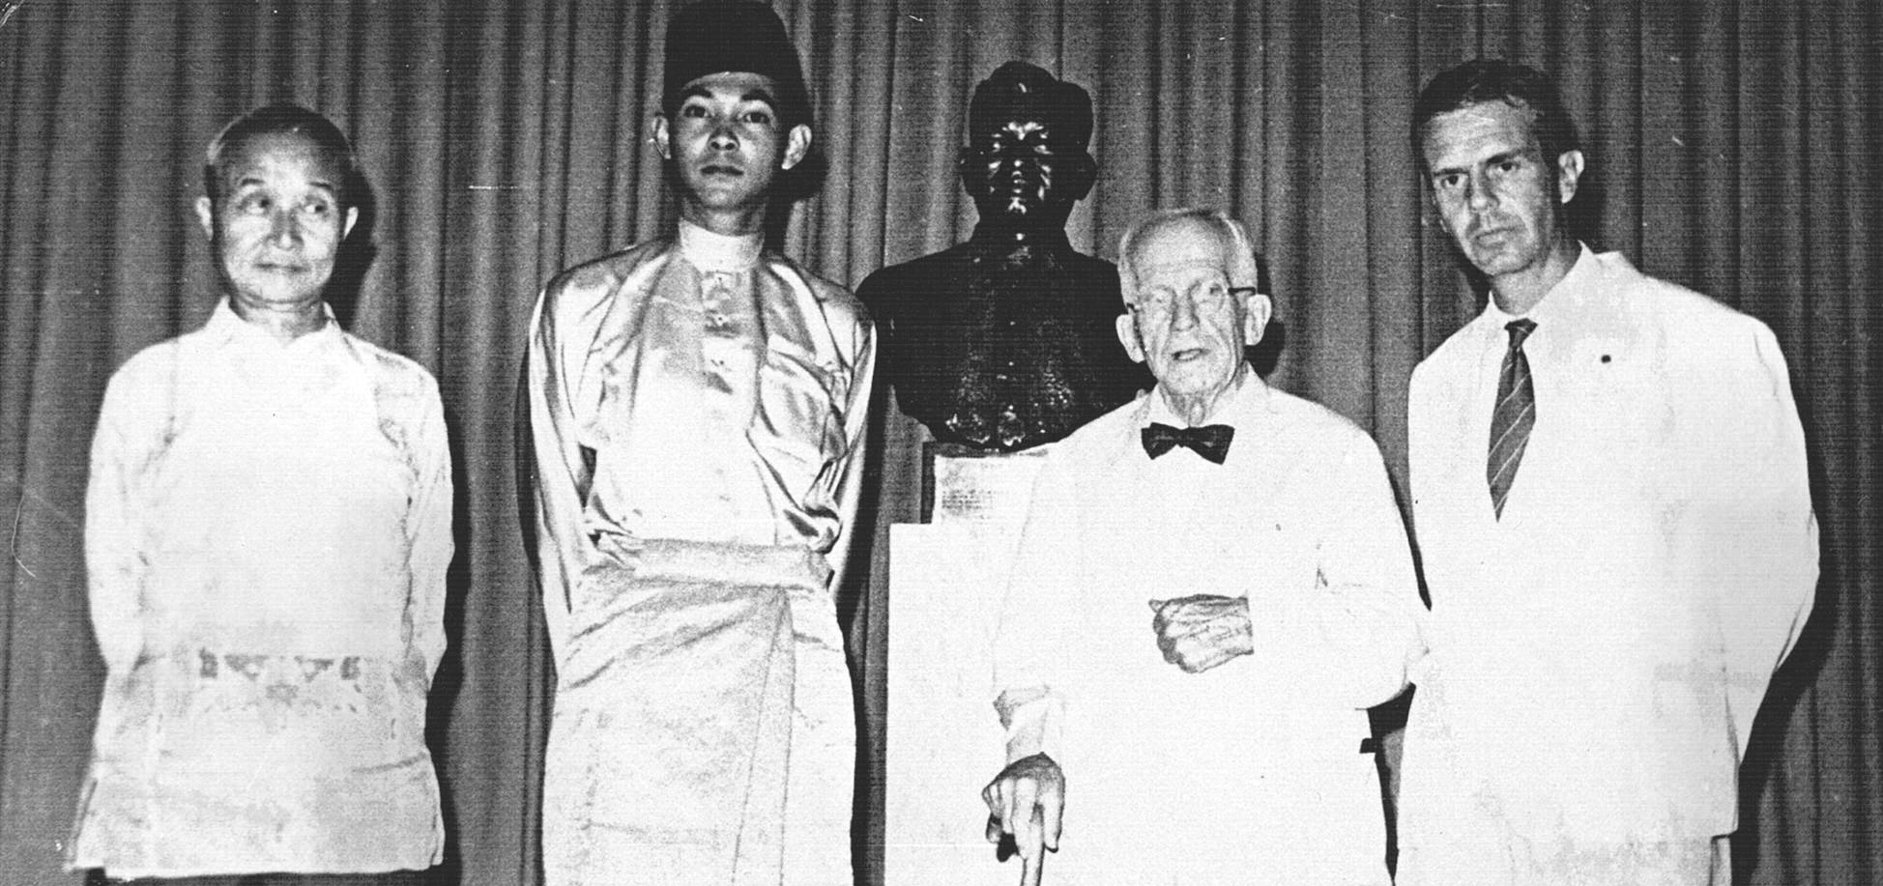
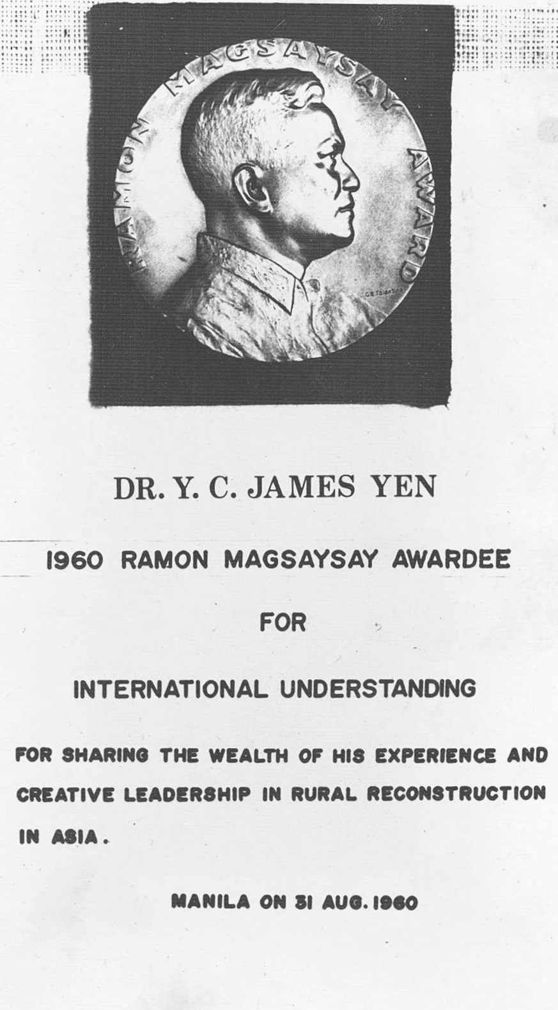
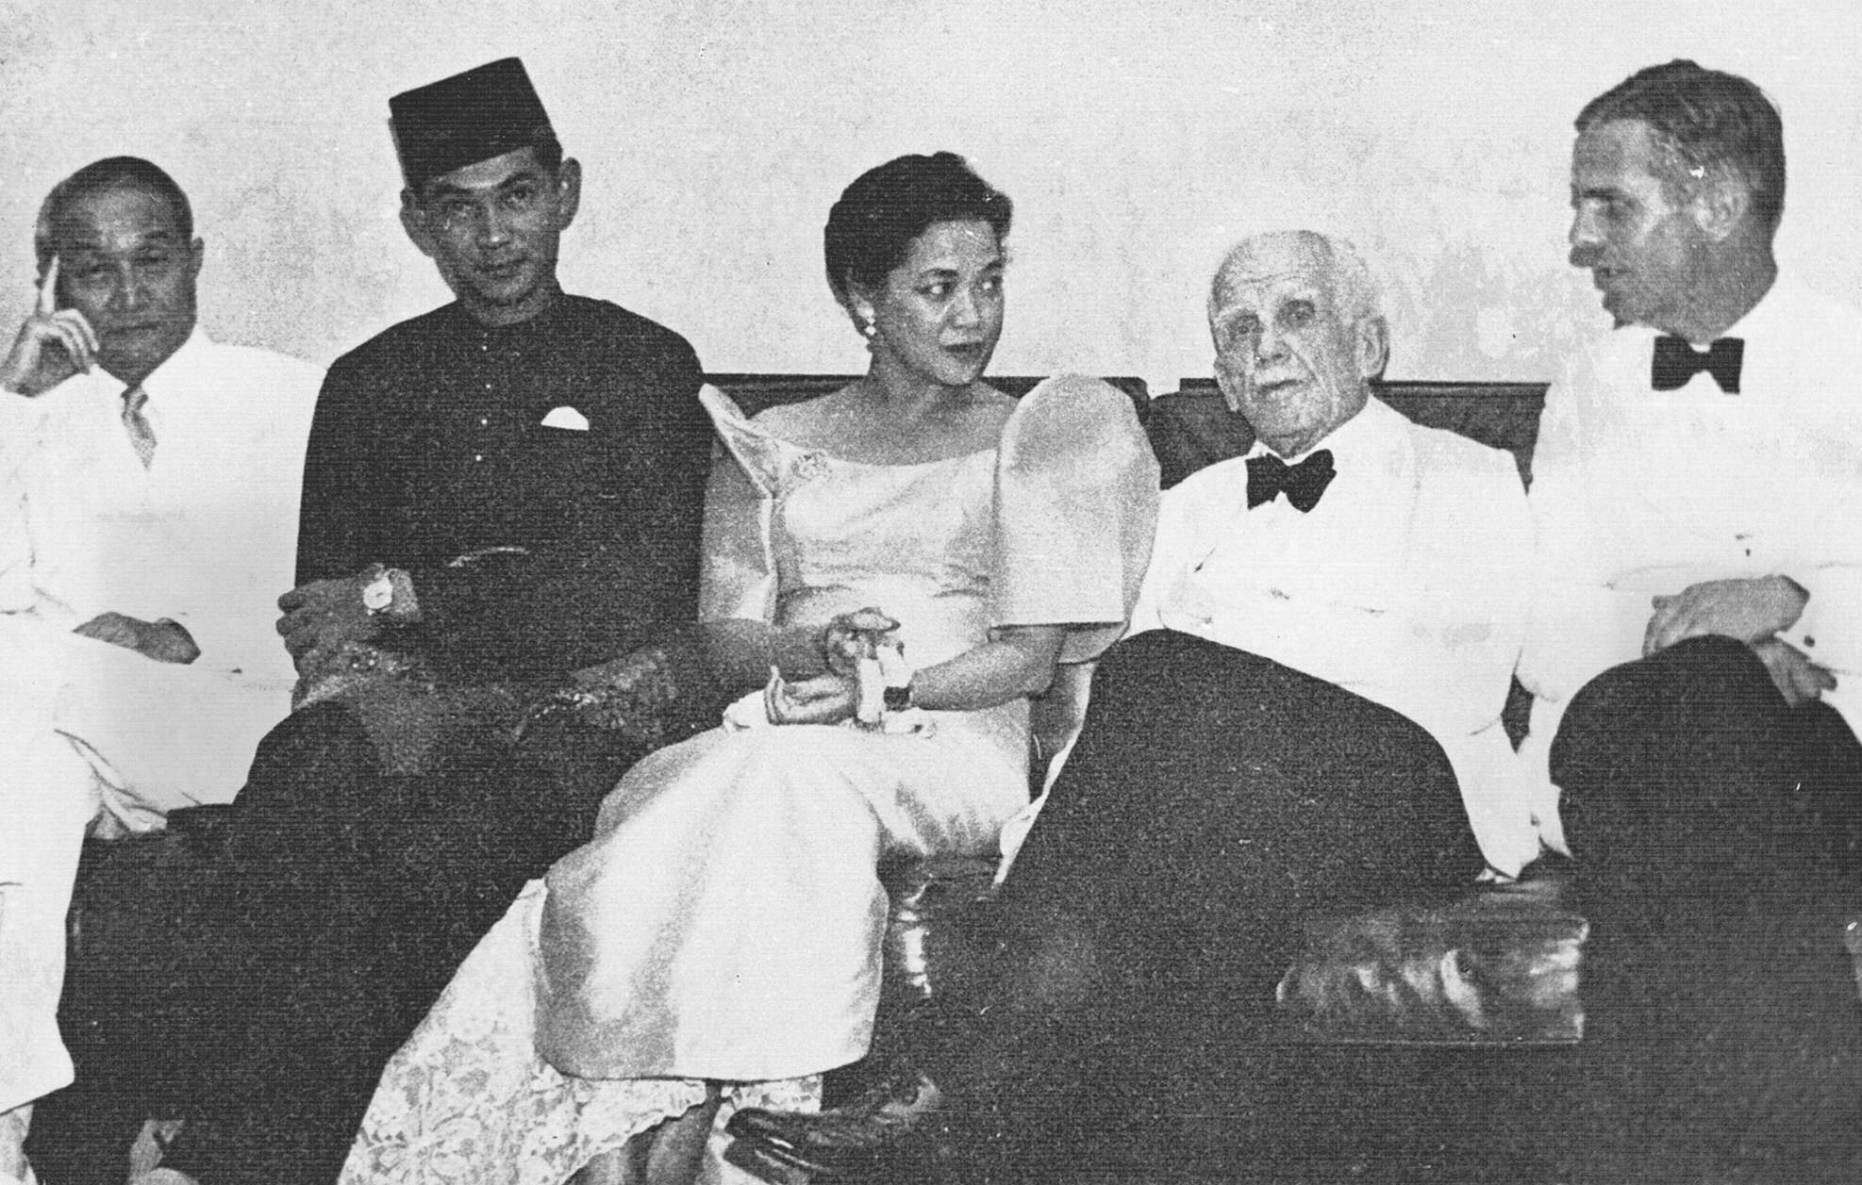
Above: The four 1960 Awardees
Below: With Mrs Magsaysay

Slide 21
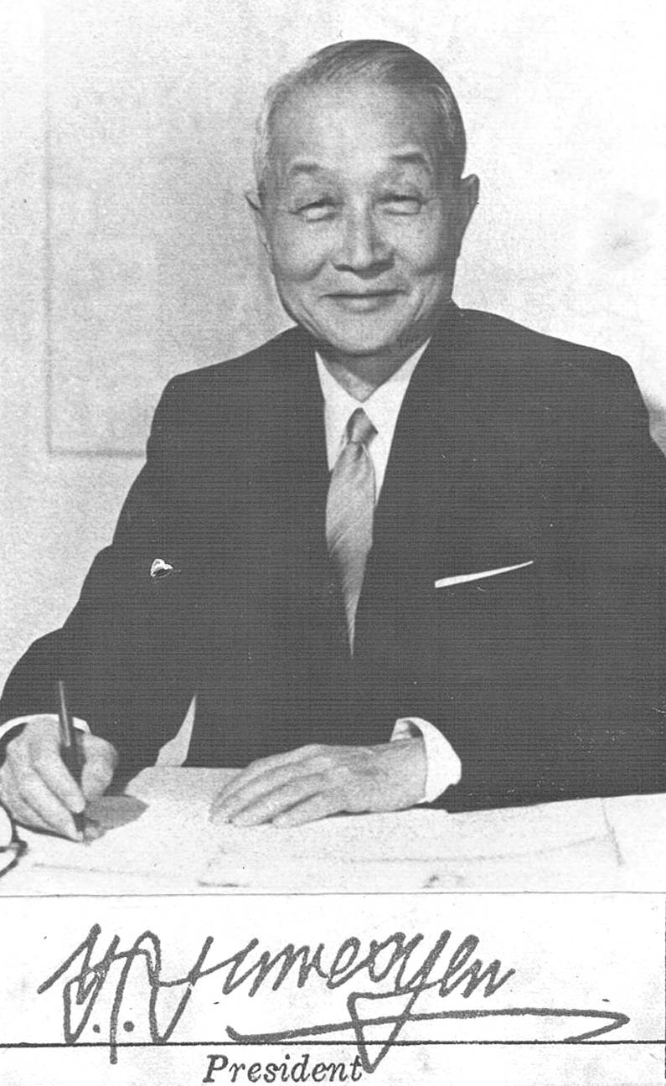
James Yen’s official portrait and signature as IIRR President, c.1966

Slide 22
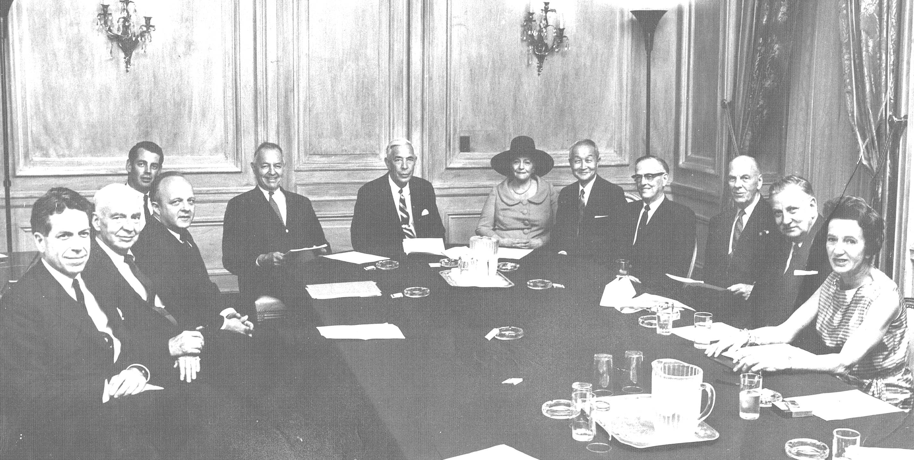
Board Meeting in New York, 1967

Slide 23
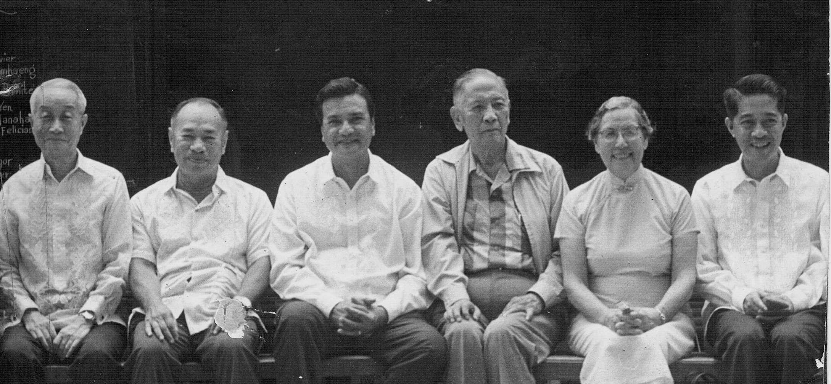
IIRR brain trust, c.1967

Slide 24
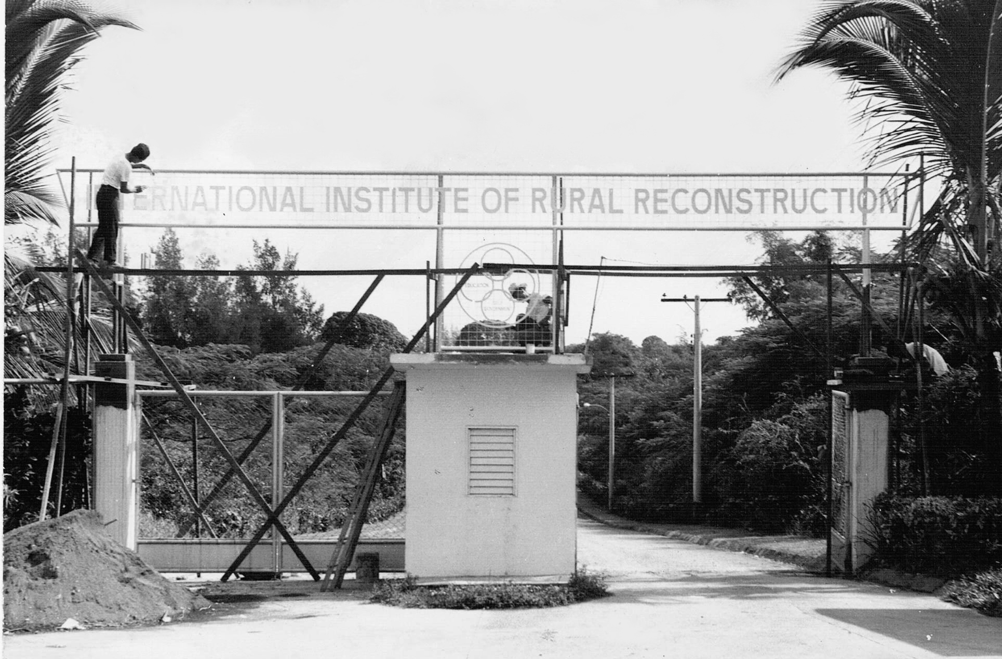
Preparing for the Inauguration of IIRR Headquarters, later to be known as the Yen Center

Slide 25
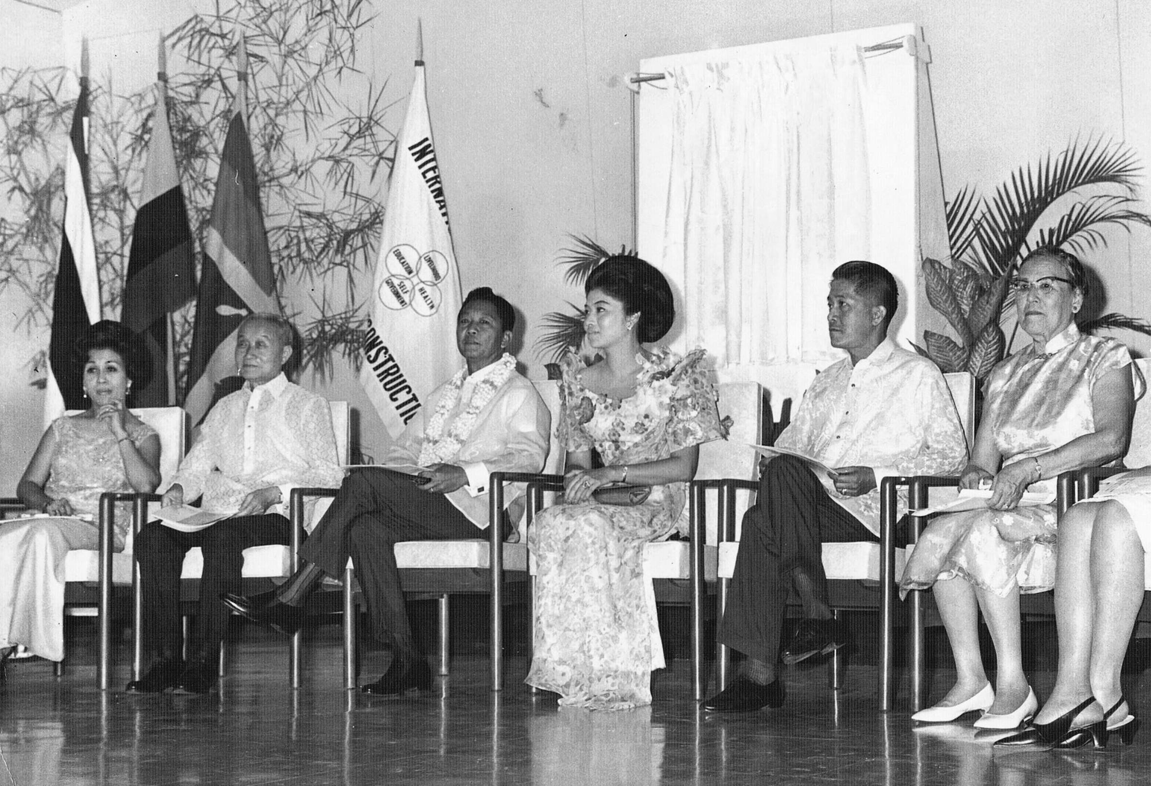
Inauguration of IIRR campus (Yen Center), 1967

Slide 26
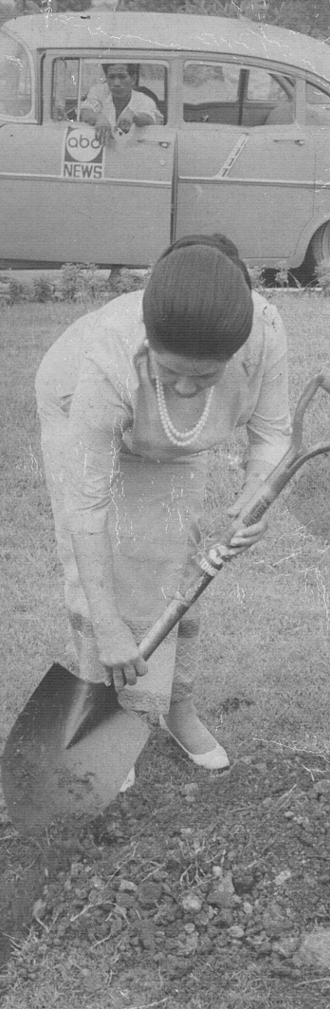
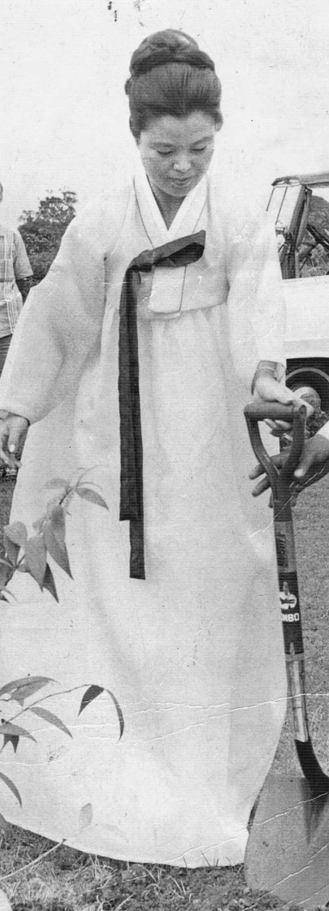
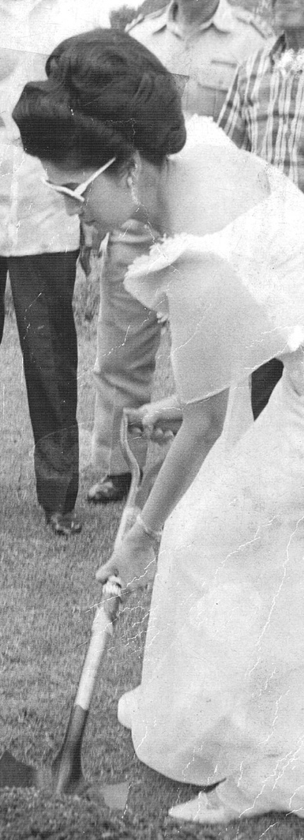
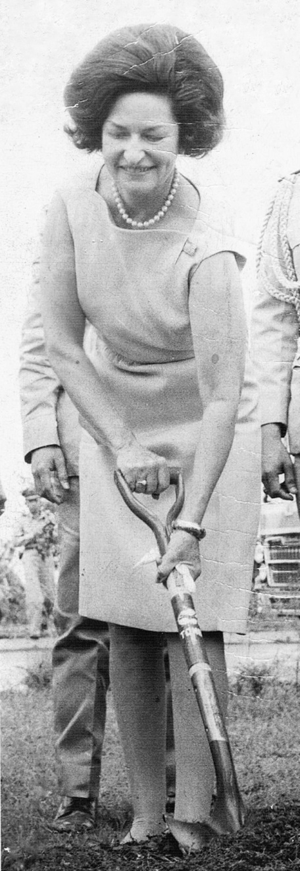
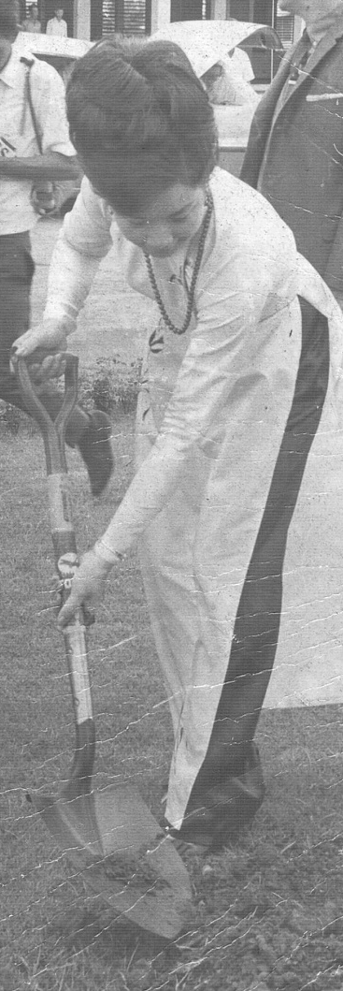
No less than five First Ladies attended the IIRR Inauguration. Each planted a commemorative tree.
Thomtom Kitti Kachoin, Thailand
  Yang Soo Yoo, South Korea
Imelda Marcos, Philippines
Ladybird Johnson, USA
Madame Kao Key, South Vietnam

Slide 27
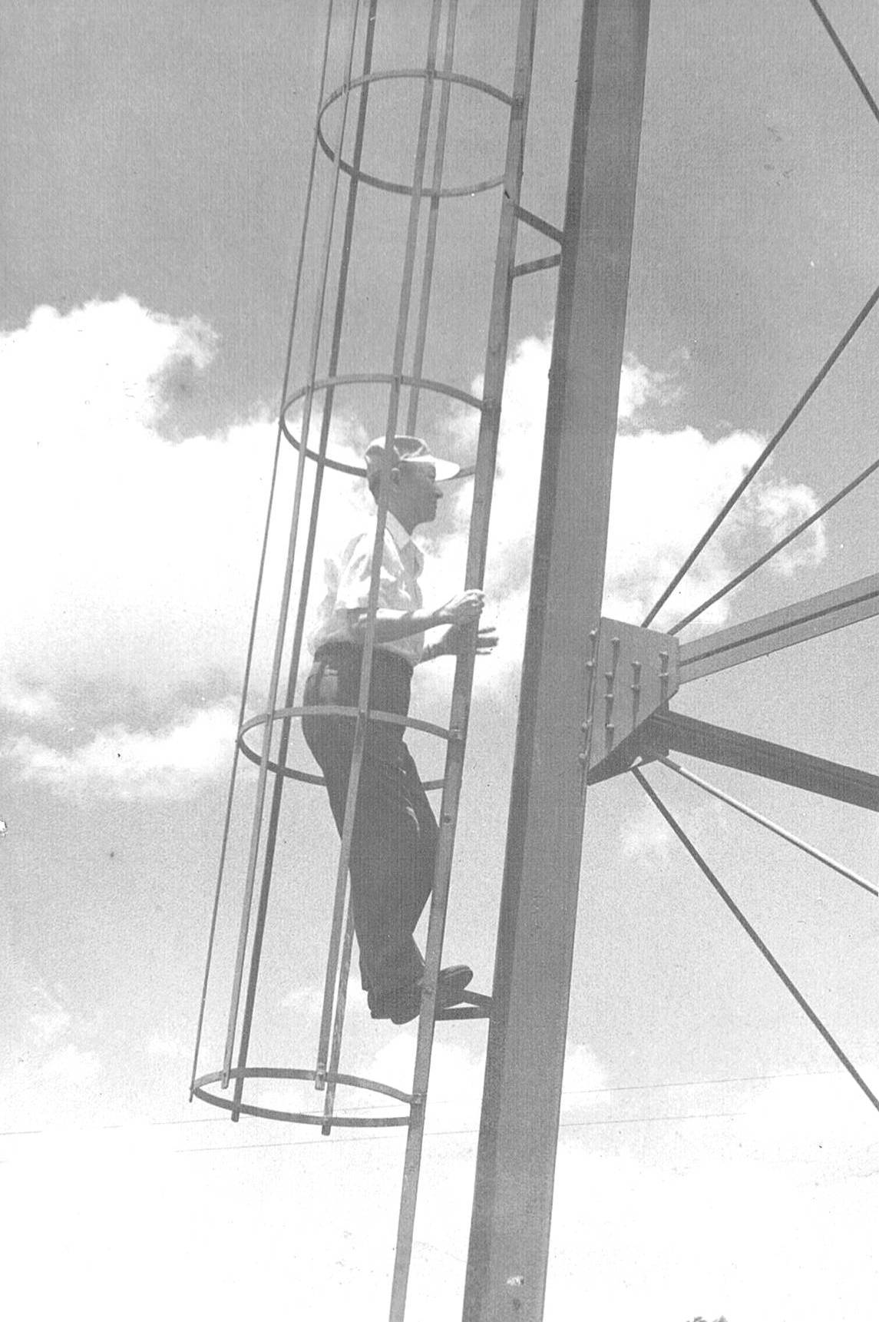
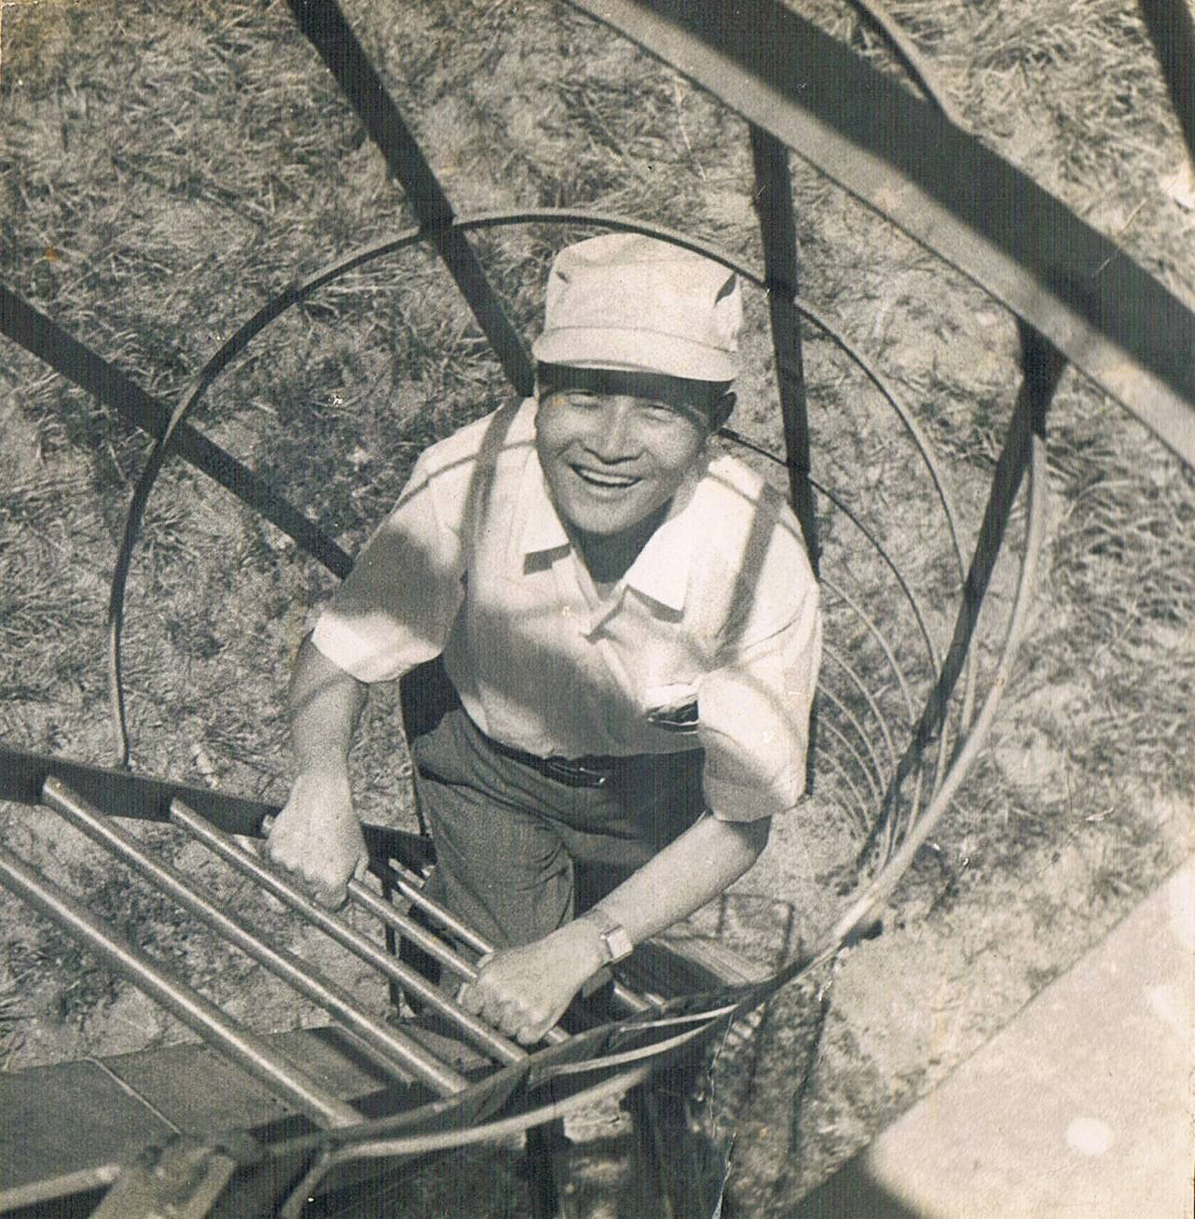
James Yen climbing the IIRR water tower in 1967 at age 74

Slide 28
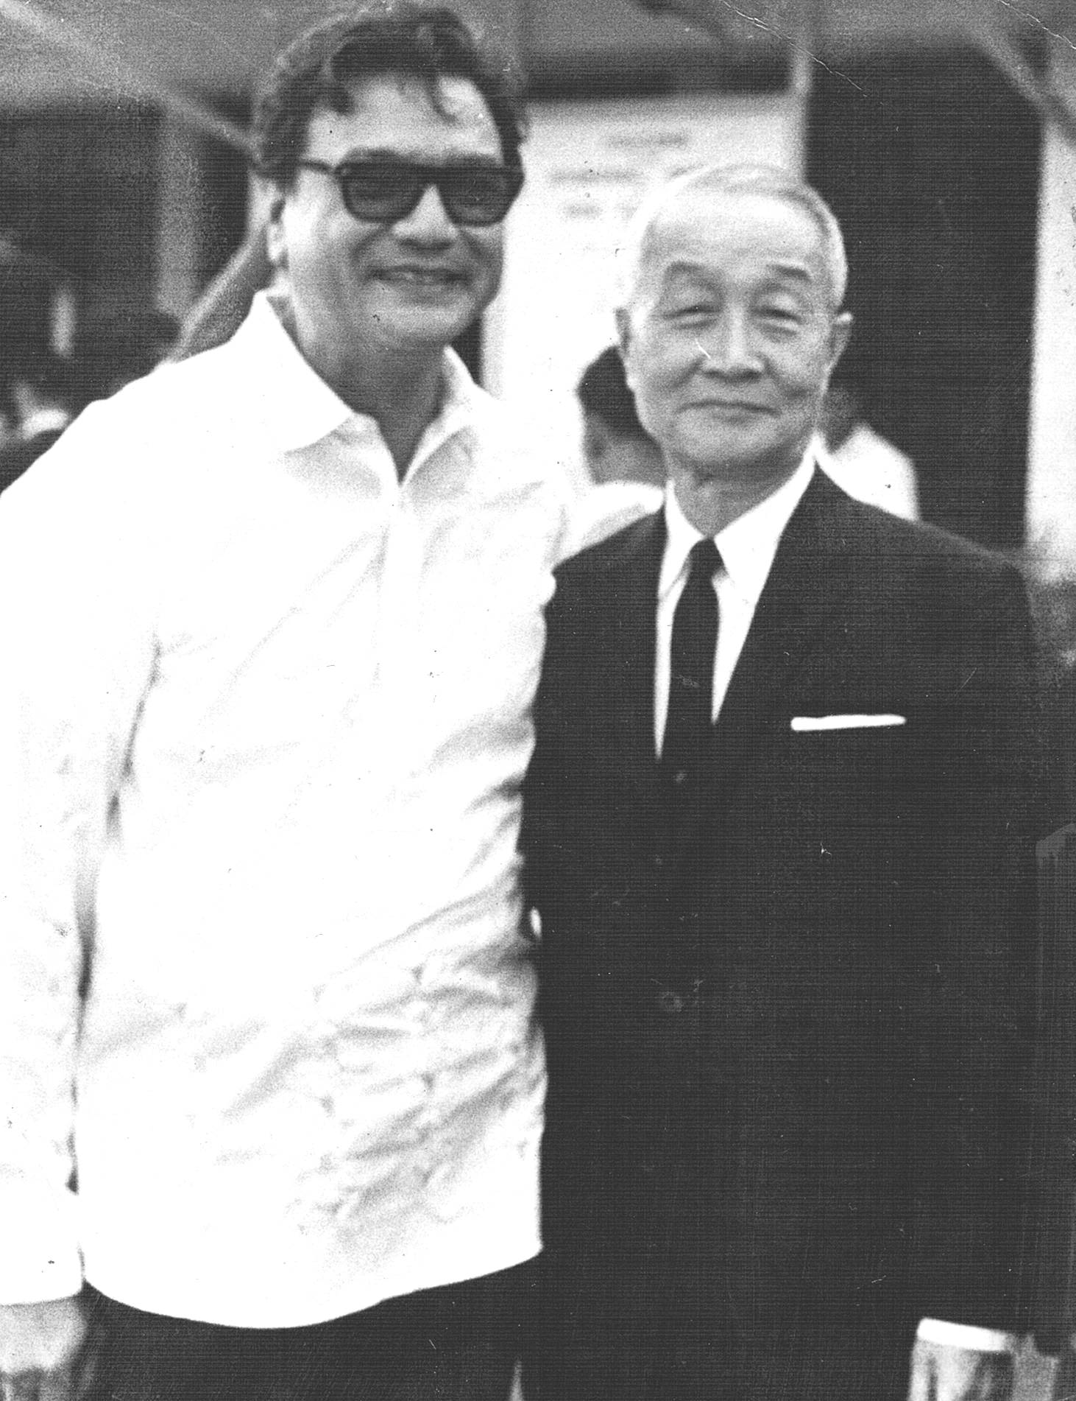
With Senator Manuel Manahan, c.1967

Slide 29
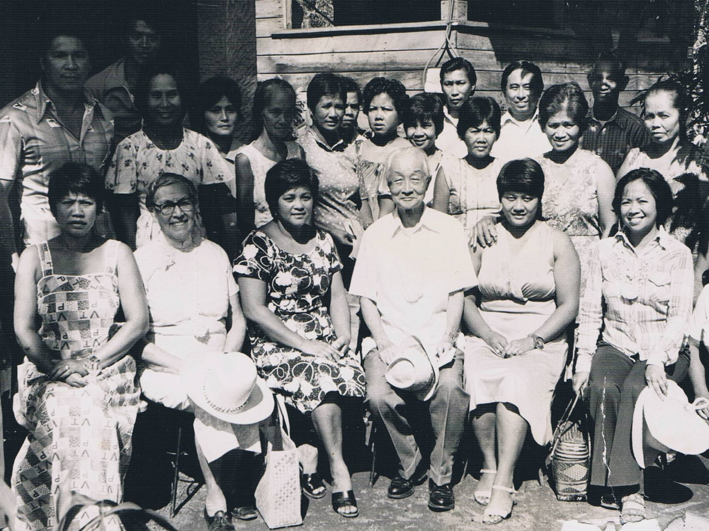
The Yens on a field visit in the Philippines, c.1968

Slide 30
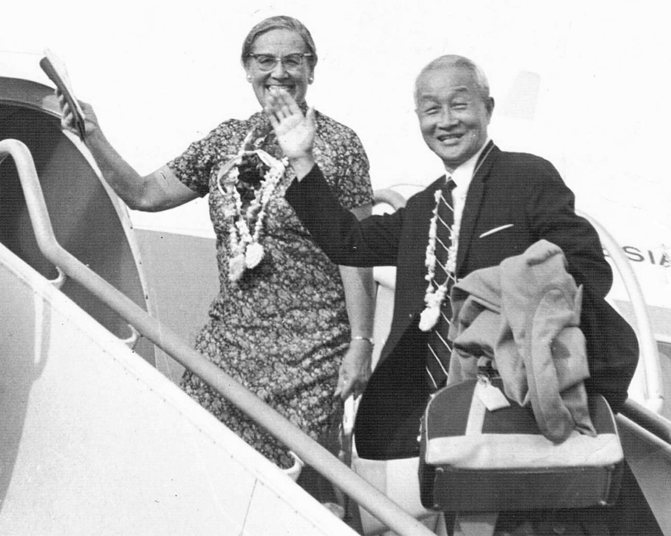
Departing for New York,
8 September 1970

Slide 31
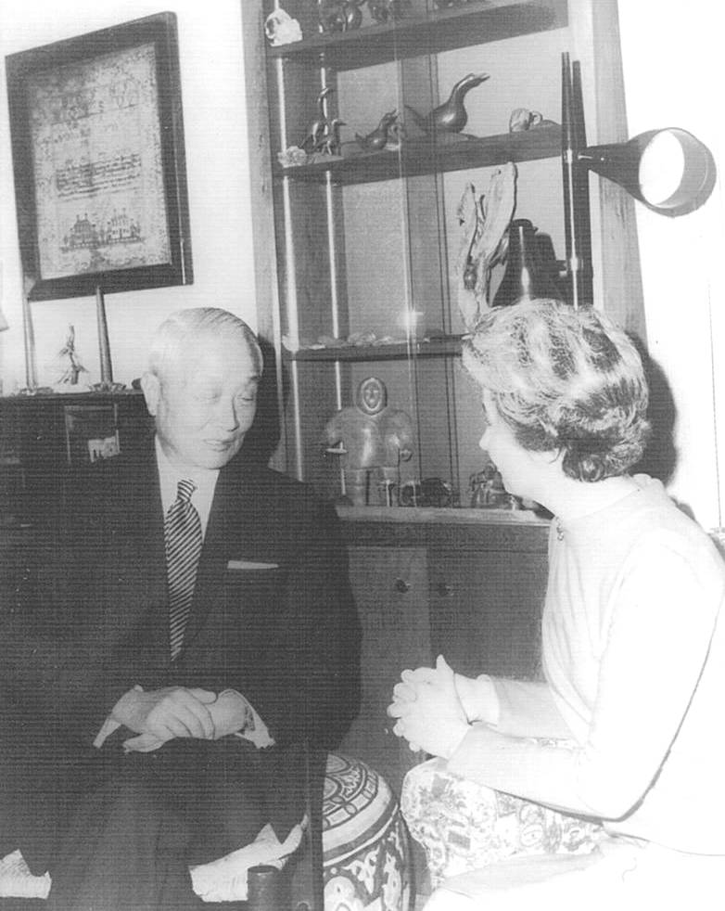
With Mrs Ida Friday at Lichenwood, 1971 (age 78)

Slide 32
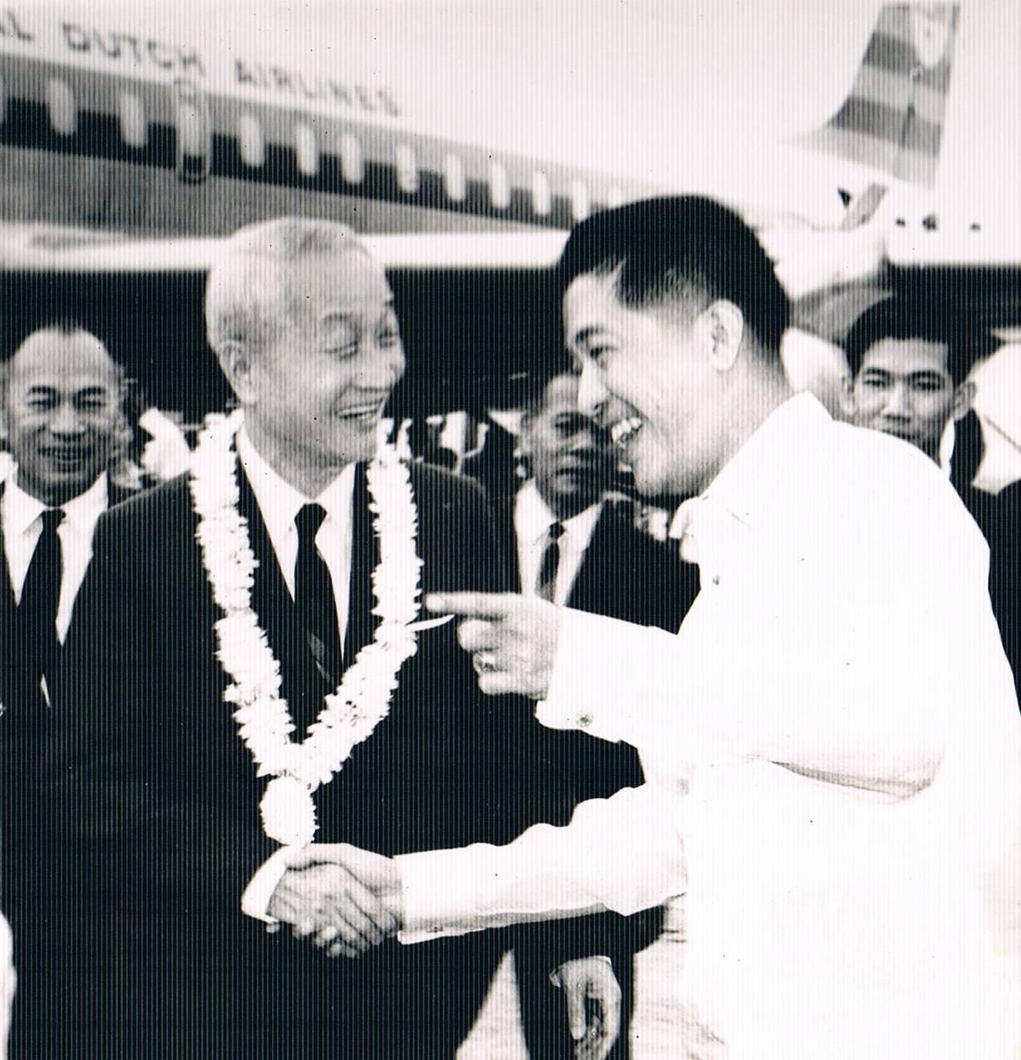
Arriving at Manila, c.1973

Slide 33
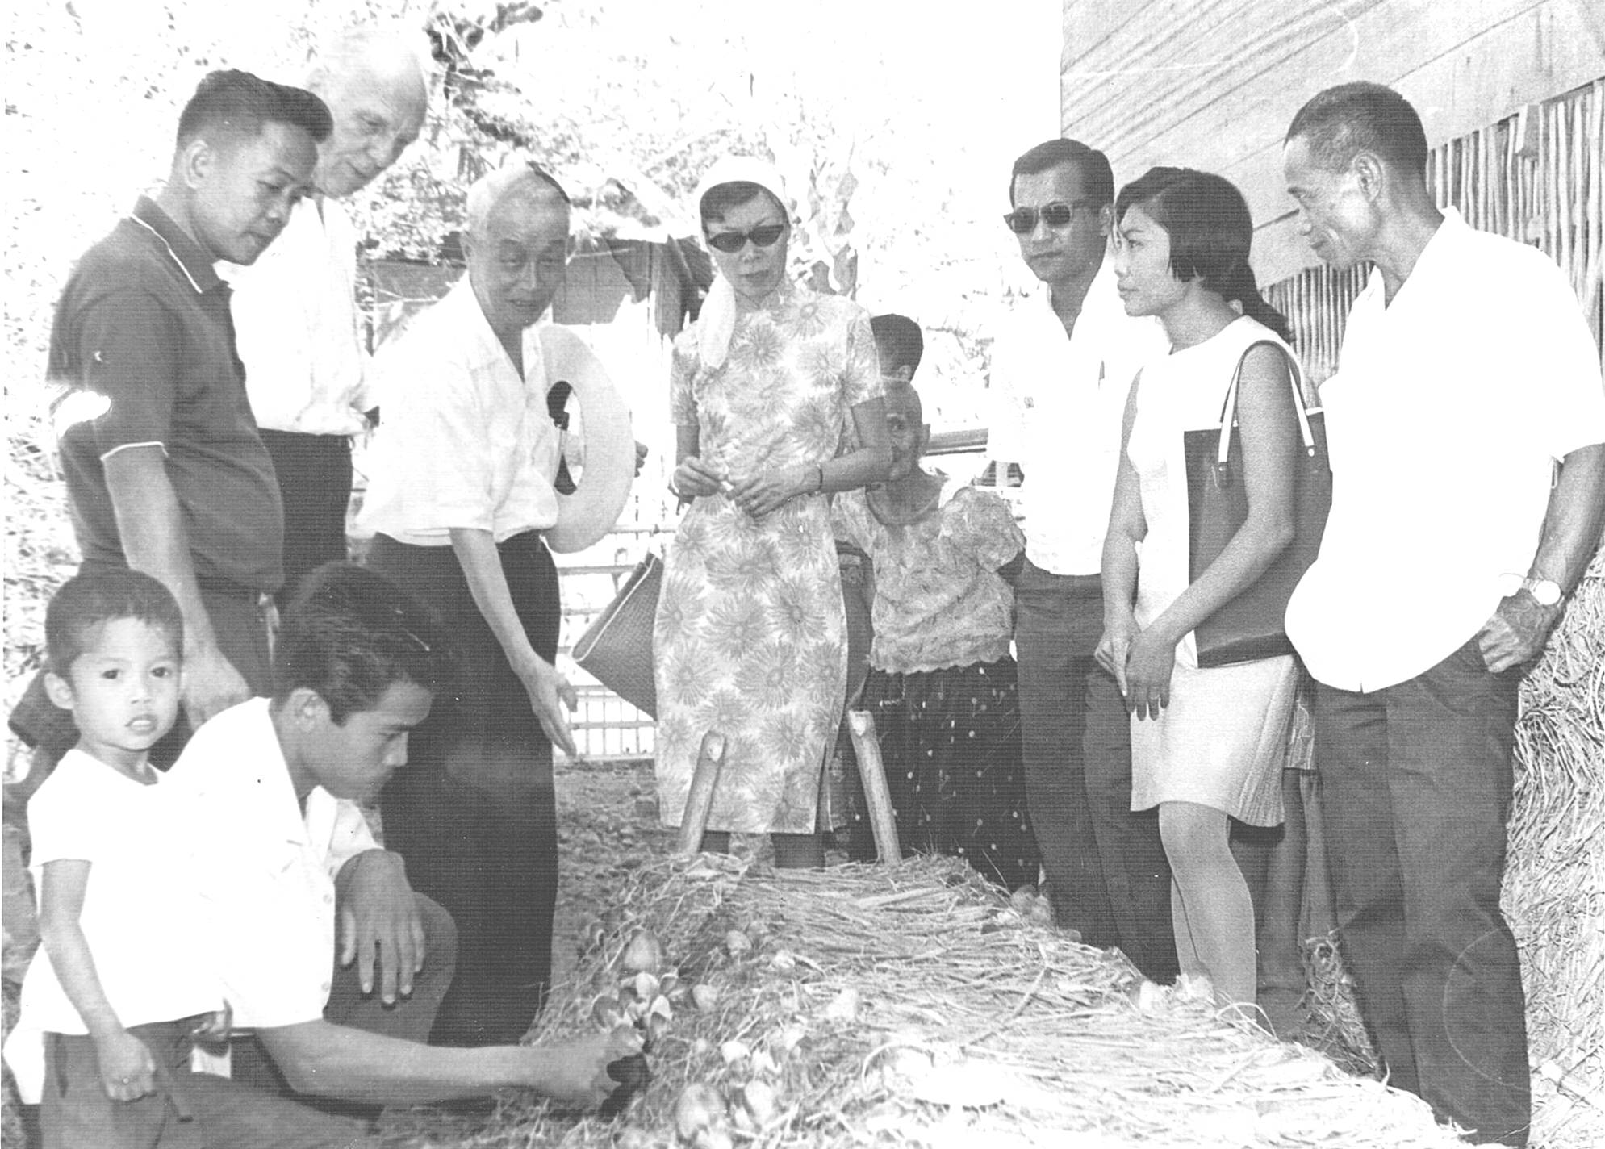
Field visit in the Philippines, c.1974

Slide 34
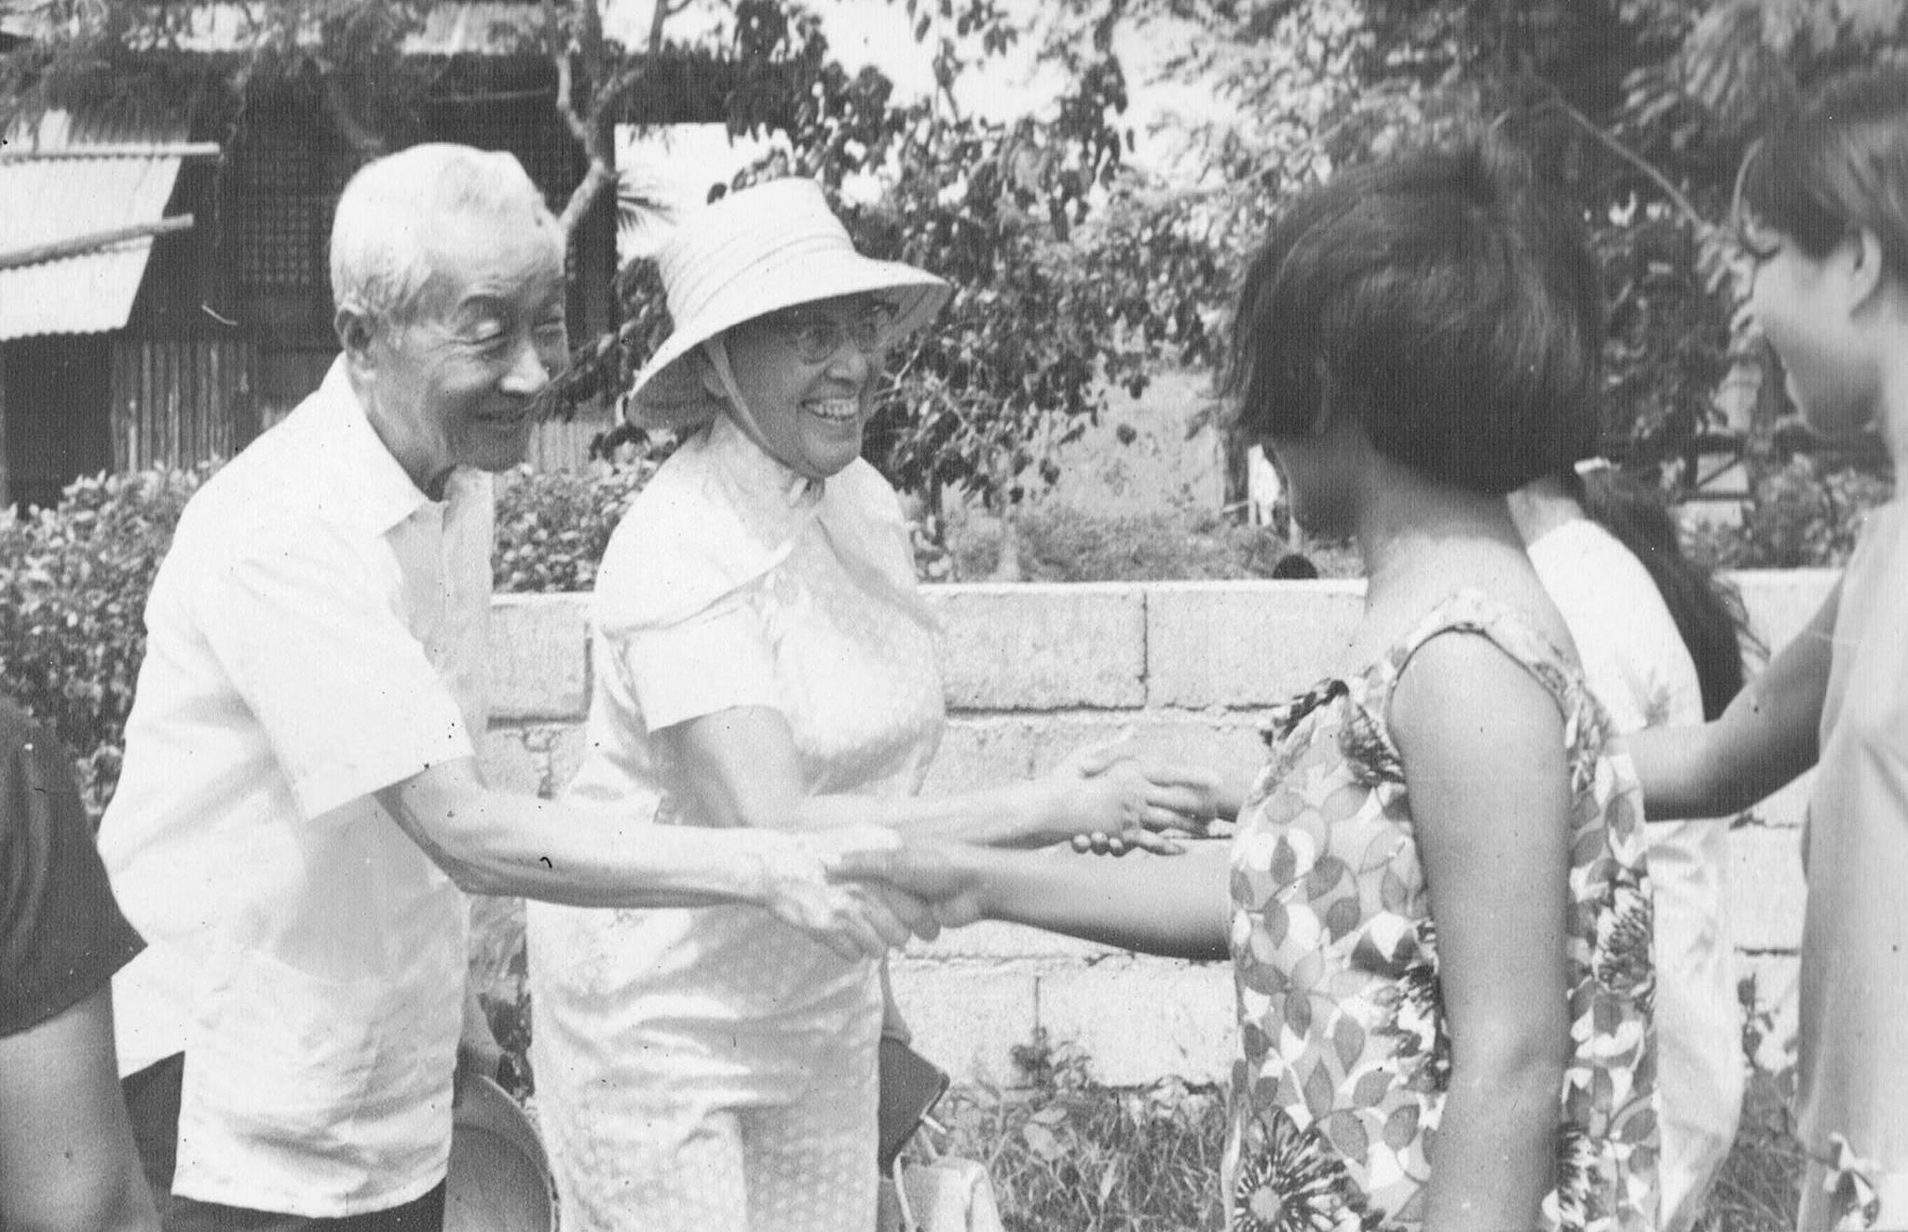
James and Alice Yen on a field trip in Cavite, c.1975

Slide 35
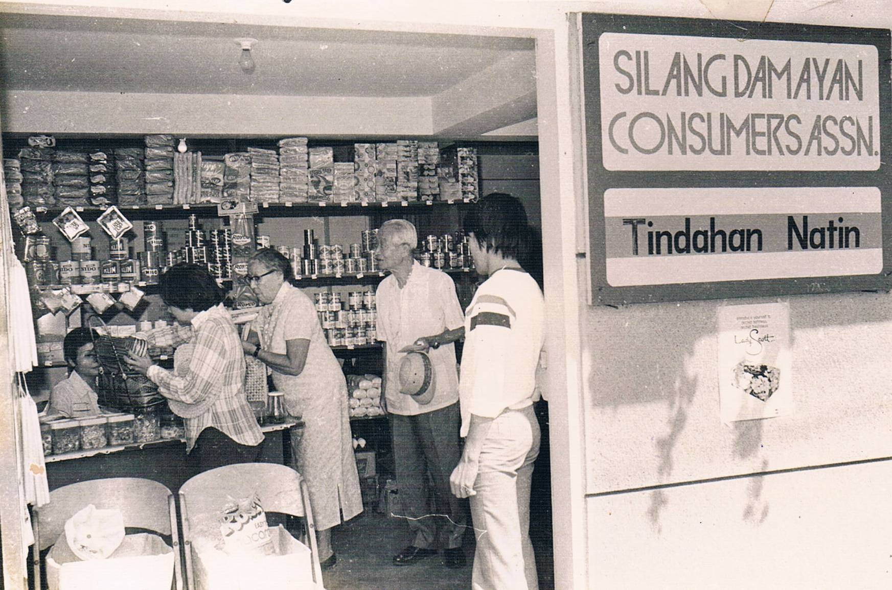
Visiting a cooperative, c.1975

Slide 36
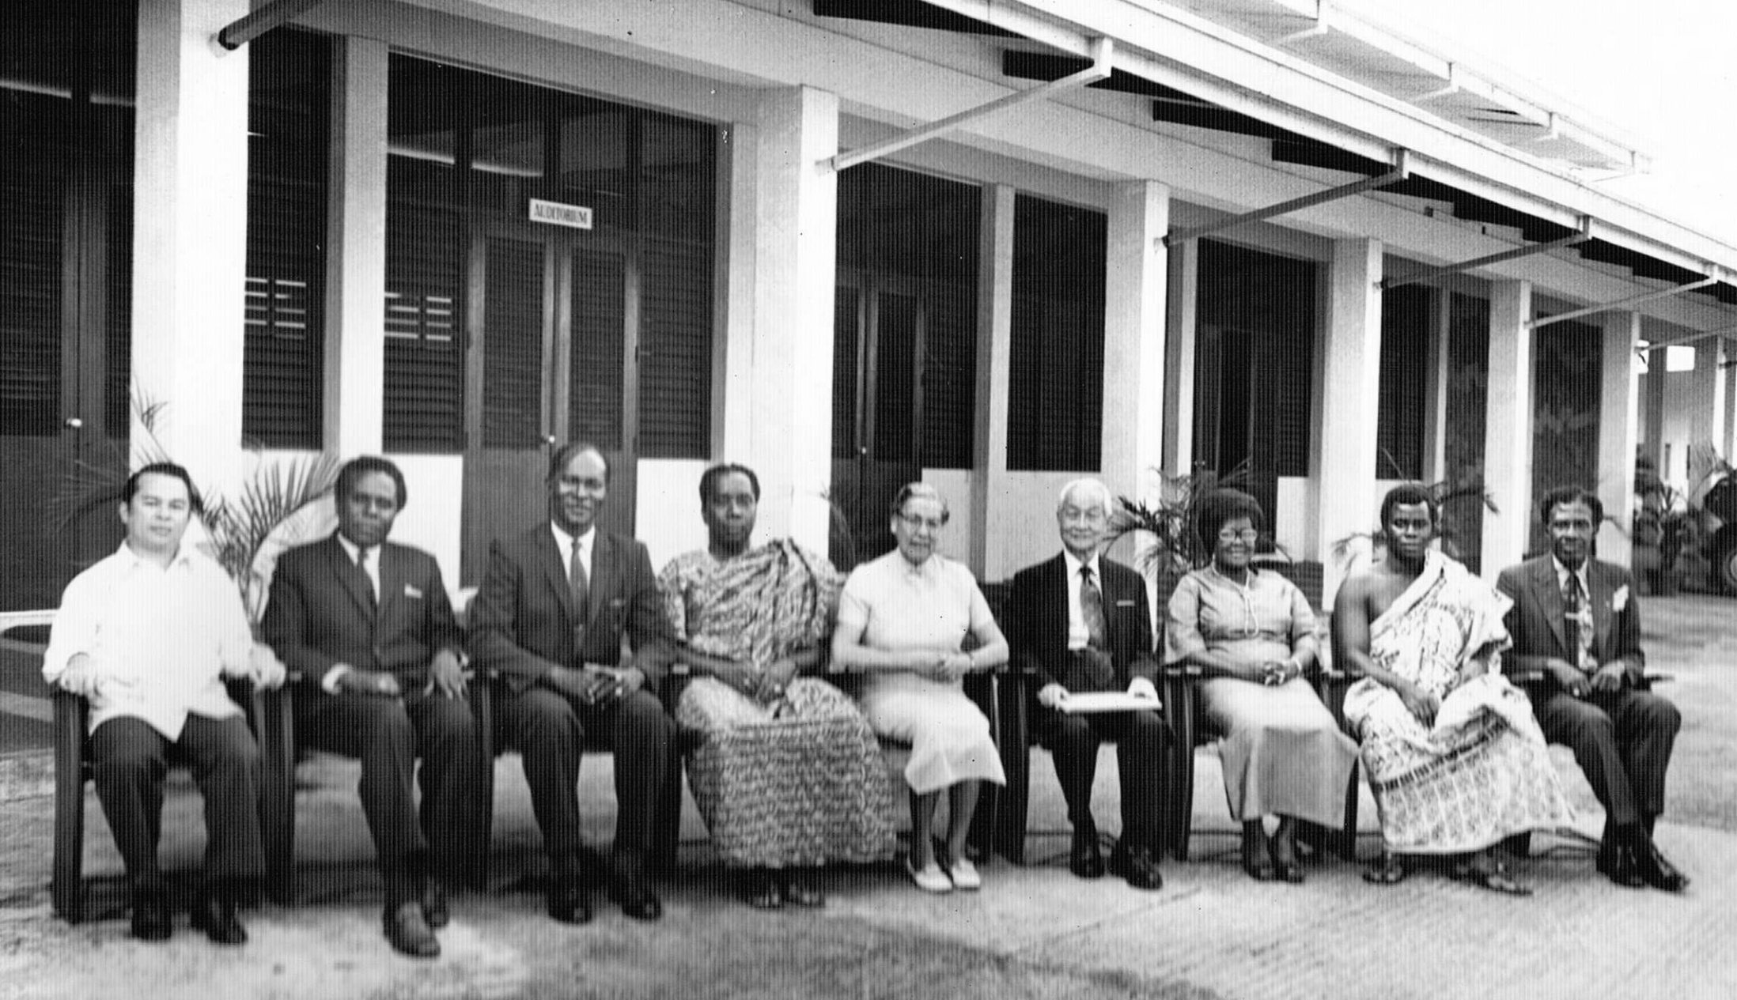
Meeting of officers of national rural reconstruction movements, c.1978

Slide 37
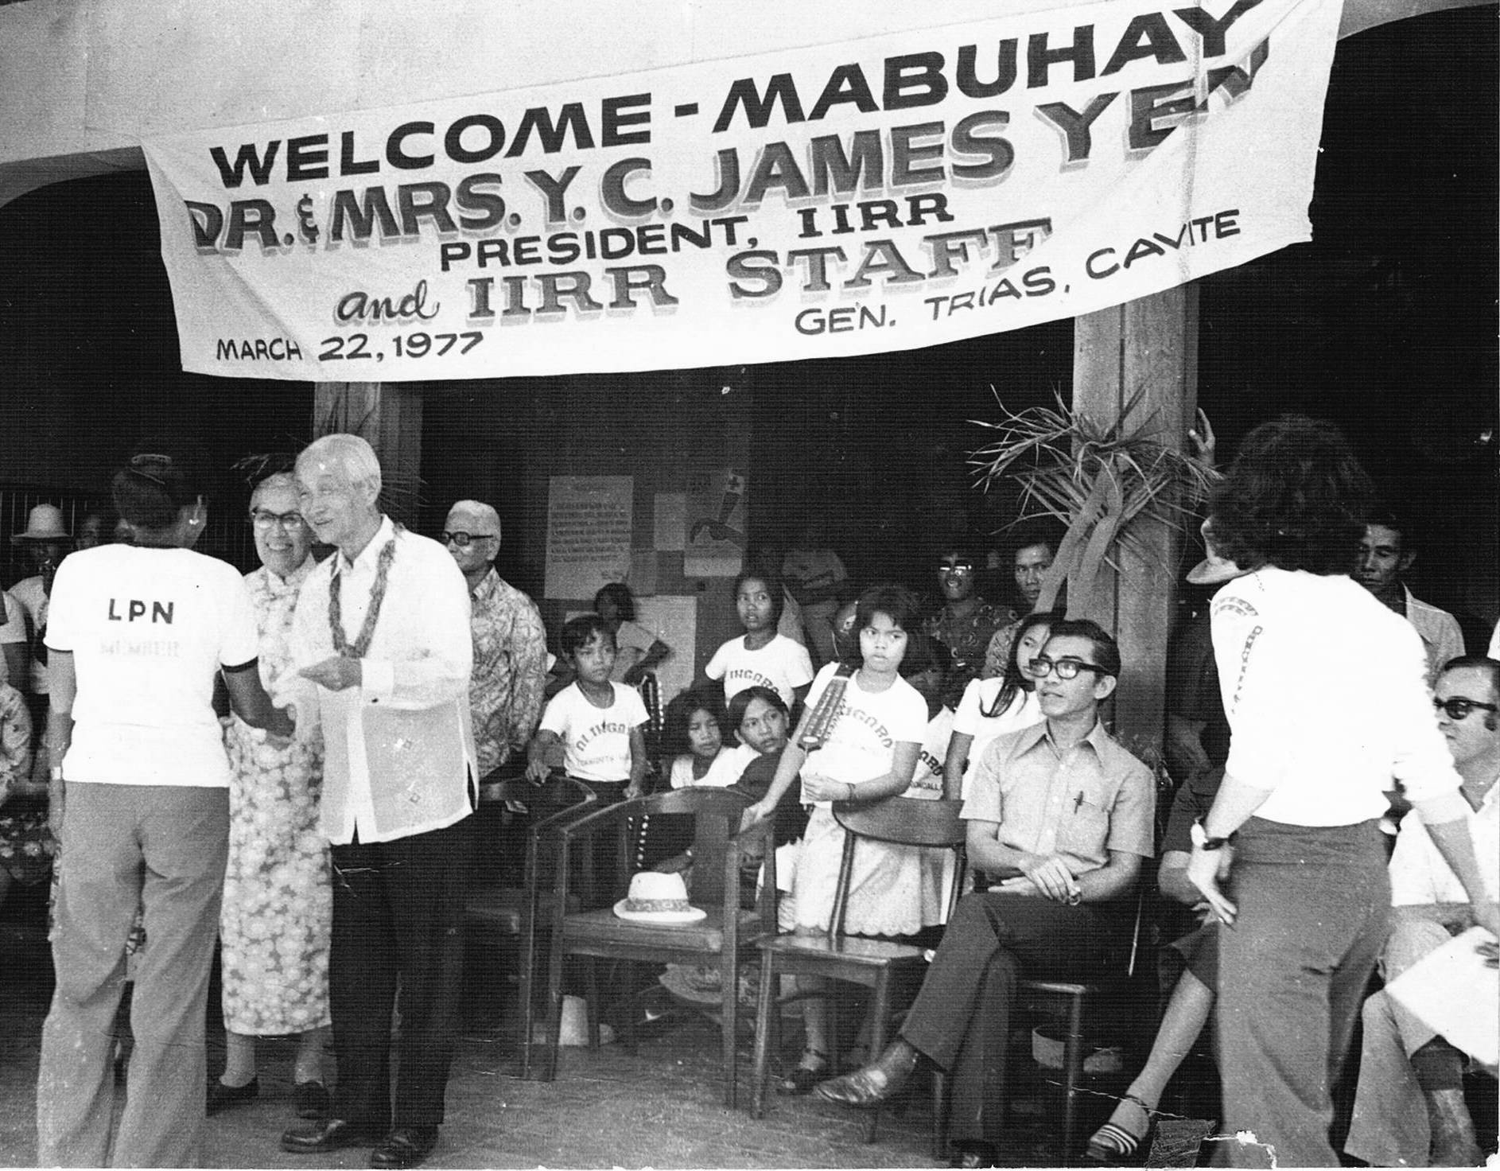

Slide 38

With King Bhumibol of Thailand, c.1983

Slide 39

Assisted by an interpreter, Dr Yen explains the ideals of rural reconstruction and the work of IIRR

Slide 40


Presenting awards at IIRR, 1985
With Tony de Jesus, Vice President, IIRR
With John Batten, Director of International training

Slide 41

With Dr Juan Flavier, who replaced Yen as President, IIRR, and later became Secretary of Health, Philippines

Slide 42

Christmas 1980 – his first without Alice

Slide 43

Family photo in New York, December 1980

Slide 44

Dr Yen and Dr Flavier with Thai trainees at IIRR, April 1981

Slide 45

Meeting with Filipino volunteers at his home in Yen Center, May 1981

Slide 46

At the beach in the Philippines, May 1981

Slide 47

Enjoying seafood at the beach, May 1981

Slide 48

Alice Yen’s Memorial Service, June 1981

Slide 49

Planting a tree at Alice Yen’s Memorial Service, June 1981

Slide 50

At Yen Center, June 1981

Slide 51

In the field in the Philippines, 1981

Slide 52


Participating in an IIRR course, May 1981

Slide 53

90th birthday, New York, October 1983

Slide 54


Pages in James Yen’s notebooks prior to the visit of a Chinese delegation

Slide 55

On the eve of his China trip, September 1985

Slide 56


Dr Yen honored by Chinese Embassy in Manila prior to his return to China, September 1985

Slide 57

Dr Yen revisits his homeland with Juan Flavier, 1985

Slide 58

Beijing, September 1985

Slide 59

Station at Shijiazhuang, capital of Hebei Province, China, September 1985

Slide 60

Family photo in New York, 1985

Slide 61

Last photo taken of Dr Yen, 1990

Slide 62


Slide 63

The IIRR team remembering the James Yen legacy

Slide 64




Memorial Service for James Yen, 1990
Buddhist prayer led by Au Pica Hatda (Cambodia)
Hindu prayer led by Vaishali Hiralal Patel (India)
Muslim prayer led by Hakim Khan (Pakistan)
Christian prayer led by Sylvester Steven (Papua New Guinea)

Slide 65


Juan Flavier, 1990

Slide 66


These six images are copied from the October 1987 issue of Reader’s Digest

Slide 67


Slide 68


Slide 69


Slide 70


Slide 71


Slide 72

A long life…
…a huge legacy

