Slide 1

Enriching Maple in Appalachia:
Taxes and Fees for Your Maple Enterprise
(Module 4)
By
Cindy Martel and Tom Hammett
Future Generations University Appalachian Program
with supported from the
USDA AMS-ACER
Access Grant Program
Notes:
Welcome to Future Generations business learning sessions for enterprise development. This session will provide the introduction to the important tax registrations and exemptions that you need to consider and plan on for your maple operation. We would like to acknowledge the programs that have assisted Future Generations University in assembling this information, particularly the USDA AMS-ACER Access Grant Program as well as the resources developed by others. Please remember that this presentation is not intended to advise you on how to structure or invest in your business; please utilize the resources to assemble a team to uncover what will work best for your situation. Hopefully this session will provide some questions and resources as you move forward.

Slide 2
IMPORTANT
This module and the information contained should not be construed as legal, business, tax or professional advice. It is imperative that you seek out professionals and state and federal tax agencies before you make any tax related decisions, practices or changes for your enterprise.

Slide 3
Before you start this module….
Download the worksheet for this module;
Become familiar with the learning objectives for this module;
Have business planning notebook handy; and
Tax decisions impact your whole organization. So it is important that you work on this module with some of your team
Reminder: when you finish, please complete the feedback form for this module.
Notes:
Before you move forward, please make sure you have a hard copy or access to the worksheet (You can download this from the topic folder).

Slide 4
Module objectives:
3
1
2
4
Develop list of resources and team to support and answer questions on tax responsibilities
Create systems to record taxable income, report tax collections and make payments
Integrate tax requirements into new product development
Identify the types of taxes that may apply to your enterprise
Notes:
At the end of this session, we hope you gain knowledge and resources for the following objectives:
Identify the types of taxes that may apply to your enterprise;;
Develop a resource list and team to collect and document tax responsibilities;
Create systems to record tax income, report collections and file reports;
Integrate tax requirements into new product development and annual reporting.

Slide 5




Who’s on your team?
Viewers of this file can see comments and suggestions.
CommentCancel
You might consider including……
Applicable state agencies
Stakeholders and partners
Attorney, accountant and other business professionals
Representatives of similar enterprises
Notes:
Think of all those who might help you in all the decisions you need to make about setting up your business.

Slide 6
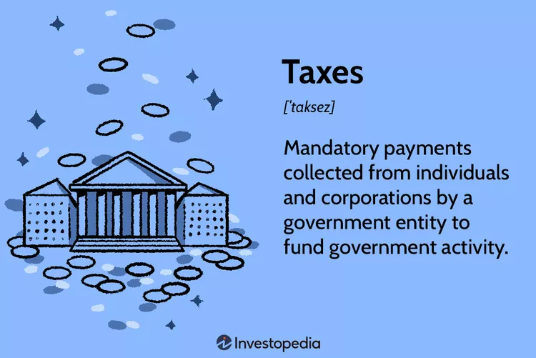
Types of taxes may include:
Sales tax
Income tax
Excise tax
Property tax
Payroll taxes
Use tax
Franchise tax
Tariffs and import taxes
Source: https://www.investopedia.com/terms/t/taxes.asp

Slide 7
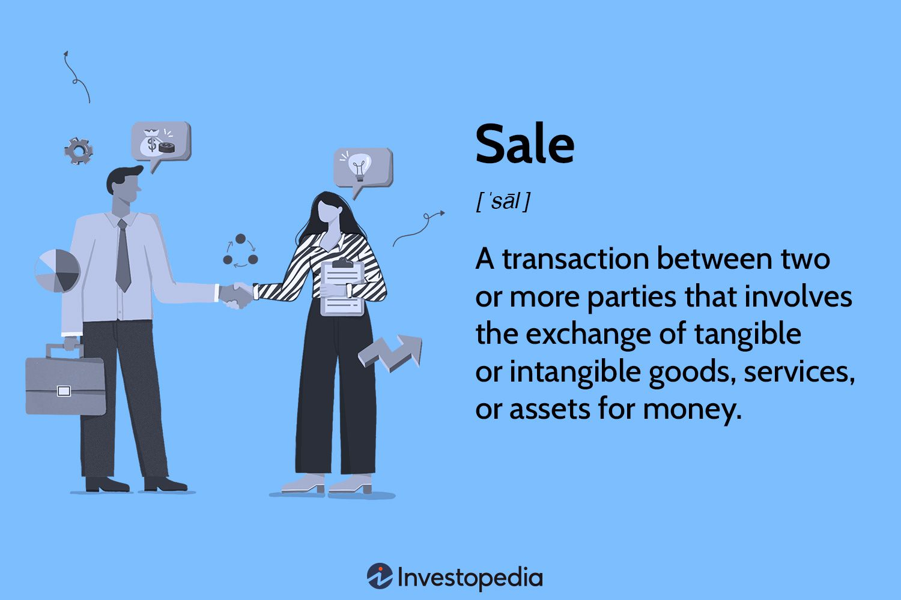
Sales (Use) Tax
Tax charged during a sale
Can be more than one tax charged on a sale
Questions to ask:
Where and to whom do I sell my products?
Am I responsible for sales tax collection and reporting?
Is my point-of-sale system able to track my sales tax requirements?
Consult with my team for registration and reporting requirements.
Notes:
An example of a mixed sale would a transaction that involved produce, maple fudge in a single serving container and a bottle of wine. What taxes might apply in VA? In WV?
Important to be sure that point of sale systems (commercial or hand written) account for tax collected as the person collecting the tax must report and pay the agencythat collects (i.e. state tax department, alcohol and beverage, etc.)

Slide 8
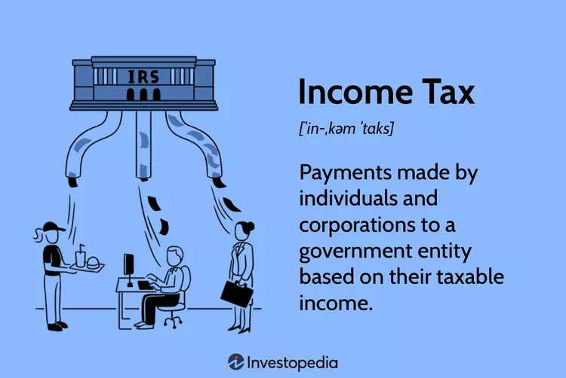
Income Tax
“Income tax” refers to a type of tax imposed on income generated by businesses and individuals
Source of revenue for governments
Taxpayers and businesses must annually report income and file a tax return
Questions to ask:
How does my business structure impact my personal and business assessment?
Are there business practices and procedures that can limit my income tax responsibilities?

Slide 9
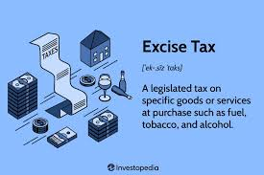
Excise Tax
Known as “luxury tax”
tobacco, fuel, and alcoholic beverages
Spirits, such as maple infused liquor, are taxable
Questions to ask:
Are you making or selling maple wine or other maple based alcoholic products?
Are you selling to general public, wholesaler, others?

Slide 10
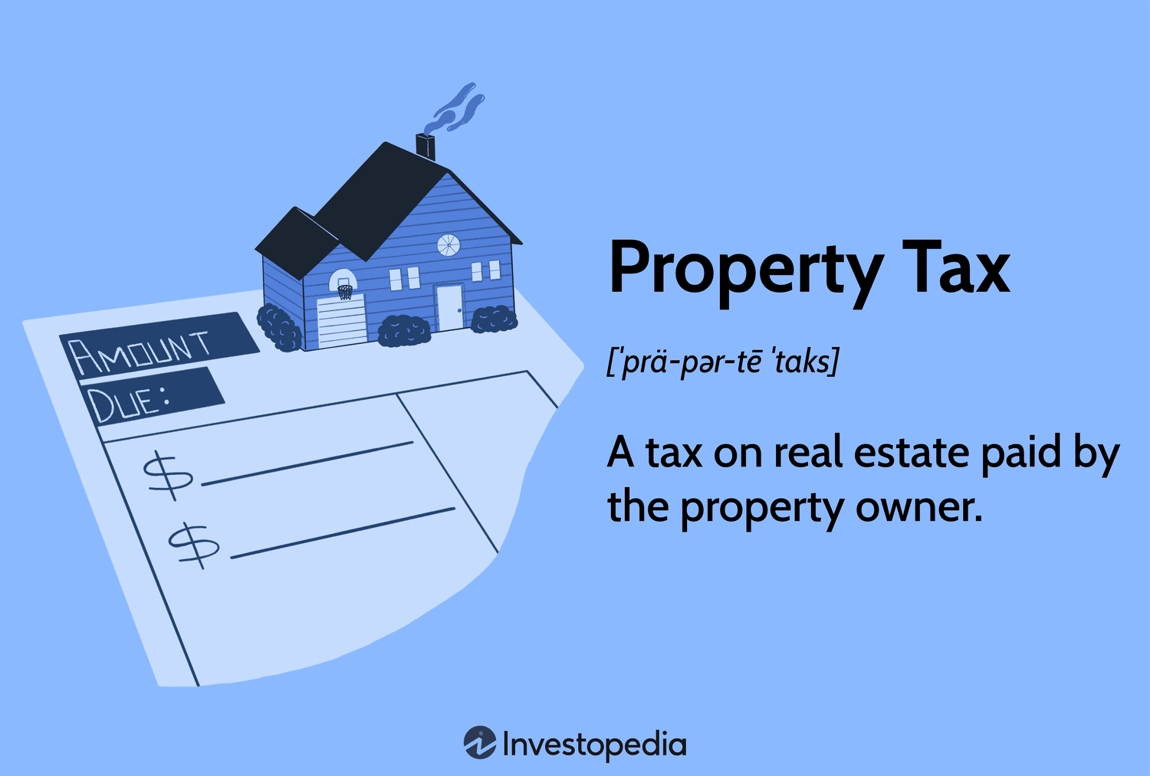
Property Tax
Local tax based on classification/use and value
For agribusinesses, commercial and agricultural land/use are most common
West Virginia and Virginia have programs that assess based on agricultural use and productivity (i.e., WV-Farmland Valuation; VA-Land Use Value Assessment)
Questions to ask:
How is my business titled and owned?
Do I qualify for an agricultural land assessment/tax benefits?
What are local requirements and filing deadlines?
Notes:
Additional resources and topics are included here to reduce tax and other liabilities (payment responsibilities) that may or may not apply to your business. Contact syrup@future.edu, your local Extension Office, Natural Resources Conservation Service (NRCS), Farm Service Agency (FSA) or other agriculture resource provided/specialist to explore these programs and determine if your enterprise qualifies.
https://tax.wv.gov/Documents/PTD/ptd.publication.003.ValuationOfFarmLand.pdf
https://cms1files.revize.com/princegeorgeva/VACOOP_LAND_USE_BROCHURE.pdf

Slide 11
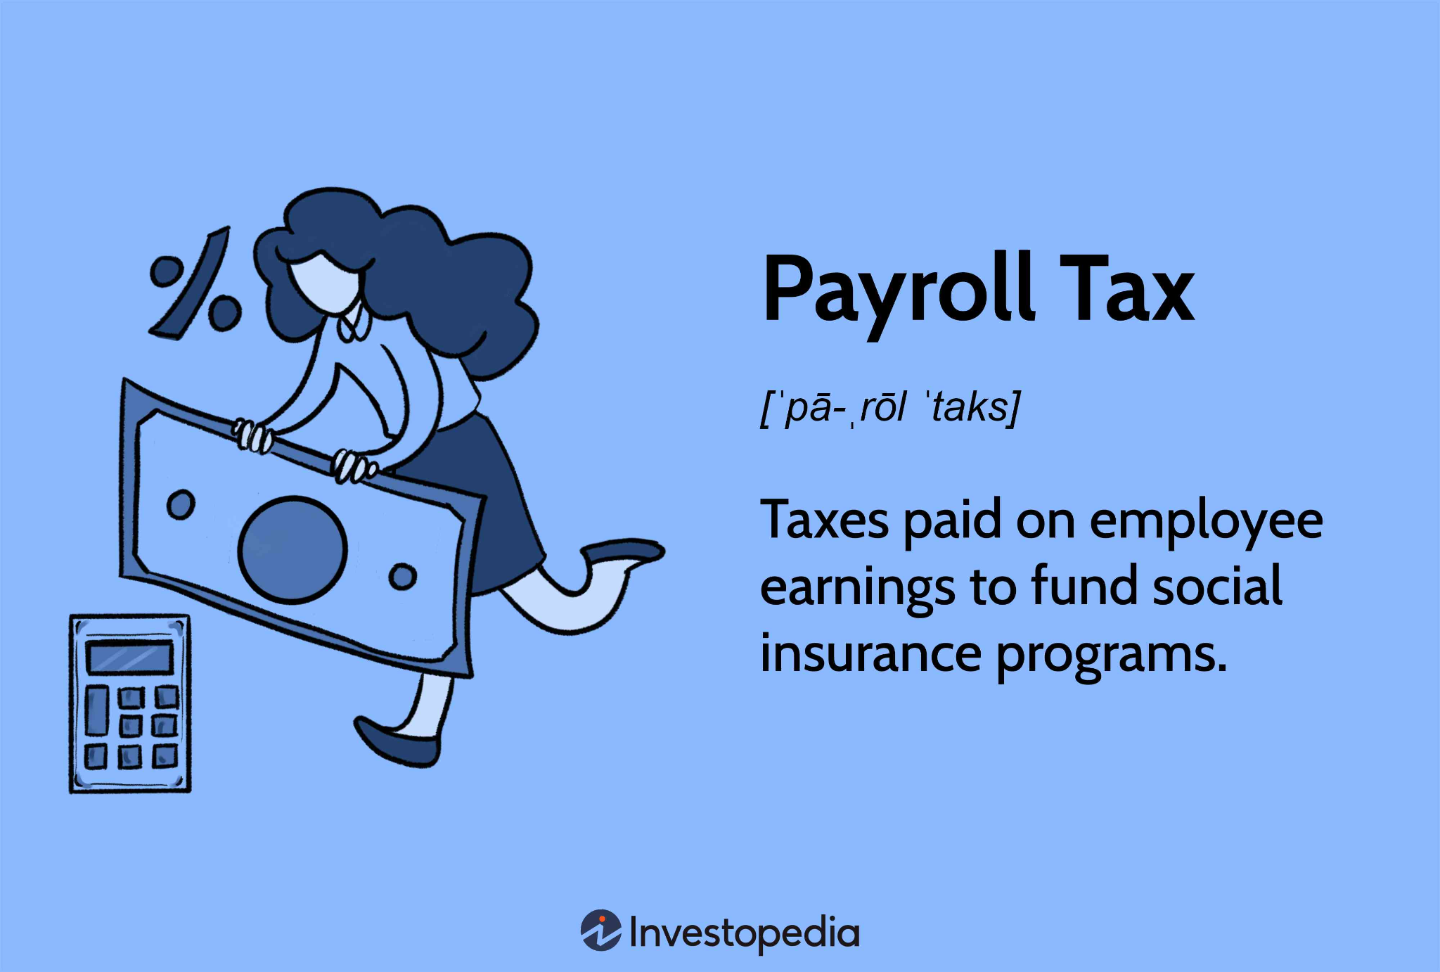
Payroll Taxes
Specific rules related to agriculture employees
Refer to your team (attorney and accountant)
Questions for your team:
Do I have employees for which i need to make payroll deductions?
Do I have employees on H1 visas?
Am I required to file payroll taxes?
Who will prepare and mail my yearly Form W2 for employees?
Notes:
https://www.ers.usda.gov/webdocs/publications/41928/19066_ah719k_1_.pdf?v=0

Slide 12
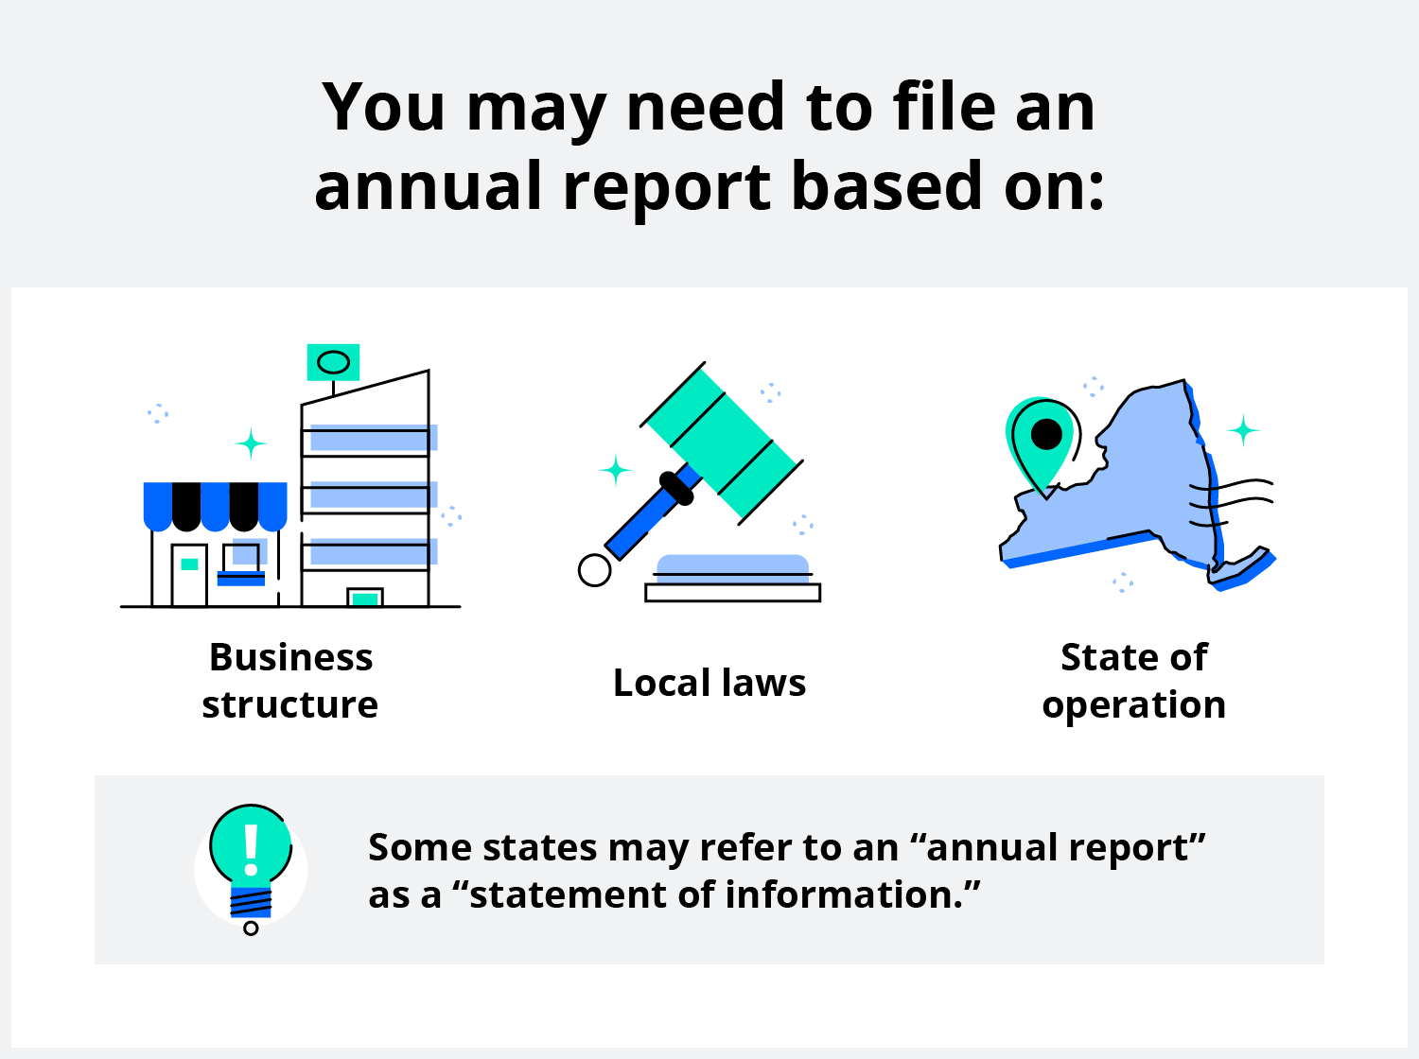
Franchise/Annual Report Filing and Fees
Yearly business tax payable to Secretary of State (WV) or State Corporation Commission (VA)
May be based on income
Questions to ask:
Where to go for answers to tax related questions?
Can a business self-file?
What are the filing deadlines?
Notes:
https://scc.virginia.gov/pages/Businesses
https://business4.wv.gov/operatemybusiness/Pages/Annual-Reporting.aspx

Slide 13
Tariffs and Export Taxes
Fees on products or ingredients that are sourced overseas, OR your product when it is exported.
Possible questions for your team:
Do you sell your products to exporters?
Was your imported evaporator taxable? (i.e.: from Canada)
Who will you go to on your team for advice?
Notes:
SUSTA, state offices of international trade, commercial service, trade center(s)

Slide 14
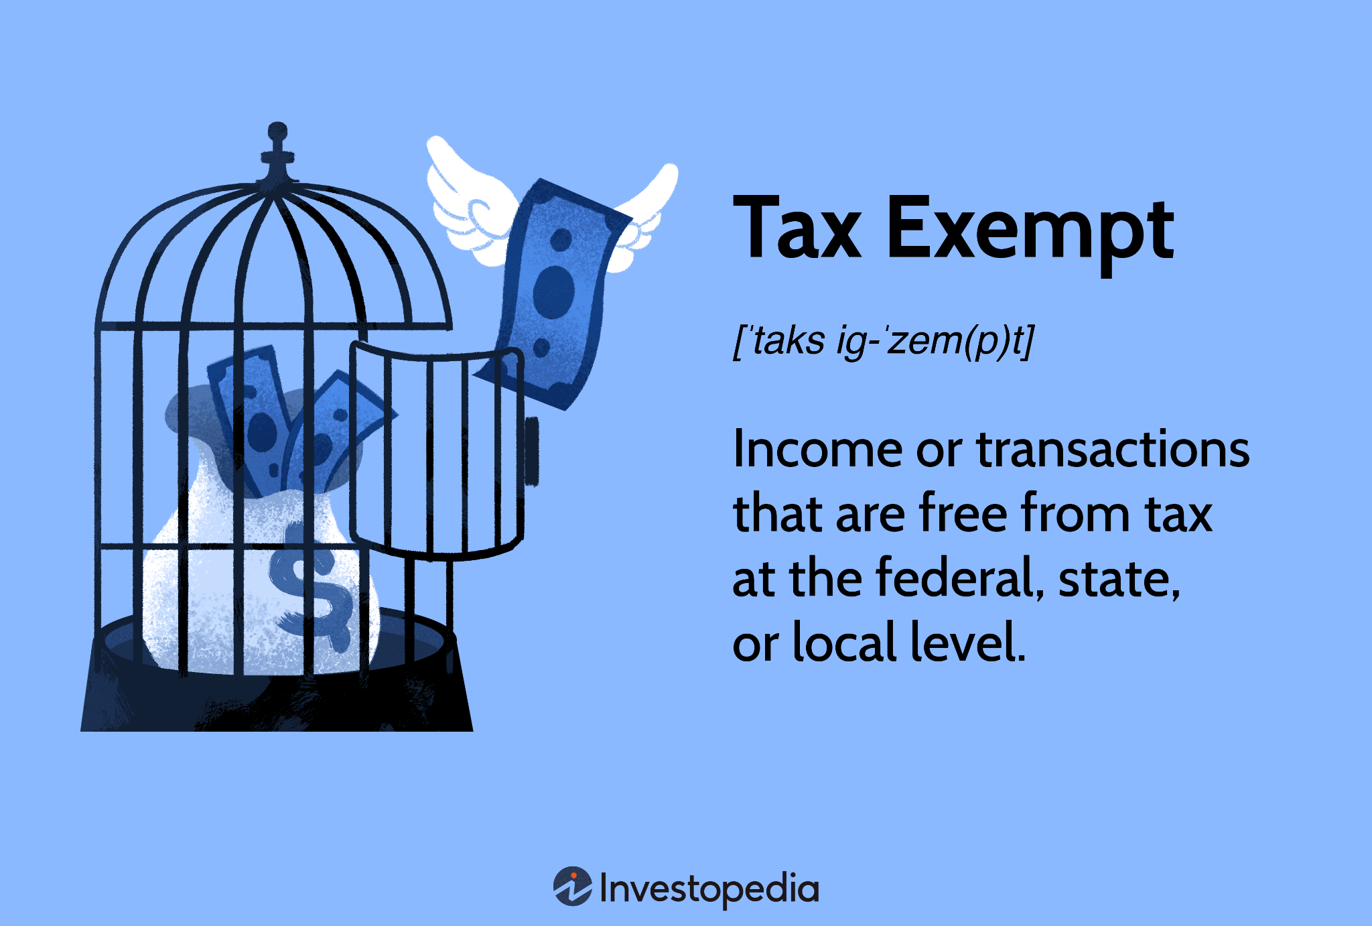
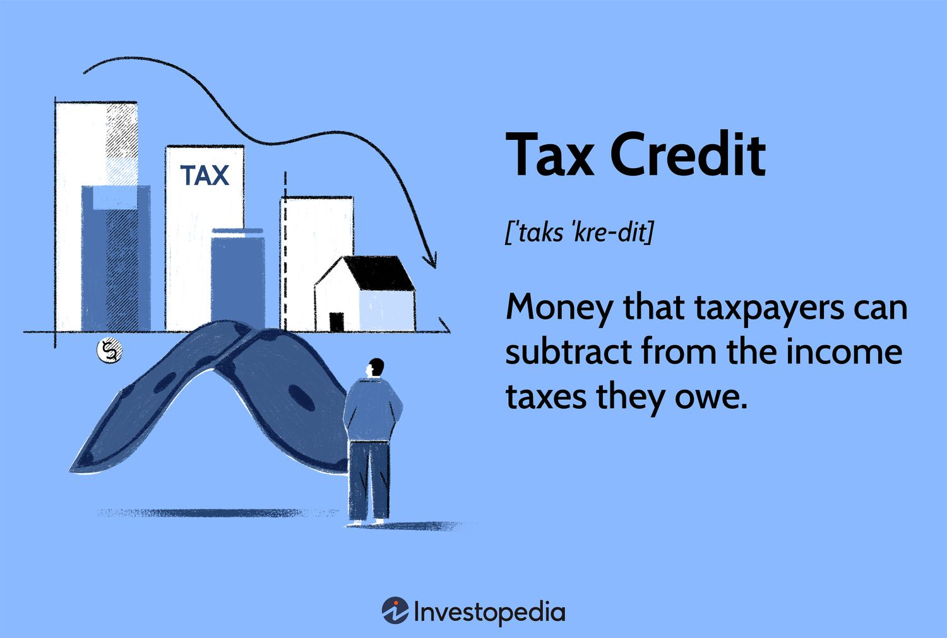
Tax Exemptions and Credits

Slide 15
TAX EXEMPTION
Excludes sales tax based on type of business and nature/use of expense; done at the sale location
May require a number/form on file
Reduces amount of tax owed based on investment, best practices, etc.
Usually taken on IRS Schedule F form specific to agriculture and farm operations
Get advice and learn about regulations from your advising team
TAX CREDIT

Slide 16
Other sources of assistance
Use the Resource/Contact List handout to locate sources
Check your local chamber of commerce for resources/assistance
Economic development agencies often offer assistance
Cooperative Extension specialists at Virginia Tech/West Virginia University are also available to assist you
Senior Corps of Retired Executives (SCORE) is a ready source
What are other information sources near you?
Notes:
CAUTION: Beware of search engine ads that provide business registration services. Many are credible and the experience to get the process completed, their fees don’t include working through the formation questions.
Printed resources (link provided, .pdf in Module resource folder)
https://www.tax.virginia.gov/agriculture-and-farming-credits
https://tax.wv.gov/Documents/TSD/tsd371.pdf
https://www.vafb.com/Portals/FBA/PDFs_and_Resources/membership_at_work/48050534_VFBF%20Farmers%20%20Direct%20Sales%20and%20Use%20Tax%2011-7-17.pdf

Slide 17
Where you sell may impact how you you collect and report taxes
Selling direct to customer
Retail and wholesale opportunities
Bulk packaging
Wholesale drums/retail units
Distributor or aggregator
Regional and national warehouses
Retail units packed by case
Value-added
Interstate commerce (across state lines)
Online sales
Intrastate commerce (in-state only)
Farm stands
Sugarhouse sales
Farmers markets
On-farm restaurants
In-state fairs and festivals
At home use (i.e., incorporate in value-added products)
Go to this module’s Worksheet to begin formulating your tax questions.
Notes:
You may have already answered these questions in your vision and mission statements, you may not have responses or you are working on expanding your marketing and branding efforts. Answers to any of these questions (whether now or in the future) will help you identify the exposure and liability risks you may have as you move forward to establish a formal business entity. Take a few moments on the worksheet to document what you know and want.
If you are an existing business and are thinking about expansion, provide information about where you are and where you want to be.

Slide 18
Please go to the worksheet for Module #4
This worksheet will help you develop questions about taxes
Questions for each enterprise will be unique
Don’t worry about content in this module that doesn’t apply
Your best response maybe to add team or seek other resources
The worksheet is a work in progress; as new markets, products and technologies are added, you should review your tax accounting and reporting, and make changes as necessary

Slide 19
Reminder:
This module and the information contained should not be construed as legal, business, tax or professional advice. It is imperative that you seek out professionals and state and federal tax agencies before you make any tax related decisions, add new practices, or make major changes for your enterprise.

Slide 20
Did I learn what I needed to know?
Please find and complete the Evaluation for this Module (#4)
This will help us make sure that your needs were met and that when we put together future training modules that they will be useful to you.
Notes:
Your feedback will help us provide useful sessions on topics that are important to you and others working in the maple syrup sector.

