Slide 1
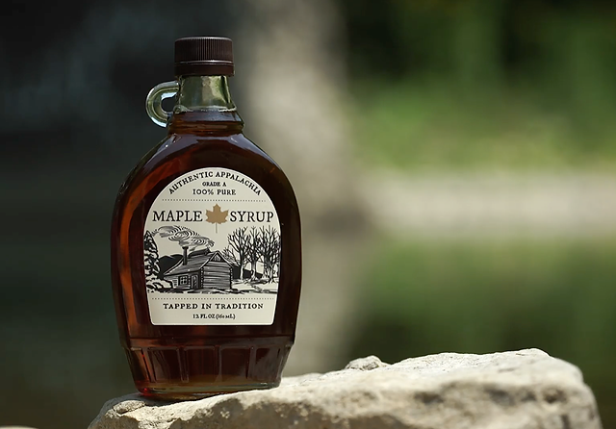

Enriching Maple in Appalachia: Developing a Marketing strategy for your maple syrup products: What you should consider?
By
Tom Hammett and Cindy Martel
Appalachian Program
Future Generations University
supported by the
USDA AMS-ACER
Access Grant Program
Notes:
Welcome to Future Generations University’s business learning sessions for maple enterprise development. This module will provide an introduction to marketing - an important part of your enterprise development. We would like to acknowledge the programs that have assisted us assembling this information, particularly the USDA AMS-ACER Access Grant Program as well as the resources developed by other maple development programs.
Please remember that this session is not intended to advise you on how to conduct your business. As in previous sessions we encourage you to determine what will work best for your situation. Hopefully this session will provide answers to some of your questions and needed resources in the area of marketing. So, get your pen and paper ready, and put on your thinking cap!

Slide 2
Before you start this module….
Download the worksheet for this module
Remember, this may be applicable for other nature-based enterprises!
Review the learning objectives for this module
Have your notebook and a marketing book handy (see list of suggestions at the end of this module)
Consider working on this module with some of your team
Refer to other modules that incorporate business planning
Notes:
Before you move forward, please make sure you have a hard copy or access to the worksheet (You can download this from the topic folder).

Slide 3
The agenda for this session
Review key aspects of marketing
Develop a marketing strategy that will help sustain/grow your enterprise
Build skills and confidence to develop marketing strategy
Before we start:
What are your questions about marketing and developing a market strategy? Jot them down and if they are not addressed in this module, besure to engage one of your team members.

Slide 4
First step we should review the basics of marketing
Components: Product, Price, Place, and Promotion (the “4 Ps”)
Understand your situation:
  Your production capacity (now and planned)
  Product sold (package, size, prices)?
  What are your current markets?
  Current marketing and promotional efforts?
Develop a market plan
  What are the components of a marketing plan?
  What marketing data is needed/appropriate? and Where will you find it?
  What resources and assistance can you access?
Notes:
If you have not already established a formal vision or mission statement for your business, no worries, these questions should help you get there. Feel free to jot notes or thoughts in response to these questions on your worksheet as you go through this session. You should also pause the presentation to reflect on your own situation as you need. Add your responses to these questions on your worksheet.
Reasons to finalize my maple business idea: starter options include succession planning, taxation requirements, etc.
Who are my competitors ideas: local, state, regional, national and possibly international, packaging, delivery options, pricing, etc.; jot notes, reference session on “Developing my Elevator Pitch” and start to identify differentiators.

Slide 5
Objectives for this module:
3
1
2
4
Review basic components of marketing
Understand the key aspects of marketing
Discuss key aspects of marketing strategy
Develop confidence to build marketing strategy
Notes:
At the end of this session, we hope you gain knowledge and resources for these objectives: Raise awareness of market planning and resources that you might find helpful as you develop your marketing effort.

Slide 6
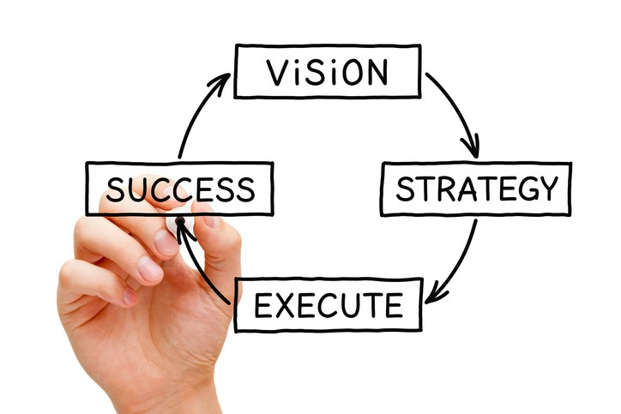
How does your Vision relate to marketing?
Revisit your worksheet for Module 1
Your vision will help you develop a market strategy
Notes:
As mentioned in previous sessions, having a Vision for enterprise is important it helps to keep you focused. When considering marketing it will help you develop the resources and linkages that help you succeed in marketing your products. If you have not already done so, you should re-check your vision statement. Does it need revision to reflect your marketing goals?.

Slide 7
Where does your market strategy fit in?
Basic business plans often include:
Background
Organization (describe your enterprise’s layout and workplace)
Operations plan (process/operations)
Marketing plan (strategy) (What are your products/services?)
Revisit your SWOT analysis to see if there are an marketing related factors that impact your plan; if not consider modifying (see Module 1)
Financial plan (Do you have a marketing budget?)
Summary
Marketing strategy is critical to developing the other parts of your plan.
Based in part on Perry and Childs (2012)

Slide 8
Here are few questions that you should consider:
Who are your current customers and what do they value?
Who are your competitors? Where are they marketing their products?
Can you link your planned/anticipated production with market potential?
What are your market opportunities?
Is your marketing plan appropriate for your enterprise?
What challenges do you have when marketing your products?
Notes:
Before we begin it is important to have a common understanding of marketing and some of the terms used. Here are a few. Selling is the act of negotiating and bringing the product to the customers. Marketing is a process by which you raise customer awareness. In a sense your are setting up the environment for customers to recognize need and decide to buy your product.
What do you know about the market(s) for maple syrup products? Are your marketing needs in your business plan? Can you link your planned/anticipated production with market potential? Can you link sap production, with storage, processing and/or bottling capacities?

Slide 9
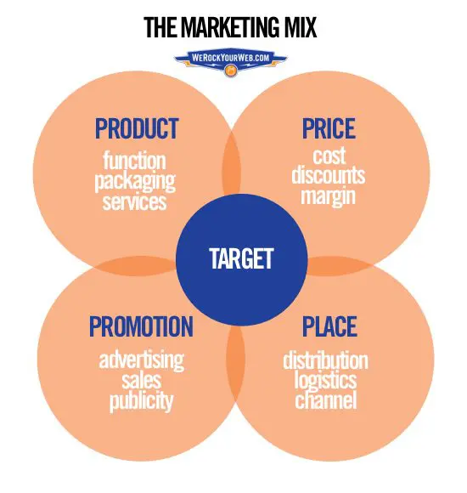
The four Ps
Product,
Place,
Price, and
Promotion
Notes:
It is important to think about your marketing mix strategy - the “four Ps” This is commonly referred to as “marketing mix”. This is the skeleton on which your marketing activities should hang.

Slide 10
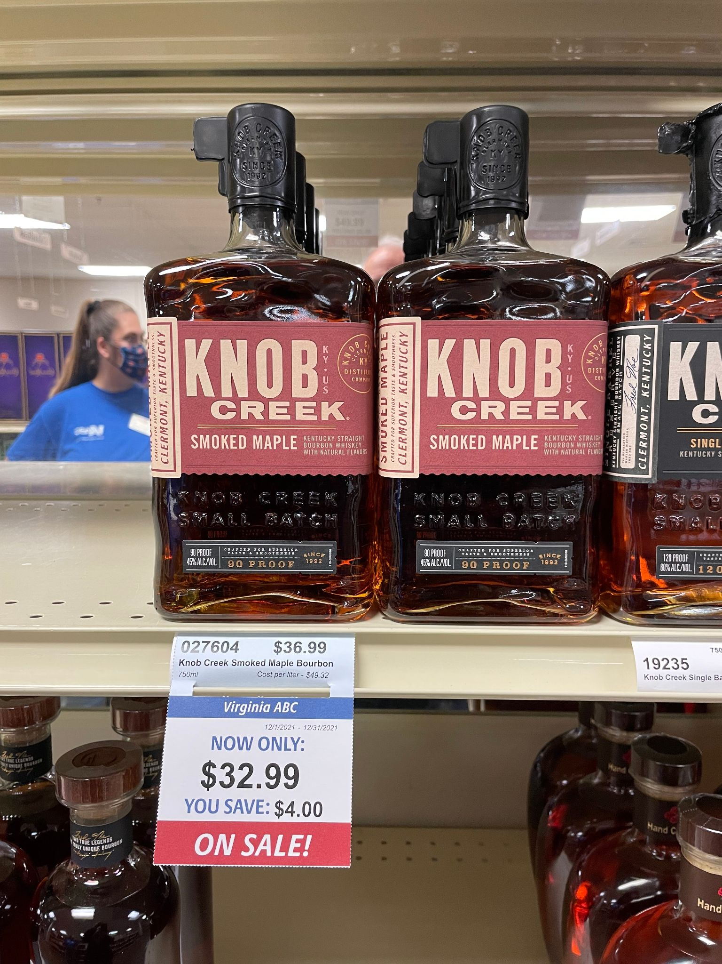
P #1 - Product
What products will you offer and how are they unique?
What about the function, packaging and services of your product(s)?
What do you notice about the example in the photo?
How would this information help you assess your product’s presence in the marketplace?
Notes:
Feedback could include packaging, labeling, shelf information, etc.. We see an example of a maple value added product - a maple flavored beverage.
You will need to be able to concisely describe your product, and how it differs from your competitors’ products. A business planning guide will help you develop your marketing plan. such a guide is available from the SBDC.

Slide 11
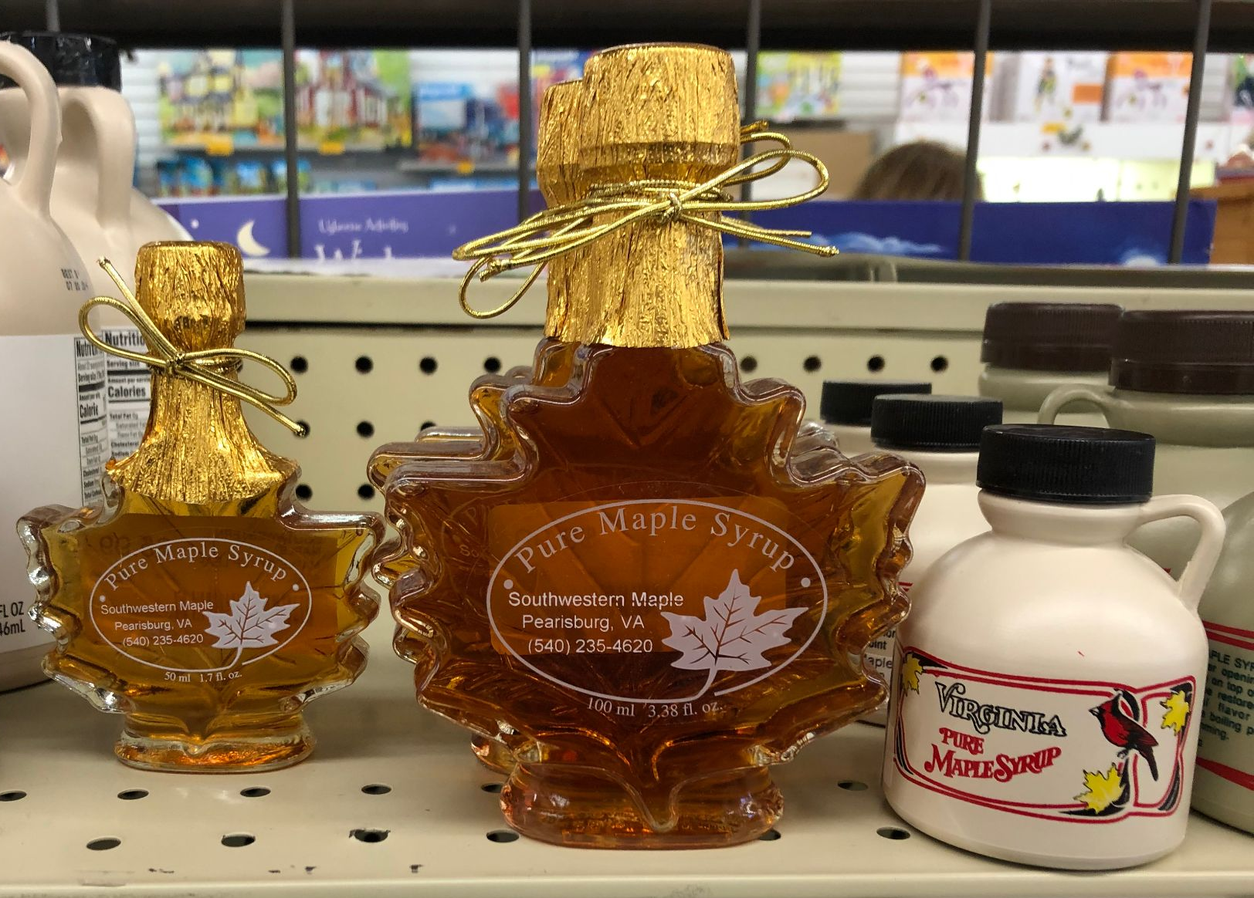
P #2 - Place - distribution and packaging
There is more than one way to place your product in market (direct sale, farmers markets, in retail stores)
What is best for you and your products?
How do competitors distribute their products (i.e., health food distributors)?
What have been the packaging trends for syrup? (plastic, glass, tin? small or larger sized containers?)
Is there a cost to place your product?
The answers to these questions are the basis for initial distribution strategy.
Notes:
Place is simply how will your get your product to your customers? HOw do you place it in the market? What is your distribution strategy?
We show here two types of packaging - one class and the other plastic. Two deciding factors for customers the type of packaging, and size of container. In this case pint or half pint.

Slide 12
Where do you want to sell your product(s)?
Direct marketing opportunities
Retail and wholesale opportunities
Intrastate commerce (in-state)
Farm stands
Sugarhouse sales
Farmers markets
Catering
State fairs and festivals
At home use
Packed for restaurant use
Wholesale in barrels
Consumer-ready (boxed bottles)
Distributor or aggregator
Regional and national warehouses
Value-added products
Interstate commerce (across state lines; i.e., online sales)
Notes:
Again, you may have already answered these questions when forming your vision and mission statements. You may not have responses or you are working on expanding your marketing and branding efforts. Answers to any of these questions (whether now or in the future) will help you identify the exposure and liability risks you may have as you move forward to establish a formal business entity. Take a few moments on the worksheet to document what you know and need to learn about markets for your products.
If you are an existing business and are thinking about expansion, provide information about where you are and where you want to be.

Slide 13
Getting your product to market
Direct to the customer (i.e., roadside, farmers markets, mail order/internet marketing)
Using intermediaries (i.e., you sell to wholesalers, brokers)
Or, those who represent farmers for a commission, but do not take possession or title of your product
Note: What follows on the next slide are some pieces that you may consider.
Notes:
Finding the best way to get you product to the market, and into customers’ hands is important. Each method has its advantages and disadvantages. You need to examine these methods before you select the one best for you. Your choice may change as your business grows or changes.

Slide 14
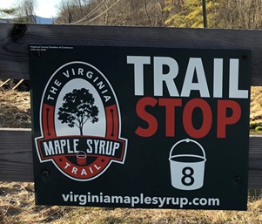
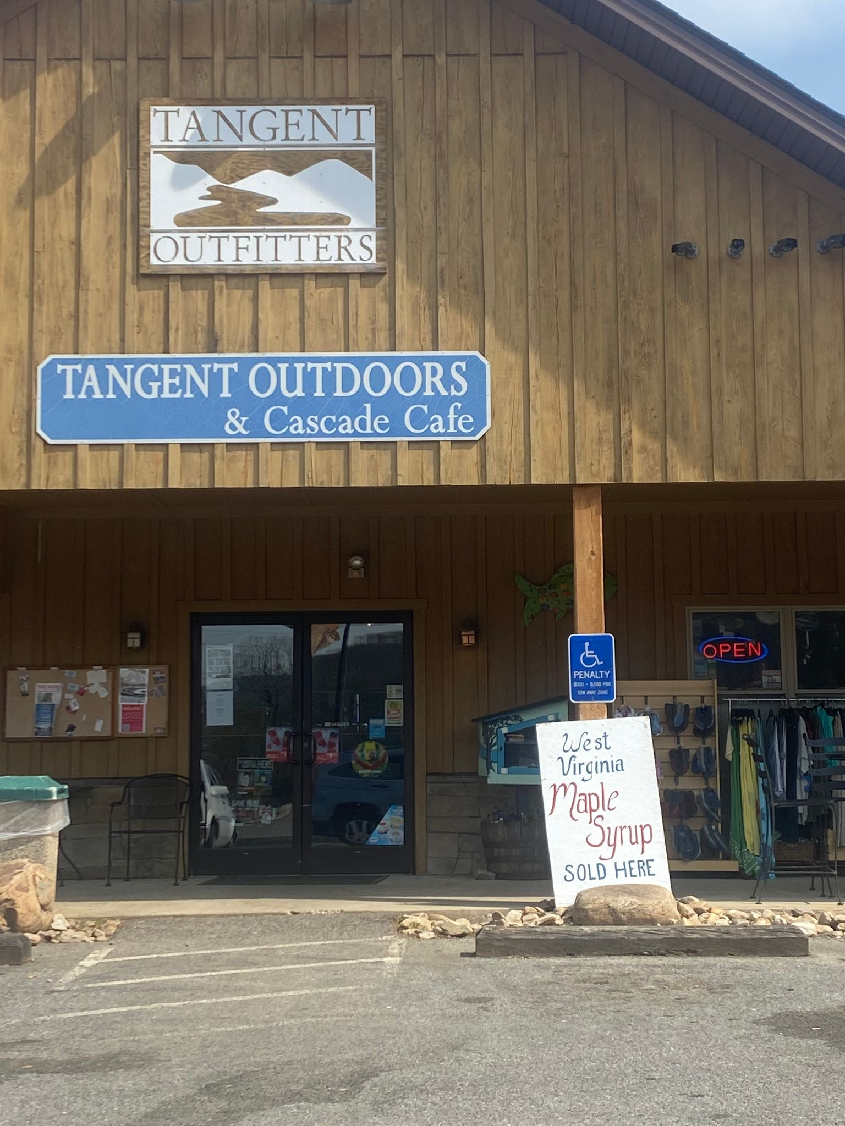
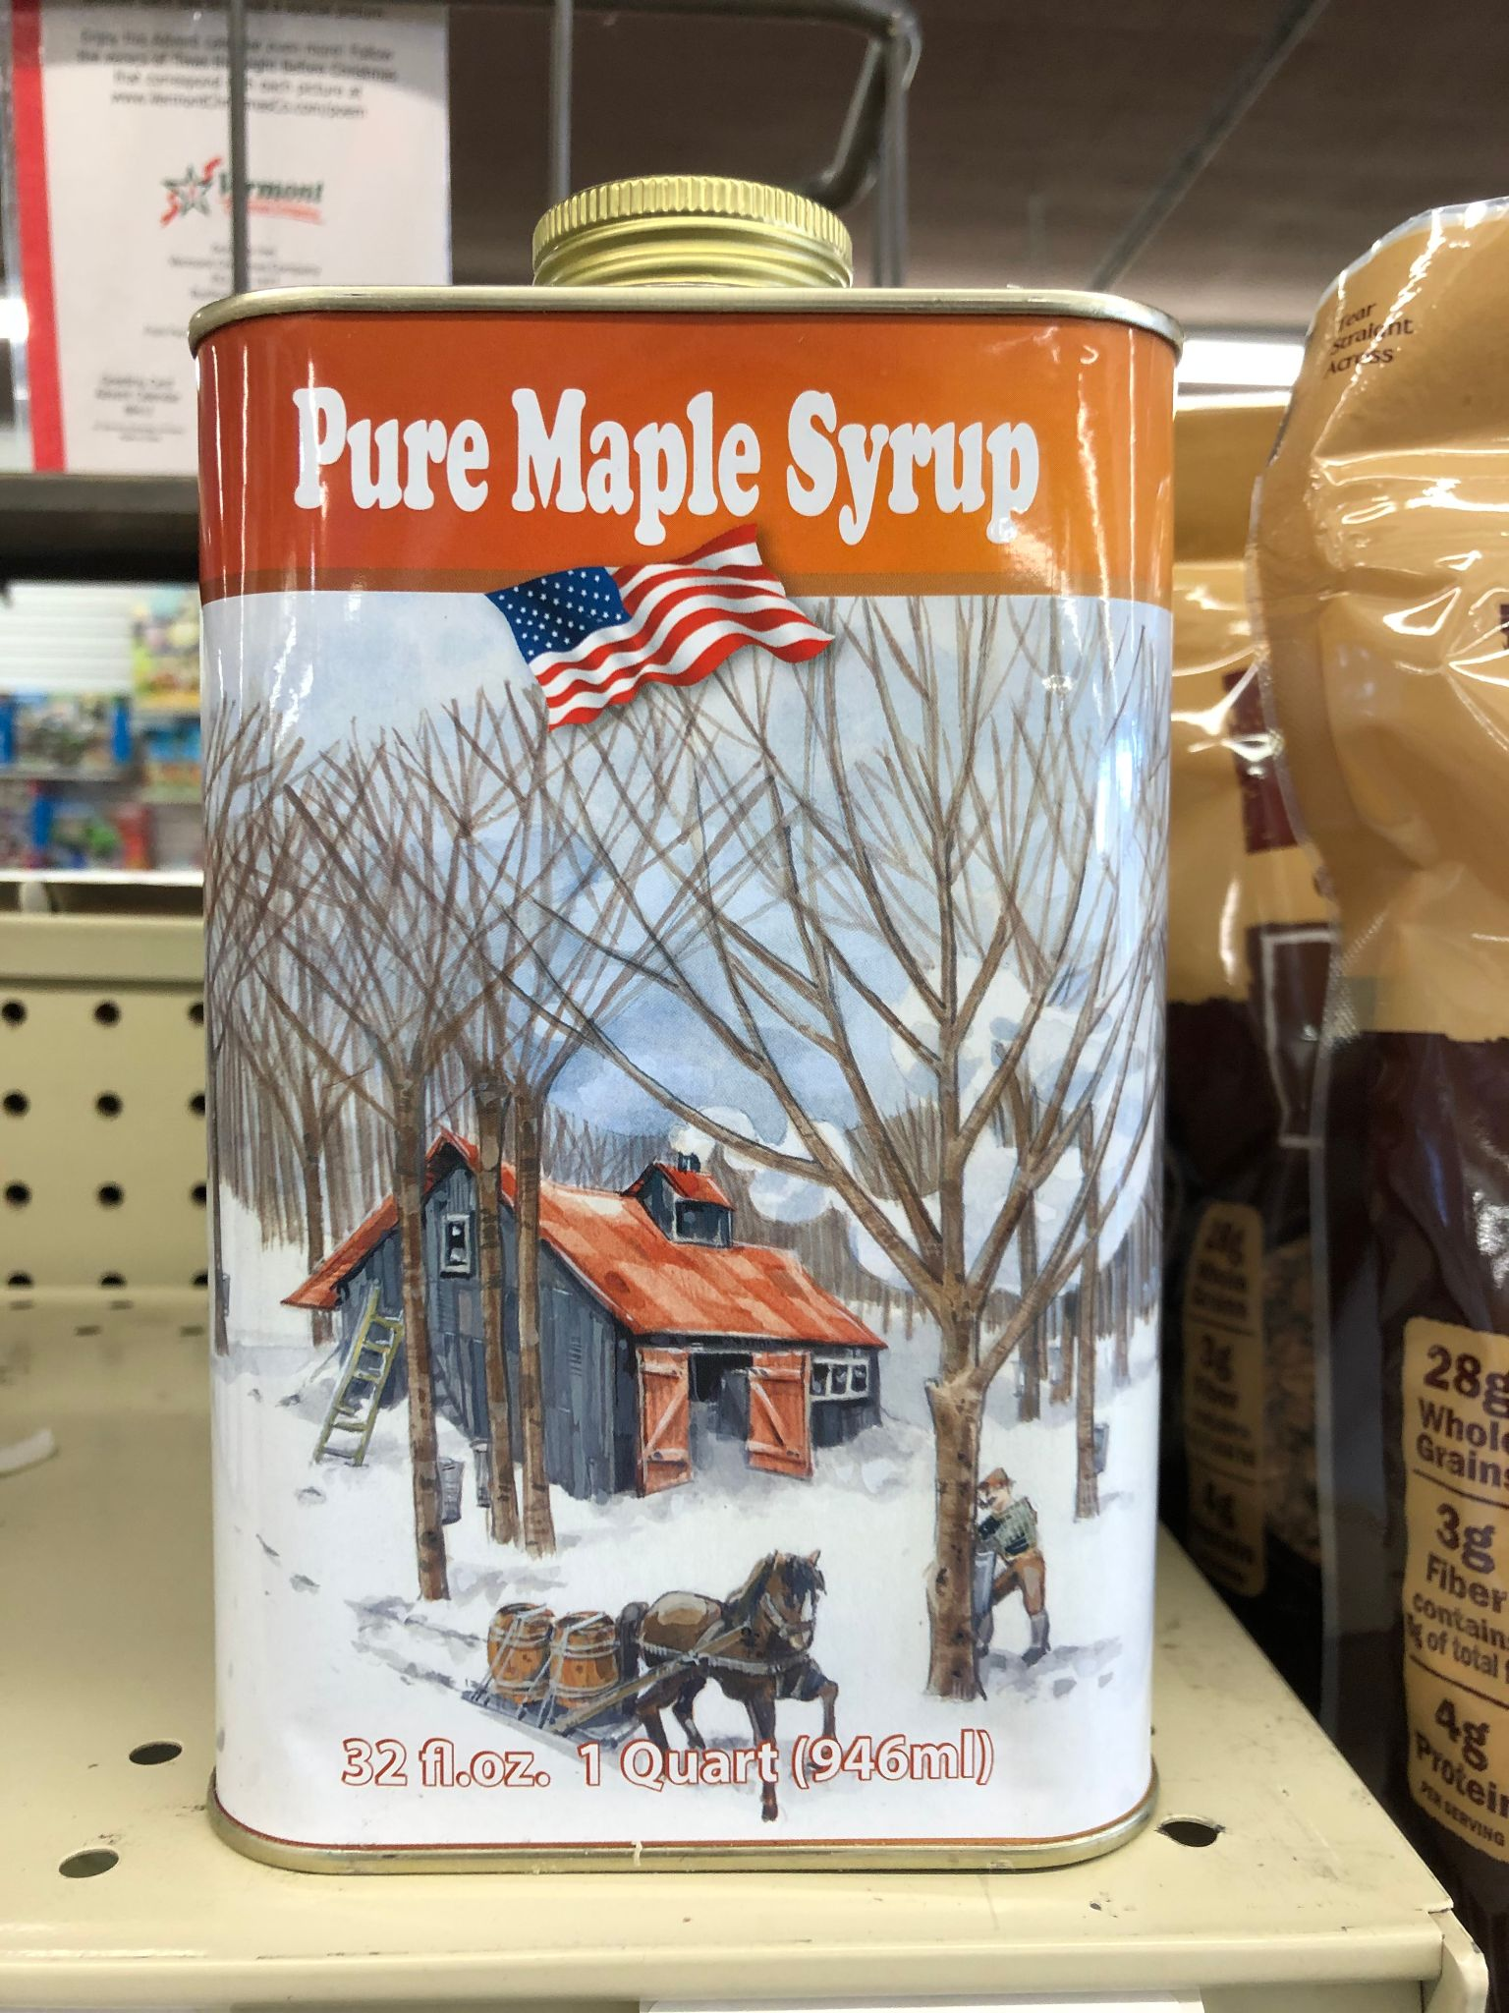
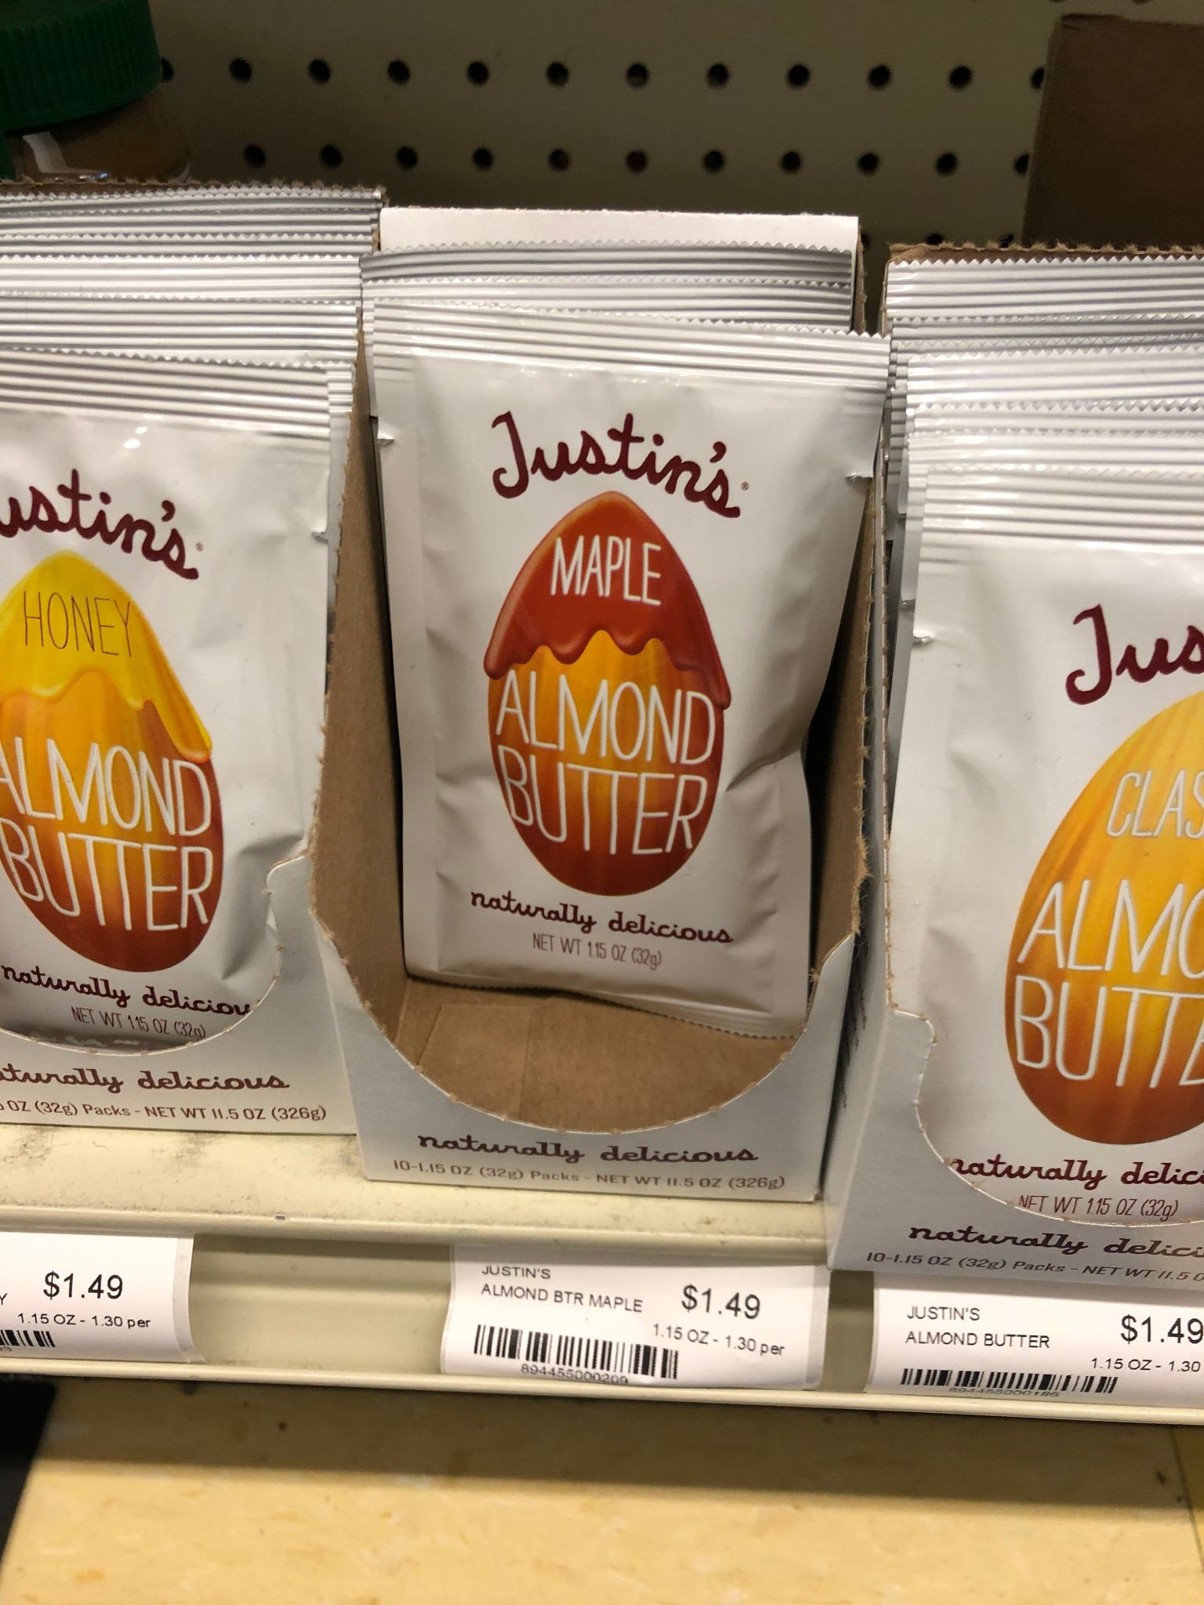
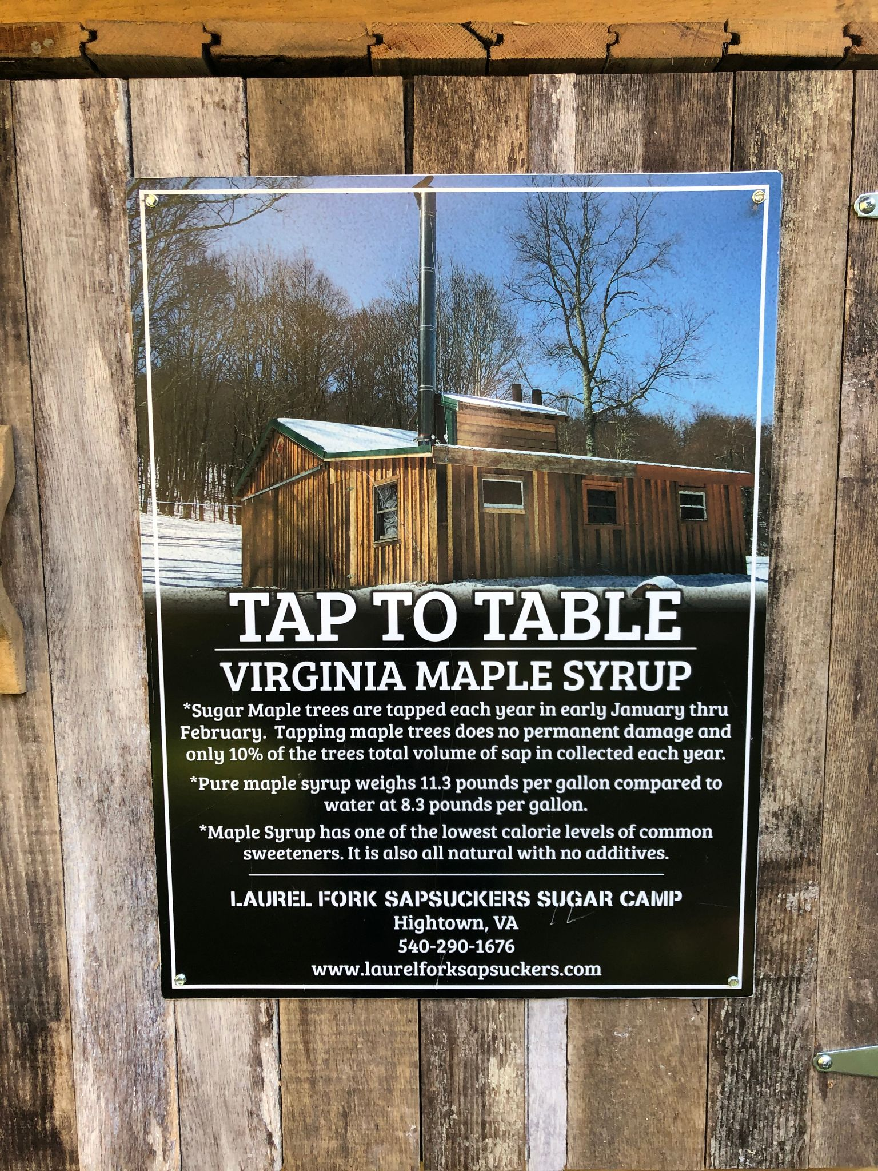
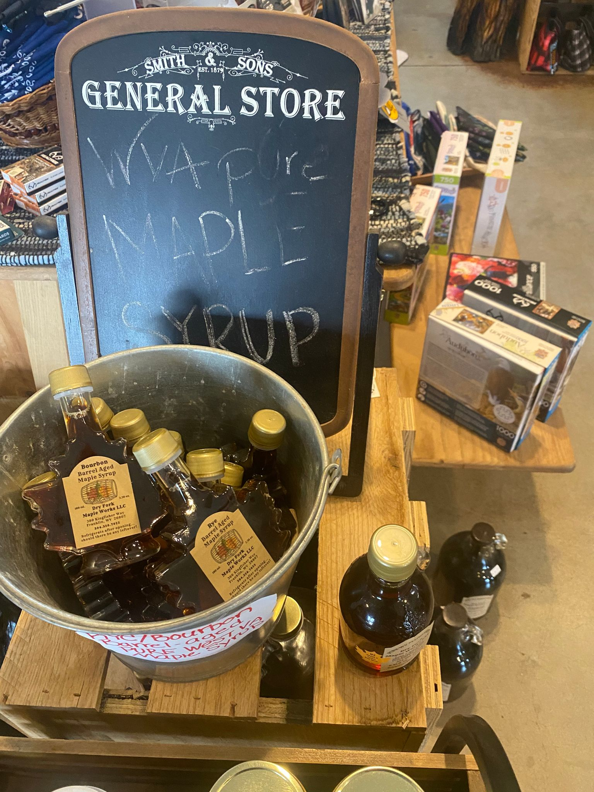
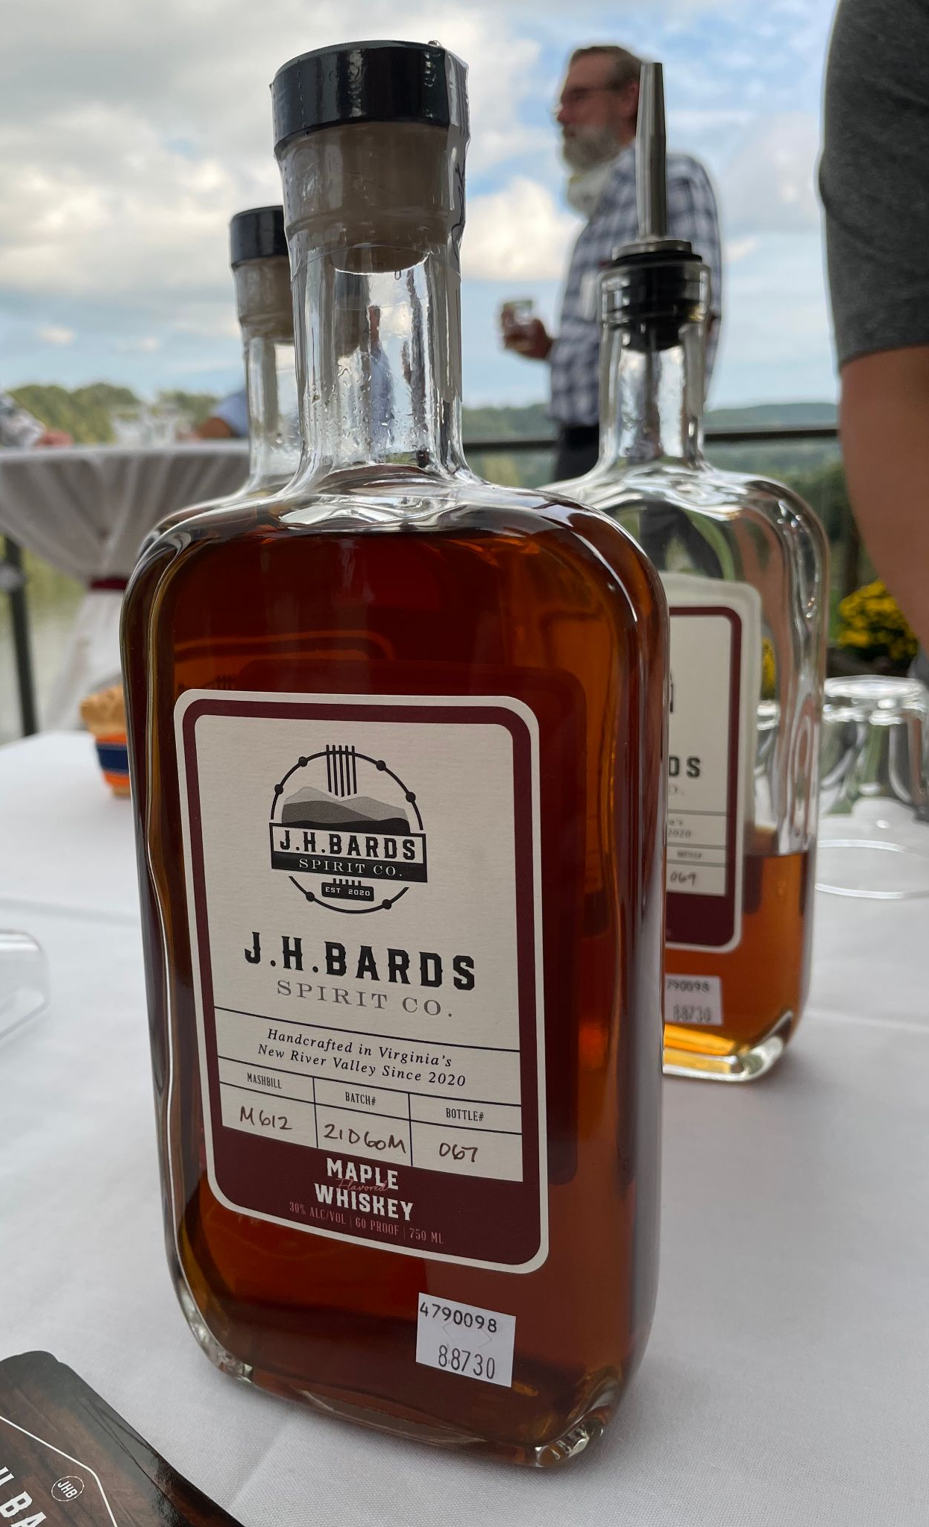
Tin was the dominate package Roadside sales are common Speciality shops and convenience stores
Capital investment
Presentation for in-store Value added - beverages Value added - maple sugar Selling to restaurants
Notes:
Where and to whom you sell your product(s) to impacts business structure based on the amount of risk, liability and regulation. Direct marketing (from producer to consumer) is where you can start your enterprise and your production/sales goals may allow you to remain at this level. Establishing and growing your business is a complex relationship between markets, production, value added and other decisions. Making these decisions will need some research and engagement with your team.
Evaporator represents capital investment—-increased production—more, possibly diverse markets, packaging and label changes, production time, etc. Capital investment could include an RO machine, etc.
An example of a consignment/commission arrangement would be selling your product to the Wild Ramp, a store in Huntington or another vendor who sells your product for you for a set percentage.

Slide 15
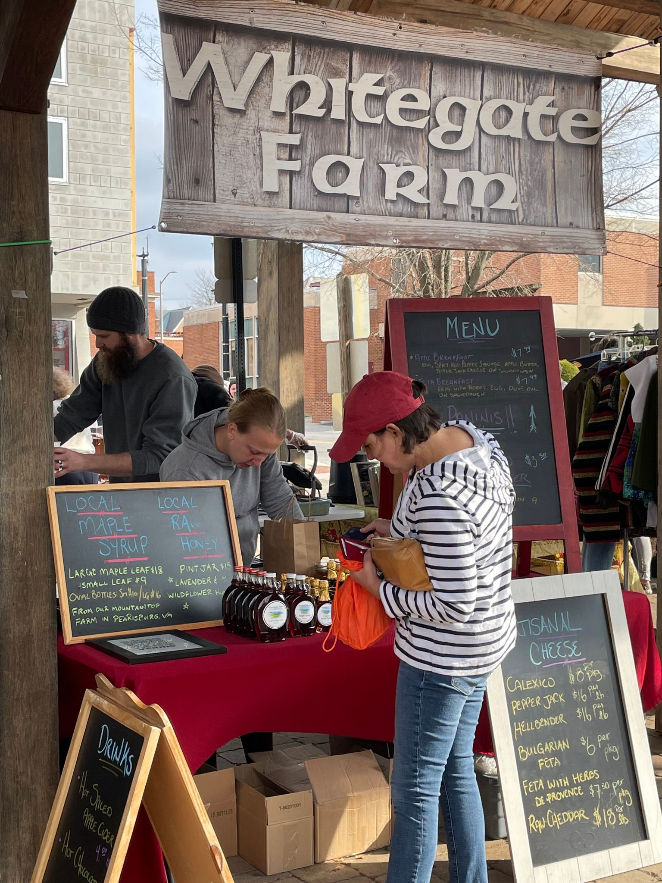
P #3 - Price
How will you determine the price for your syrup and other products?
Do you know the costs to produce your syrup?
How much do you need to charge to meet the cost and make a reasonable profit?
Have you determined pricing in the market? (i.e., prices on store shelves)
Now, you can create a pricing strategy for your business plan!
Posting pricing helps customer at farmers market make buying decision
Notes:
A pricing strategy will determine how you will price your product(s). If your product price is at or above the high point, can you list how or why you should seek a higher price? What are the typical markups in the region for maple syrup? Are you factoring in your labor costs? To learn more see the worksheet by Canella that we reference at the end of this module.

Slide 16

P #4 - Promotion
Key points here are packaging/labeling, messaging, costs of promotion
What message will you communicate to buyers or customers?
Where and how will you communicate with customers?
What costs will impact your promotion?
What stories do you tell in your promotion?
Now take this information and incorporate it into your promotional/marketing plan
What does this poster tell you
about Family Roots maple syrup?
Notes:
What are your advertising plans? What about direct sales calls? Will you make them? Will you go to a trade fair or exposition?
What about sales channels? Who will be selling your products? What are the priorities of your promotions?

Slide 17
Checklist for your marketing plan may include:
What are the traditional local markets for maple syrup?
What are the sizes of the local or regional markets?
What are the market trends? (demand for maple syrup?)
Do you have a sense of your competitors? (size, location, markets)
Based on this information, what are your target market(s)?
What are your strategies for Product, Price, Promotion and Place (distribution)?
What potential markets are you considering?
Do you have a sales strategy?
Notes:
A bit of review. Don’t be afraid to go back and modify your SWOT, and other parts of your draft plan. You should conduct a SWOT to analyze your strengths and weaknesses of your business as compared to you competitors and determine your success factors. You should now go back to this session’s worksheet and note the outline/basic points of a marketing plan. In subsequent sessions we will discuss market planning.

Slide 18
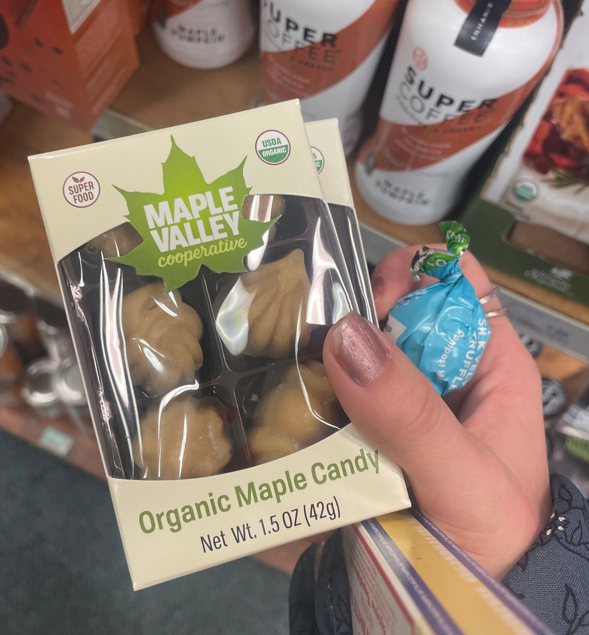
Marketing plan - things to consider
Need not be a formal plan, but may choose to include:
Description of product, price, distribution, promotion
What is your firm’s niche? Who will buy your product?
What is the demand? Where are your customers?
Who is the competition?
Sales plan - primary outlets (i.e., farmer markets, grocery stores) and direct sales (i.e., direct from your location)
Advertising planned (more than word of mouth)
Market information gathering needs to be ongoing
Consider value-added products?
Notes:
A marketing plan is most necessary for new products/markets
Look for linkages that save you time and money; Suggestion: start with the template (outline) on the worksheet

Slide 19





Where would you go for assistance?
Your mentoring team (staff, family and professionals)
Small Business Development Centers (in VA or WV)
Local chamber of commerce, economic development agencies
Virginia Tech or WVU Cooperative Extension Service
University of Vermont, maple business group
Senior Corps of Retired Executives (SCORE) - local office
WVDA Planning Coordinators or VDACS marketing team
Future Generations University (email: syrup@future.edu)
Notes:
There are several organizations and their representatives, both locally and in the region, that can help you develop a marketing plan. Don’t overlook your neighbors, other producers, those who might help you market your syrup or value added products. Your team may include but are not limited to these.
Regional market development programs/opportunities - Economic Development Authorities, regional buyers and businesses, business incubators (i.e. The Hive, SW Virginia Craft Center, Tamarack)
https://www.msbdc.org/pdf/marketing_plan.pdf
https://projects.sare.org/wp-content/uploads/960415always-something-farm-_marketing-plan.pdf

Slide 20

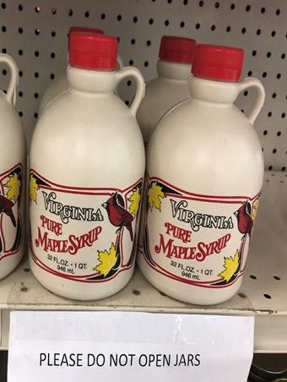
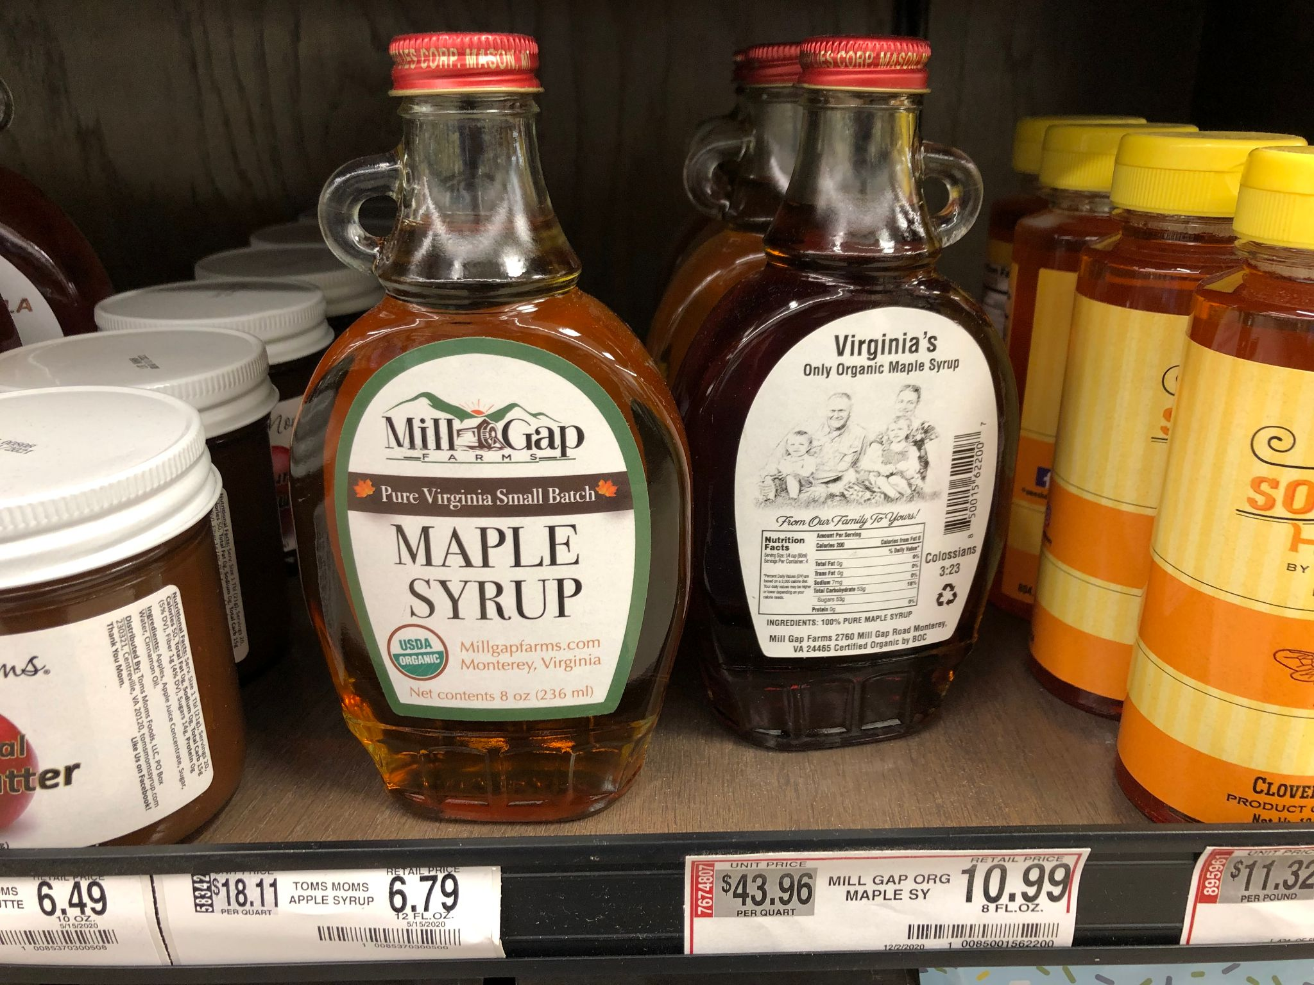
Action Plan - your next steps
Activity | Yes | No | N/A | Action Plan, timeframe and assignment
Continue to develop mentor list (include marketing expertise) |  |  |  | Ongoing
Review your SWOT Assessment for your maple enterprise |  |  |  | See Module #2
Develop a marketing mindset for your maple enterprise
Develop your marketing plan |  |  |  | Marketing plan
Incorporate marketing in your business plan
Notes:
What are the next steps? Determine the options for getting your product to market.
Remember to place your draft marketing plan worksheet into your business plan binder; you can always go back and adjust based on your marketing results/targets

Slide 21
Some helpful marketing sources:
University of Vermont. Several maple business planning tools and other resources can be found at this link: https://www.uvm.edu/extension/agriculture/maple
Perry, J. and S. Childs. 2012. Beginning or Expanding Maple Syrup Operations as a Profitable Business. NY Farm Viability Institute. Cornell University. 43 p.
Gloy, A. 2004. Putting Market Information to Work: A Marketing Planning Guide. Extension Bulletin EB-2009-04 Cornell University. 29 p.
Minnesota Institute for Sustainable Agriculture. 2018. Building a sustainable business: A guide to developing a business plan for farms and rural businesses. SARE Handbook 6. College Park, MD. 276 p.
What sources of information and advice on marketing are available near you?
Notes:
You will find several useful resources through the linkages that you make, and through several organizations that are focused on maple-based enterprises or enterprise development in general. Here are four sources that we think may be a starting point for developing your marketing strategy.

Slide 22
Did I learn what I needed to know?
Please complete the Evaluation Form for this module
This will help us make sure that your needs have been met, and that future training modules will be useful to you
Are there any other topics in this area for which you would like information?
Thank you for for your participation
Notes:
Your feedback will help us provide useful sessions on topics that are important to you and others working in the maple syrup sector.

