Slide 1

Enriching Maple in Appalachia: Self-Assessment and SWOT* - tools for enterprise decision making
By
Tom Hammett and Cindy Martel
Appalachian Program
Future Generations University
supported by the
USDA AMS-ACER
Access Grant Program
*SWOT-Strengths, Weaknesses, Opportunities and Threats
Notes:
Welcome to Future Generations University’s business learning sessions for maple enterprise development. This session will provide an introduction to self-assessment through a SWOT tool - an important part of your enterprise development. We would like to acknowledge the programs that have assisted us assembling this information, particularly the USDA AMS-ACER Access Grant Program as well as the resources developed by other maple development programs.
Please remember that this session is not intended to advise you on how to conduct your business. As in previous sessions we encourage you to determine what will work best for your situation. Hopefully this session will provide answers to some of your questions and needed resources in the area of marketing. So, get your pen and paper ready, and put on your thinking cap!

Slide 2

Before you start this module….
Download this module’s worksheet
Be familiar with the learning objectives
Have handy your business planning notebook
Consider working on this module with some of your team
Notes:
Before you move forward, please make sure you have a hard copy or access to the worksheet for this session. It is downloadable from the topic folder. Multiple copies of the four quadrant SWOT worksheet is recommended—it’s ok if you are “messy” during this session. Pencils, erasers, sticky notes and other tools are all great!

Slide 3
Module objectives:
3
1
2
4
Understand the importance of self-assessment in the decision making process
Explore the best practices for self-assessment
Conduct a SWOT assessment focused on the enterprise
Develop implementation strategies based on the SWOT findings
Notes:
At the end of this session, we hope you gain knowledge (and resources) and the confidence to complete these objectives (and a SWOT).

Slide 4
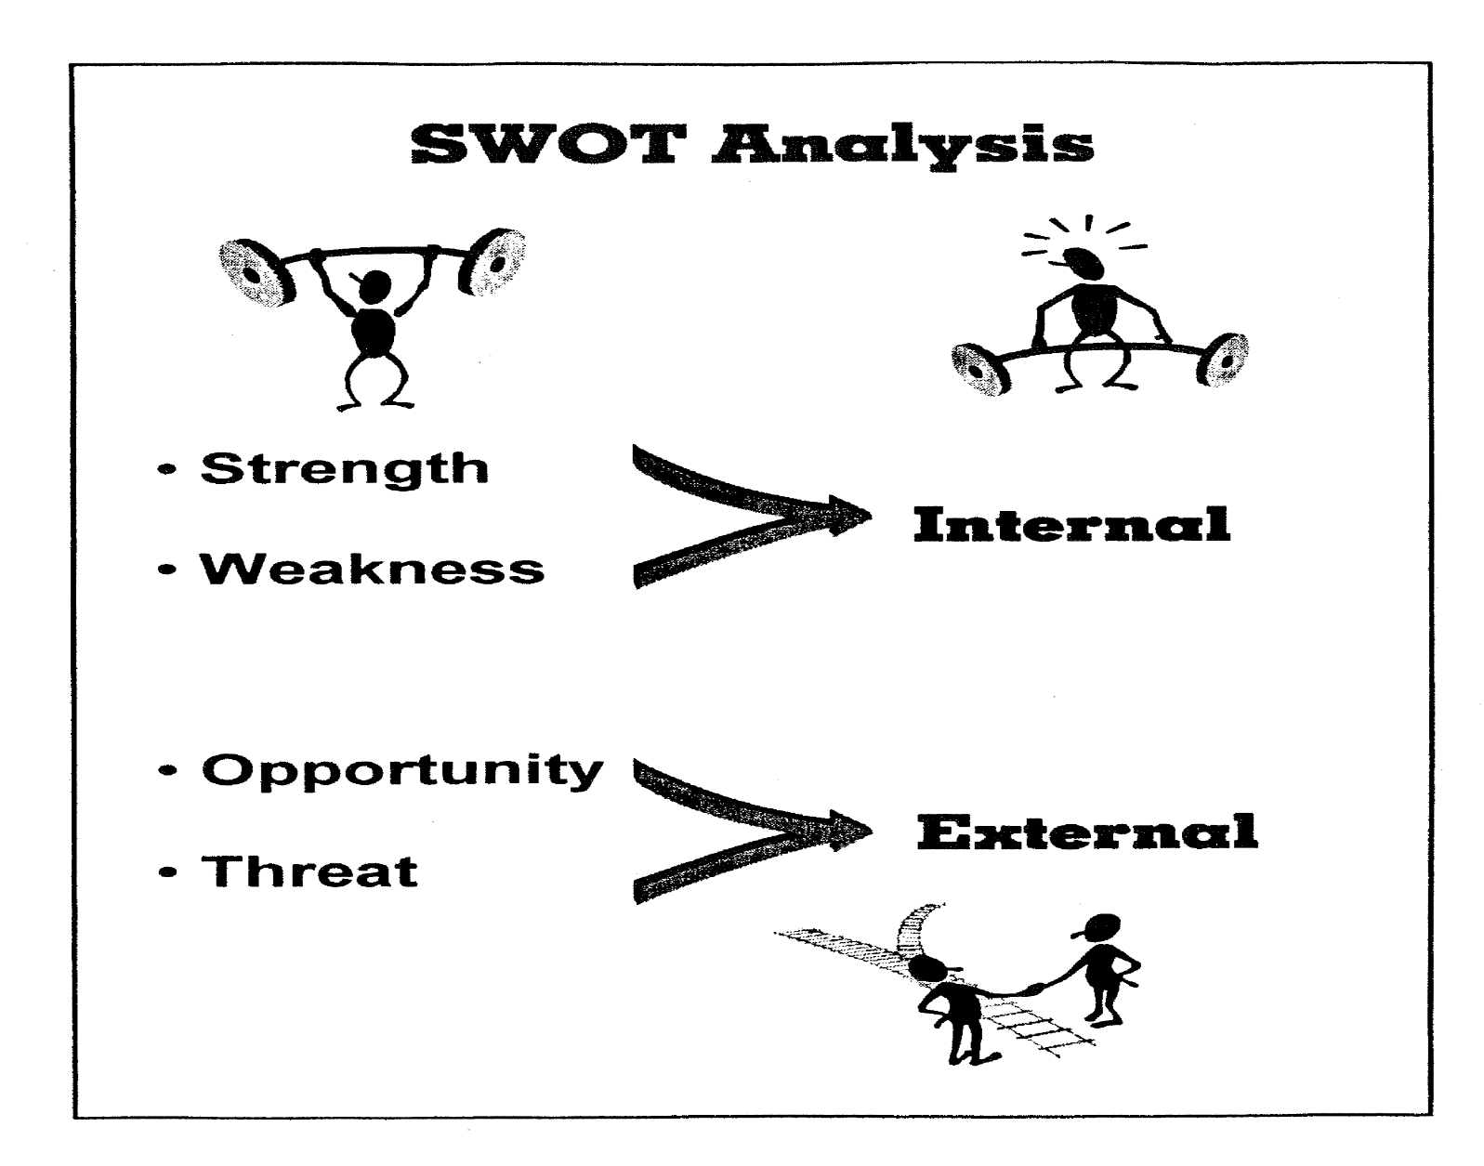
What is a SWOT?
There are 4 areas that your self-assessment will consider:
S-strengths
W-weaknesses
O-opportunities
T-threats
Video link: https://www.youtube.com/watch?v=JXXHqM6RzZQ
Notes:
SWOT self-assessments should be honest and non-threatening-this is not a forum for accusations, personnel decisions or other operational discussions; focus should be on where your enterprise is at, where it wants to go and how to best get there.
Link for the SWOT intro video (CM); send the link to TH to review

Slide 5
Context: Why should you consider a SWOT?
SWOT is a self-assessment method that will build a foundation for developing your enterprise.
Questions that you may consider include:
What would prompt a SWOT analysis?
Who should be included in the SWOT process?
How will a SWOT analysis will help you move your enterprise forward?
Notes:
There are several reasons why you should consider a self-assessment.

Slide 6
Before making a decision, you should consider resources and information you may need:
Who are the stakeholders or advisors for your enterprise?
Have you shared your vision with them?
Are they willing to give constructive advice?
What data do you have? Need? (i.e., production, financial, market information)
Notes:
Next, let’s consider in more detail the four elements of a SWOT.

Slide 7
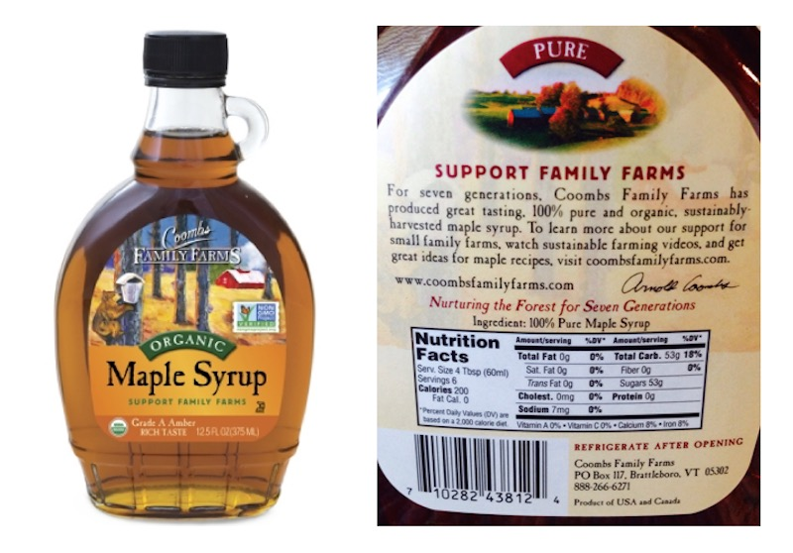
S - Strengths
EXAMPLES
Production of a high quality product in a state of the art facility
Access to additional resources (sap) to increase production
Consumer interest in value-added maple products
Strengths:
1. What do we do best?
2. What unique knowledge, talent, or resources do we have?
3. What advantages do we have?
4. What do other people say we do well?
5. What resources do we have available?
6. What is our greatest achievement?
Notes:
There are very suitable differences between these terms. So, we feel it is important to go through a few examples for each, in hopes that this discussion will help you see relevance to your own situation. This is a great opportunity to explore your strengths with you stakeholders—what do your staff, customers, suppliers and/or buyers think your product strengths are?

Slide 8

W-Weaknesses
EXAMPLES
Lack of brand recognition in new markets
Cost of new market entry
Lack of consumer awareness of pure maple v. maple substitutes
Inability to ramp up production to meet demand
1. What could be improve in each of the 4 P’s (production, promotion, place and price)?
2. What resources are we lacking?
3. What do others say could be improved?
4. What customer complaints have we had about our service?
Notes:
This is a great opportunity to explore your weaknesses with you stakeholders—what do your staff, customers, suppliers and/or buyers think the areas of improvement for your product are?

Slide 9
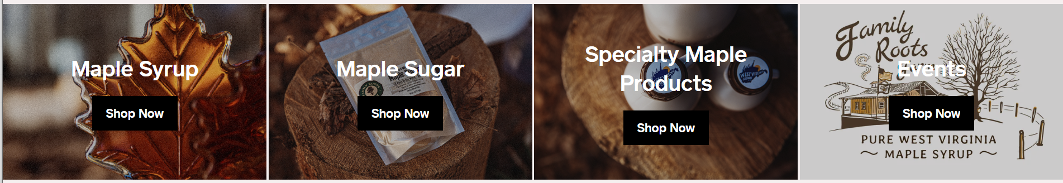
O-Opportunities
EXAMPLES
Opportunities to expand sales through ecommerce
Interest from additional market channels (i.e. retail placement)
Request and ability to fill a large wholesale order for retail sales
1. How do we turn our strengths into opportunities?
2. How can we turn our weaknesses into opportunities?
3. Is there a product needed in our market that no one is meeting?
4. Who could we support? How could we support them?
Notes:
Here are a few opportunities for your enterprise. The example given include value-addition including making maple sugar or specialty products (candy) and hosting or participating in maple events (festivals).
The key is to look for examples of what you can do to grow or continue your enterprise. These might include new markets, different products, or improved production techniques.

Slide 10
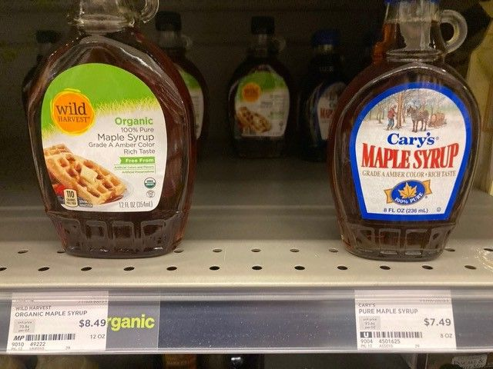
T-Threats
Examples:
Access to a commercial kitchen for value-added production
Dietary recommendations
Packaging requirements
Organic certified
1. What obstacles do we face?
2. Could any of our weaknesses prevent us from meeting our goals?
3. Who and/or what might cause us problems in the future? How?
4. Are there any standards, policies, and/or legislation changing that might negatively impact us?
5. Are we competing with others to provide service?
Notes:
Organic versus traditional pure maple processing adds a certification cost a barrier to entry as well as a price difference on the shelves. You may have bottling of a certified organic maple syrup as an opportunity from a buyer who is looking for a certified (organic) product with additional costs and certification requirements that you may not be able to fulfill.

Slide 11
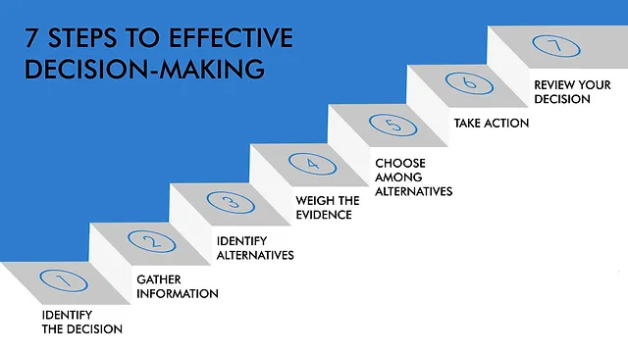
7 Steps to Effective Decision Making
Identify the decision
Gather relevant information
Identify alternatives
Consider the evidence
Choose among the alternatives
Develop and take action
Review results and impact
Notes:
The SWOT assessment has helped you do a self-assessment of your business and covers the first 5 bullets of effective decision making. Now it's time to develop strategies and implement your plan. Remember from one of the earlier slides, SWOT factors represent internal and external factors as well as duplicity (i.e. a request for a new account could an opportunity AND a weakness if you indicated limited production or access to raw materials) so look for commonalities and solutions that may address one or more quadrants.

Slide 12
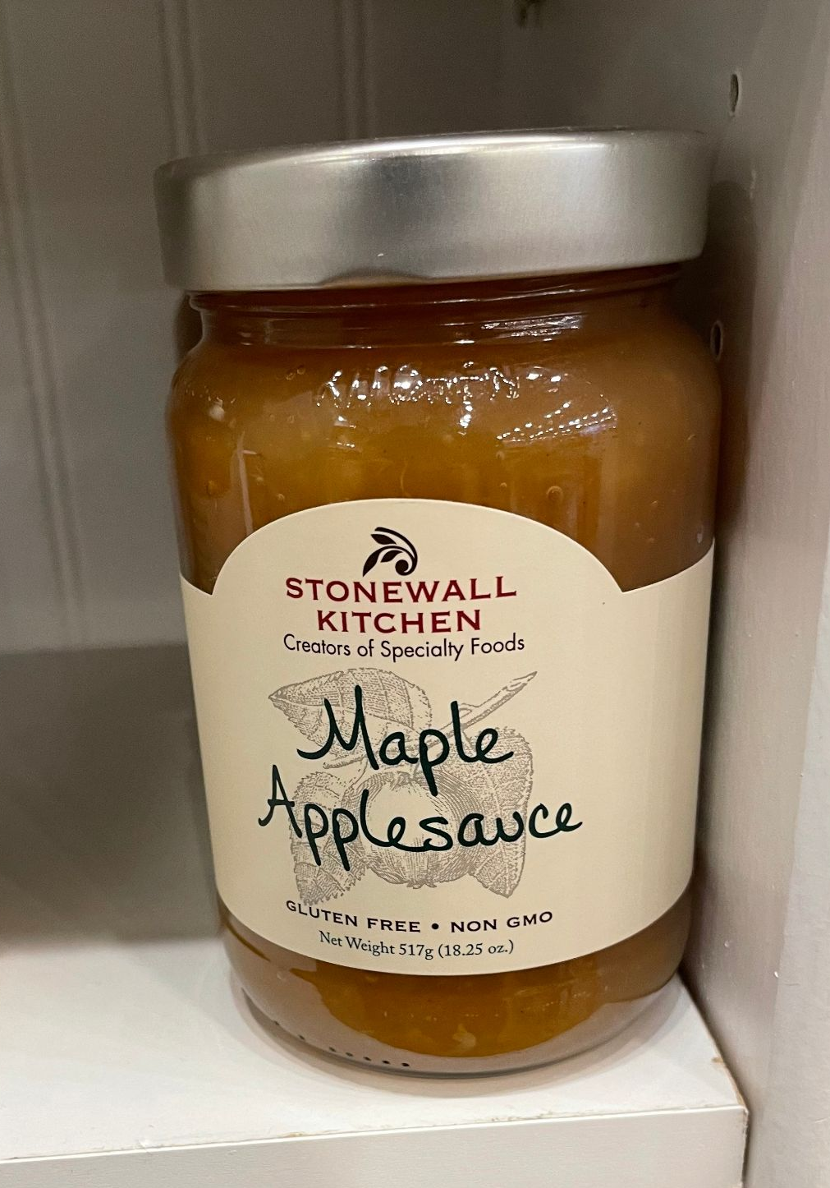
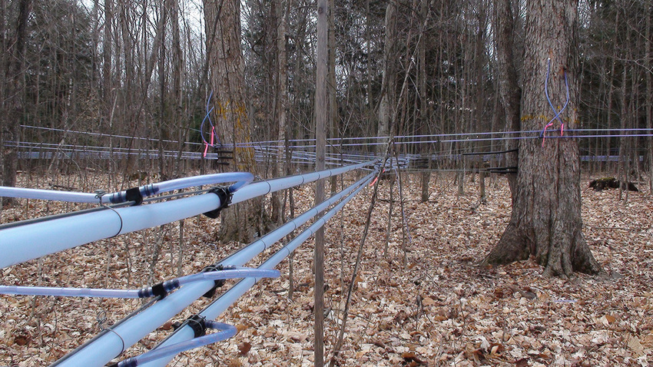
Bringing it all together; wrap up
Consider a mentor to move the process forward.
How will you document results?
Who is responsible for implementation?
Develop an SWOT action plan
Notes:
It is time to develop your SWOT action plan. It need not be sophisticated or detailed. But will be a good foundation for your planning. See the example that we have included in the following slide.

Slide 13
STRENGTHS Production of a high quality product in a state of the art facility Access to additional resources (sap) to increase production Consumer interest in value-added maple products ACTIONS:
WEAKNESSES
Lack of brand recognition in new markets
Cost of new market entry
Lack of consumer awareness of pure maple v. maple substitutes
Inability to ramp up production to meet demand
ACTIONS:
OPPORTUNITIES
Opportunities to expand sales through ecommerce
Interest from additional market channels (i.e. retail placement)
Request and ability to fill a large wholesale order for retail sales
ACTIONS:
THREATS
Access to a commercial kitchen for value-added production
Dietary recommendations
Registration or packaging requirements
ACTIONS:
Notes:
So, in summary, we have created a simple chart to show the results of a SWOT assessment that you can use. These factors are from the earlier slides, but gives you a sense of how all this will fit together. Now it's your turn! Conduct a SWOT with your colleagues, mentor and other stakeholders. Consult with the suggested resources we have listed including your SBDC, other technical service providers, and university-based sources of assistance that are specific to maple enterprises (i.e., the University of Vermont, and Cornell).

Slide 14
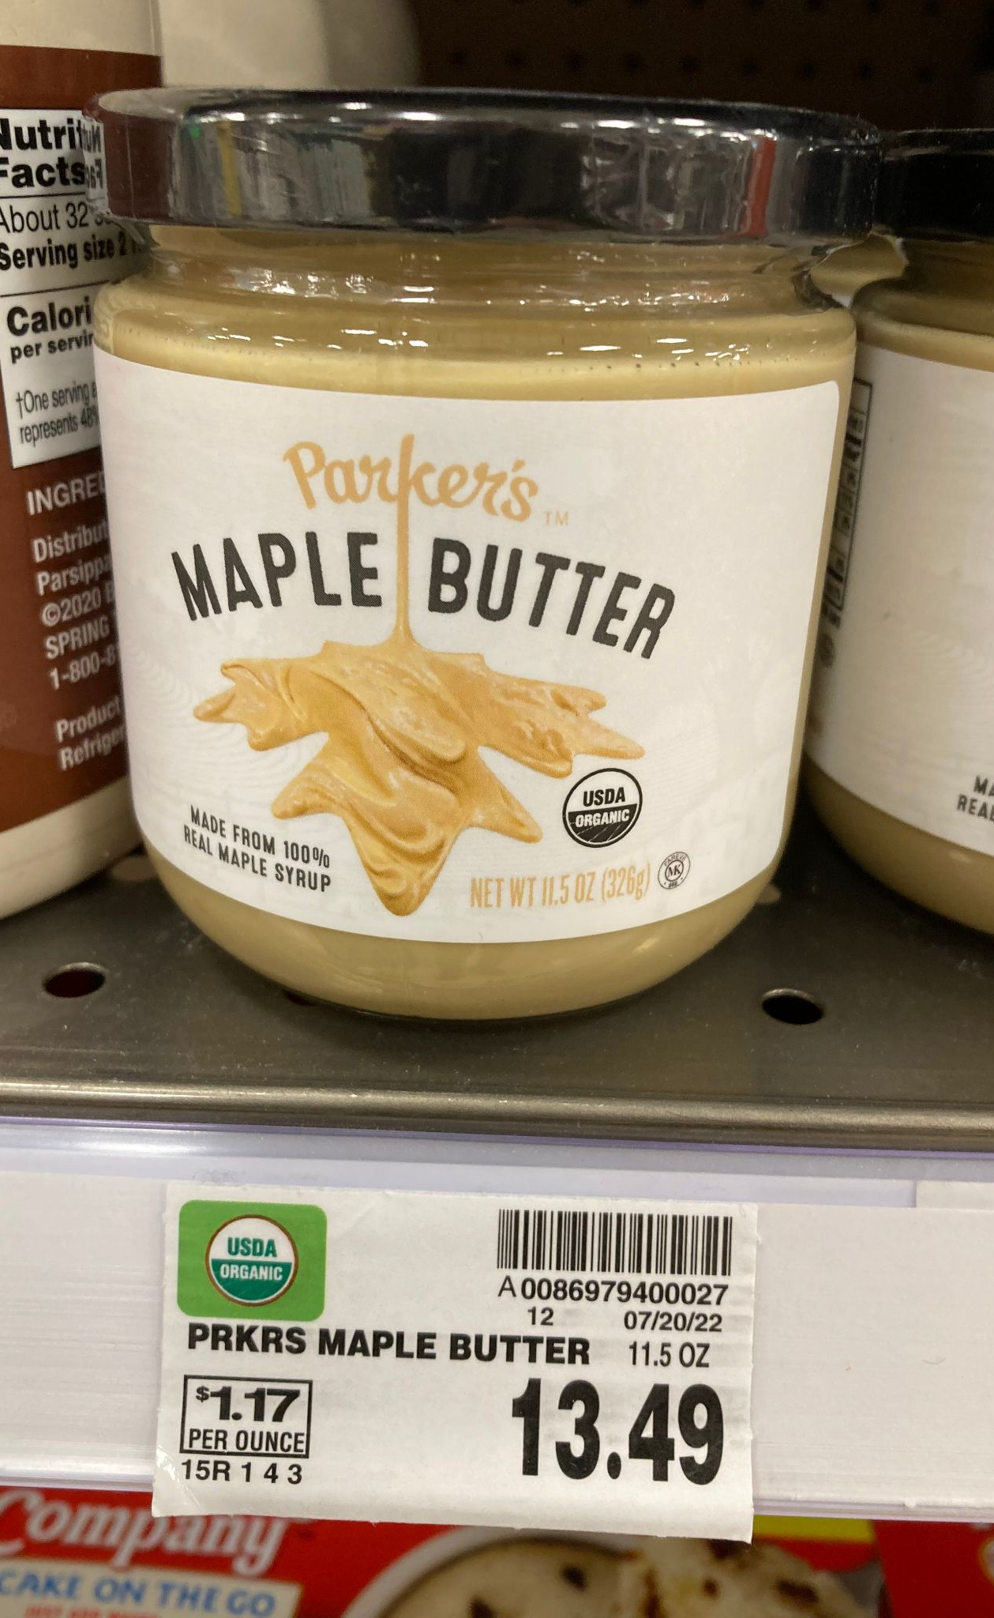
Link with your stakeholders
Viewers of this file can see comments and suggestions.
CommentCancel
Customers
Employees
Buyers/suppliers
Farmers markets
Customers
Who else might you include?
Notes:
Who will you work with in developing your SWOT?

Slide 15
Contact resources for guidance, may include:
Your mentoring team (staff, family and professionals)
University of Vermont or other maple enterprise specialists
Your local Small Business Development Center (SBDC)
Cooperative Extension Service (at land-grant universities)
Senior Corps of Retired Executives (SCORE)
Notes:
CAUTION: Beware of search engine ads that provide business registration services. Many are credible and can get the process completed, their fees don’t include working through the formation questions.
Refer to Resource/Contact List .

Slide 16
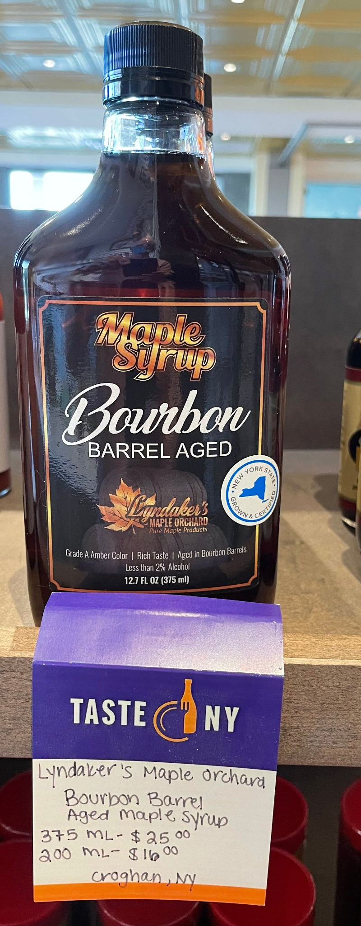
Action Plan
Activity | Yes | No | N/A | Action Plan, timeframe and assignment
Assemble a list of mentors and stakeholders for your enterprise |  |  |  | Ongoing
Conduct SWOT Assessment and SWOT Action Plan for your maple enterprise |  |  |  | This Module (#2)
Develop a marketing mindset for your maple enterprise |  |  |  | Module (#3)
Develop a marketing strategy/plan |  |  |  | Module (#5)
Notes:
What are the next steps? Determine the options for getting your product to market.
Remember to place your SWOT worksheet and Action Plan into your business plan binder; you can always go back and adjust based on your enterprise development.

Slide 17
Resources for this Module:
Here is a link to a Youtube video that helps explain the SWOT method: https://www.youtube.com/watch?v=JXXHqM6RzZQ
There are several other resources online that introduce SWOT
SWOT examples are given in several business manuals and texts
Refer also to Small Business Development Center publications

Slide 18
Did I learn what I needed to know?
Please complete the Evaluation Form for this module
This will help us make sure that your needs have been met, and that future training modules will be useful to you
Are there any other topics in this area for which you would like information?
Thank you for for your participation
Notes:
Your feedback will help us provide useful sessions on topics that are important to you and others working in the maple syrup sector.

