Slide 1
Labeling your maple syrup products - Module 7
By
Tom Hammett and Cindy Martel
Appalachian Program
Future Generations University
supported by the
USDA AMS-ACER
Access Grant Program
Notes:
Welcome to Future Generations University’s business learning sessions for maple enterprise development. This session will provide an introduction to self-assessment through a SWOT tool - an important part of your enterprise development. We would like to acknowledge the programs that have assisted us assembling this information, particularly the USDA AMS-ACER Access Grant Program as well as the resources developed by other maple development programs.
Please remember that this session is not intended to advise you on how to conduct your business. As in previous sessions we encourage you to determine what will work best for your situation. Hopefully this session will provide answers to some of your questions and needed resources in the area of marketing. So, get your pen and paper ready, and put on your thinking cap!

Slide 2
Agenda
Objectives for this module
Acronyms used in labeling
Why focus on labeling?
Basic components of labeling for maple syrup
Examples of labeling for maple syrup products
Labeling for value-added maple syrup products

Slide 3
Objectives
Discuss general label components
What you might include in your maple syrup label?
Review what is required for labels
Practice: develop a “mock label” for your maple syrup
Notes:
The end result from participating in this module is that you should feel comfortable developing a label that benefits product.

Slide 4
Acronyms
CFR - Code of Federal Regulations
FPLA - Fair Packaging & Labeling Act
PDP - Principal Display Panel (portion of the package that is most likely to be seen by the consumer when on a store shelf)
Acronyms

Slide 5
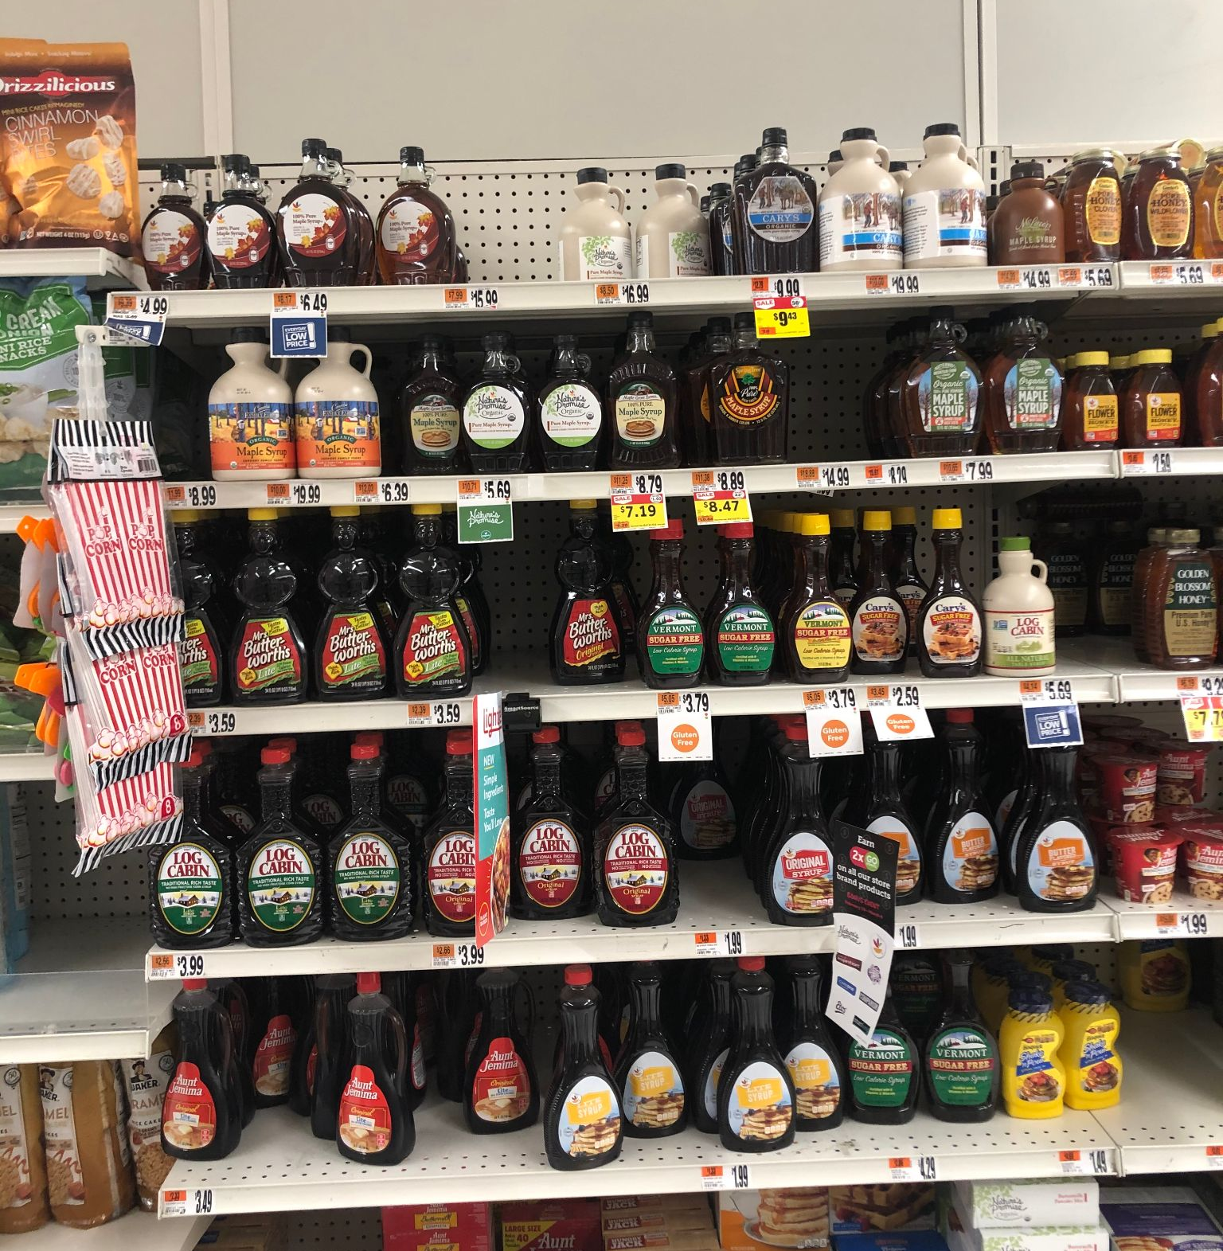
Why is labeling important?
How will consumers discern your product from others?
Experience (i.e., previous use)?
Reputation (i.e., via advertising)?
Word of mouth?
OR through the information you include in your label?
There might be several maple syrup products from which to choose!
Notes:
How will you describe your product to customers? How will your product be differentiated from others?

Slide 6
Basic Labeling Components for Maple Syrup*
Statement of identity
Net quantity of contents
Ingredient list
Statement of responsibility with producer information
*Note - FDA requirements for all products engaged in interstate commerce including retail sales, at specialty outlets (Tamarack, WV), and online sales.

Slide 7
1. Statement of Product Identity
“Statement of Identity” is the name of the food
Name must be the common or usual name of the food
Name shall accurately identify or describe the basic nature of the food or its characterizing properties or ingredients
Foods that have a Standard of Identity must conform to all requirements of the standard
(one of the required components that must appear on the principal display panel)
Reference: CFR 21, Part 101.3
Source: Ohio Department of Agriculture Division of Food Safety “Maple Syrup” Fact Sheet—UPDATED—July 2019

Slide 8
2. Net Quantity of Contents
“Net” or “Net Contents” may be used when stating the net quantity of contents in terms of volume
“Net Weight” or “Net Wt” must be used when expressing net quantity of weight
Do not include packaging weight ( i.e., bottle weight)
Net quantity of contents shall be declared in both the U.S. Customary System and the International System (metric)
Metric declaration is stated parenthetically (in parentheses)
Net quantity of contents statement must be
  in bottom 30 percent of the principal display panel
  aligned parallel to the bottom of the package
Required components that must appear on principal display panel

Slide 9
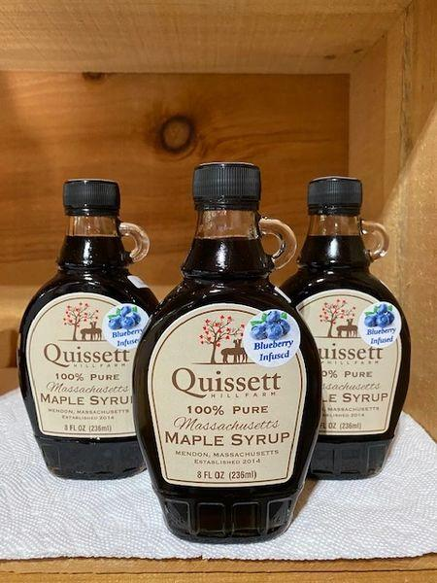
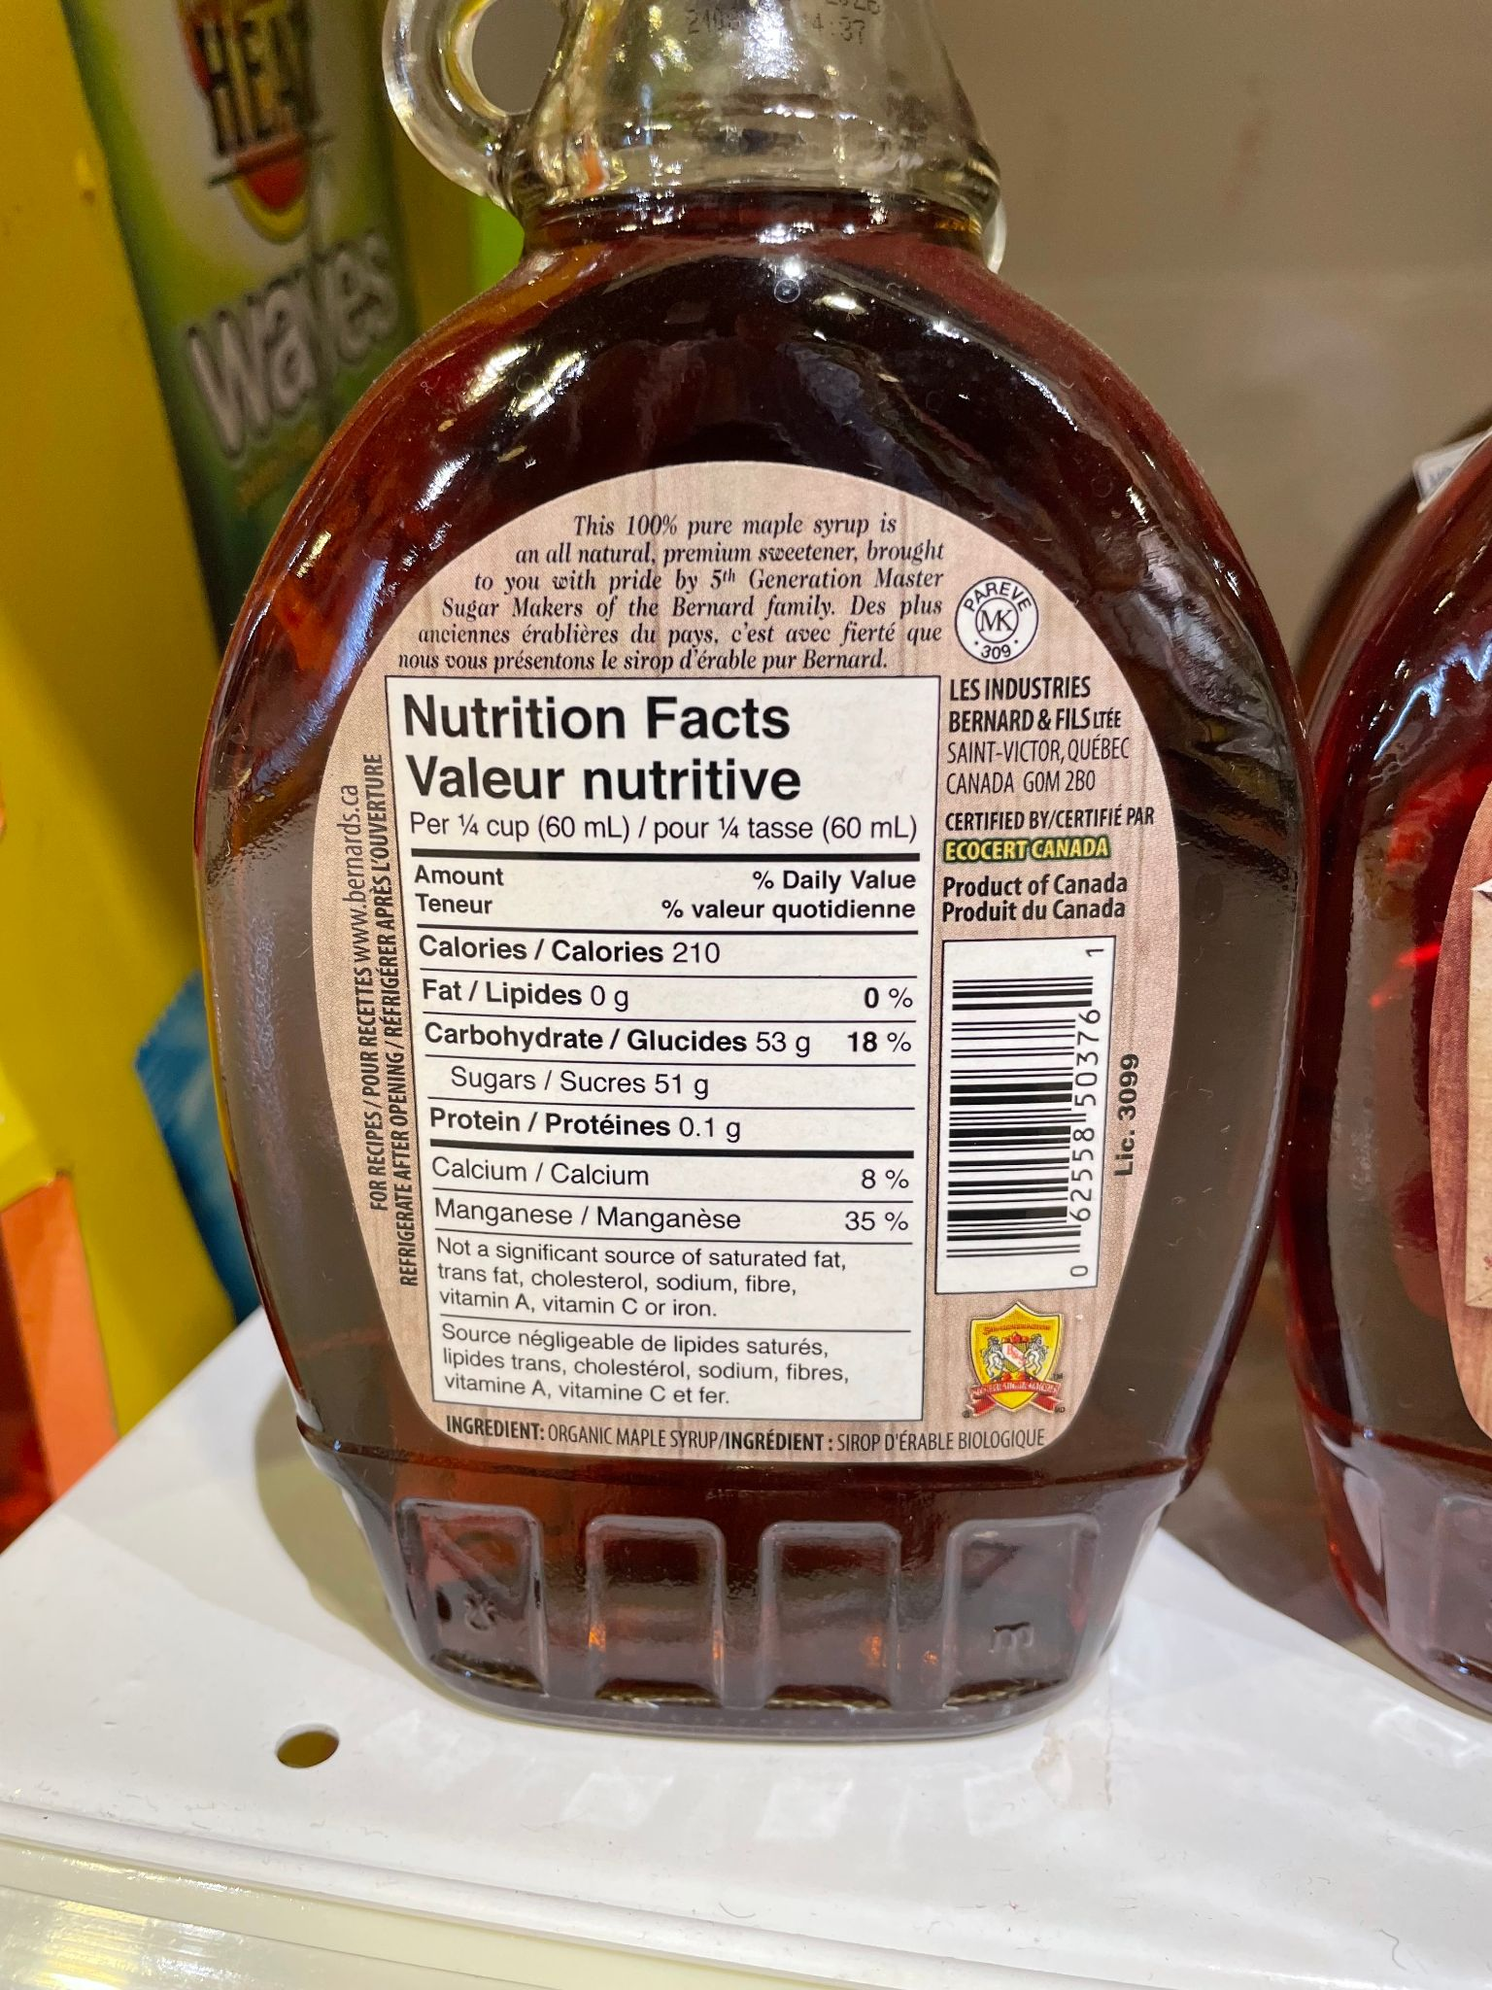
Labels on the bottle front are simple, designed to be eye catching; could illustrate the syrup making process.
On the rear, give product and producer information, ingredients, and nutritional values (photo by Hammett taken in Kenya 2023)

Slide 10
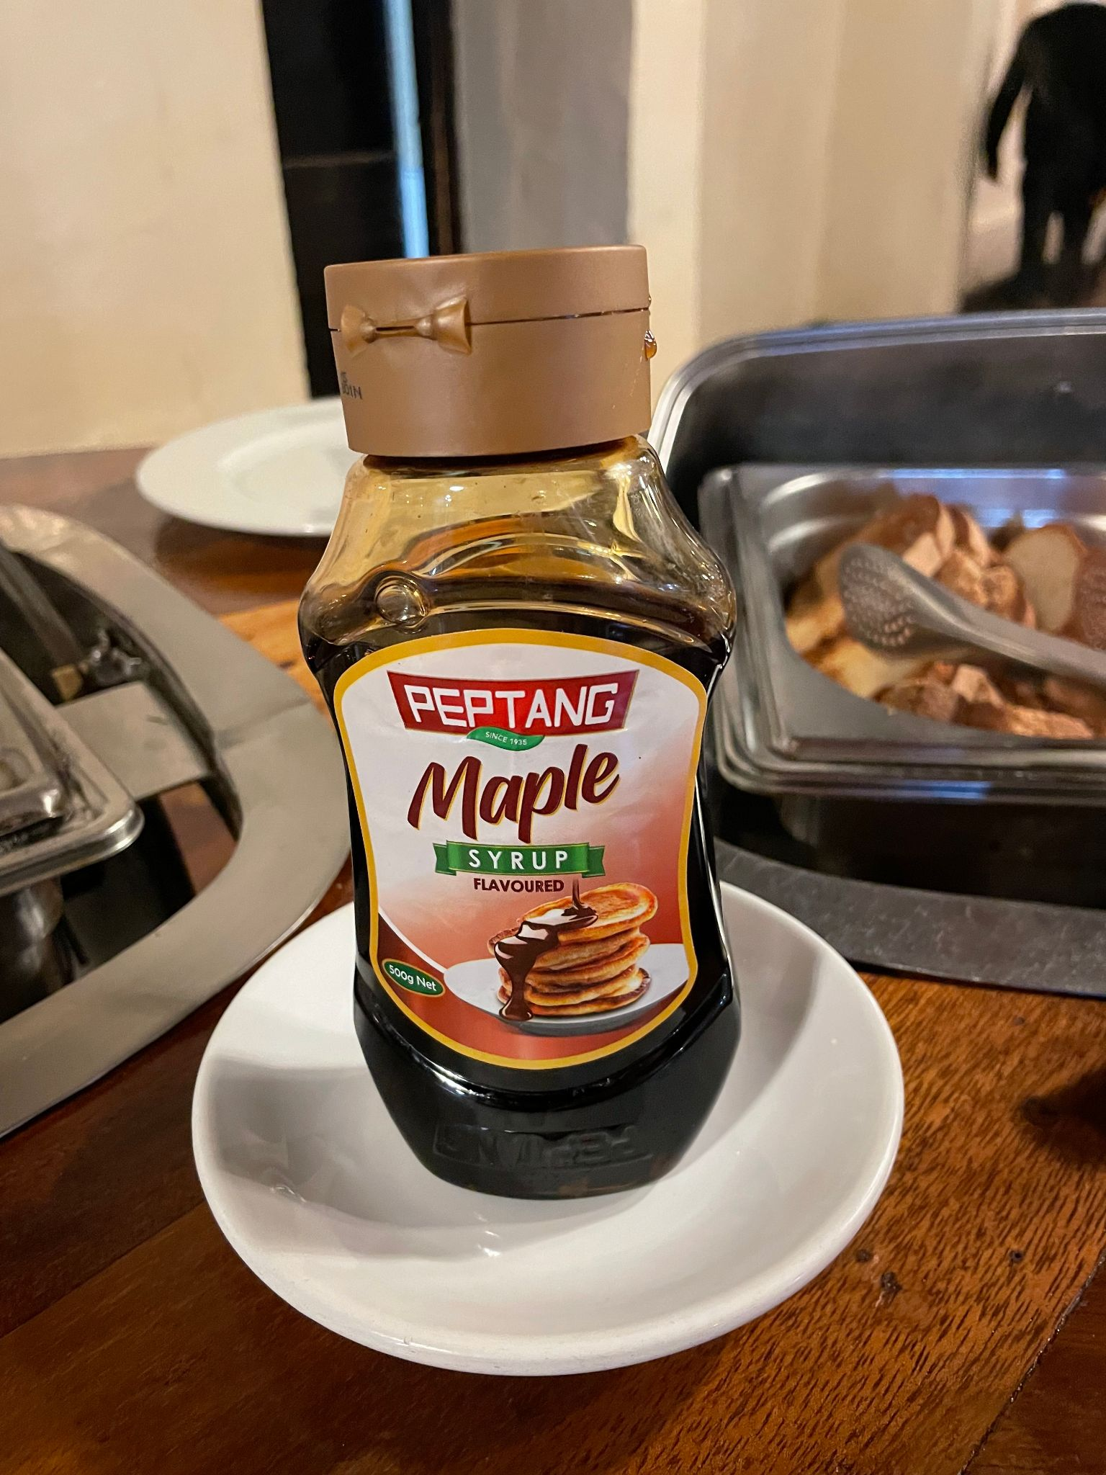
Care should be given when designing labels so that they present a true representation of the contents. This label reads maple syrup - but if you read carefully it is only “maple flavored” syrup! (photo by Hammett in Kenya 2023)

Slide 11
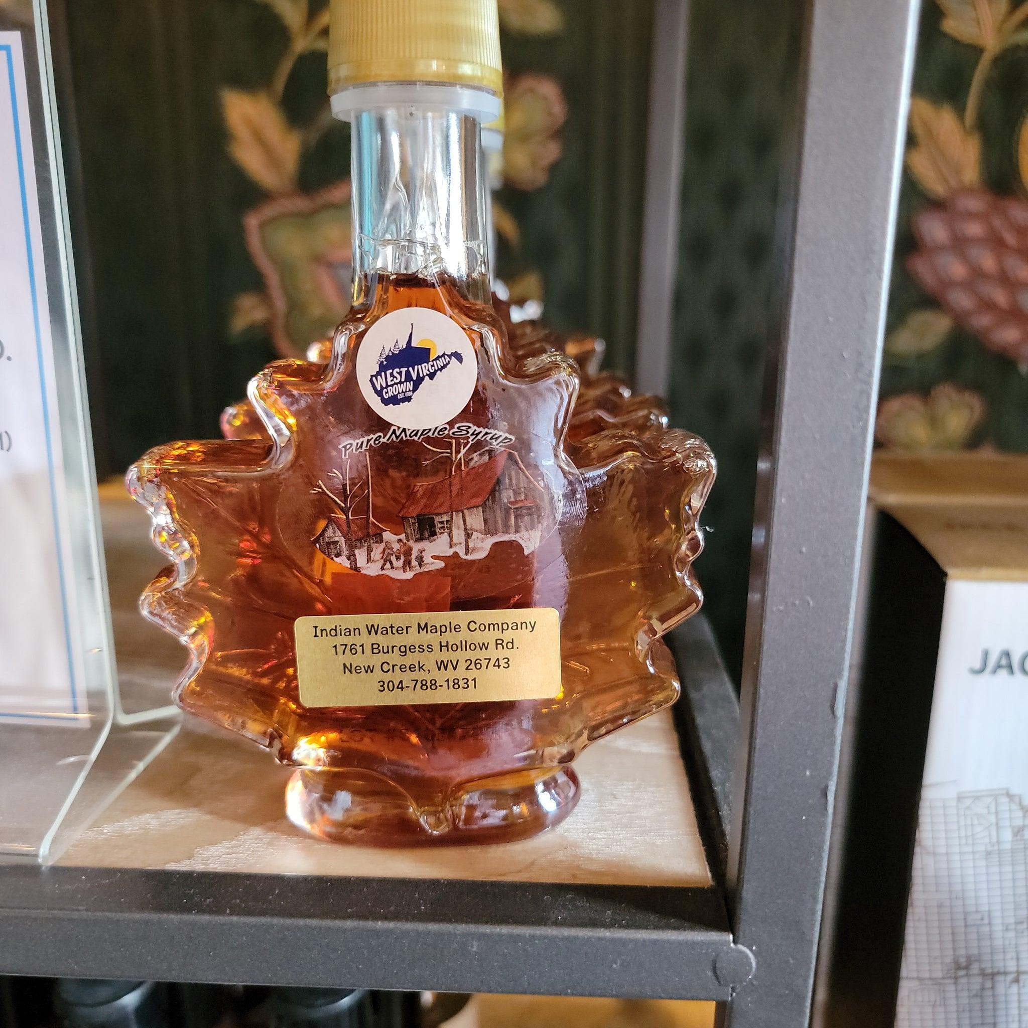
A label may be simple and serve to accent the container shape or style. (photo of syrup displayed at Tamarack April 2024 - Hammett)

Slide 12
3. Ingredient List
Packaging for most food products are required to have an ingredient list on its label. The list must:
  declare all ingredients by common or usual name
  show ingredients in descending order by weight
Maple syrup is often a single ingredient food (if not, see notes about value-added foods)
An ingredient list for maple syrup as a single ingredient food is not required EXCEPT when using optional ingredients such as salt and chemical preservatives
Pure maple syrup does not require any allergen declaration(s) on the label

Slide 13
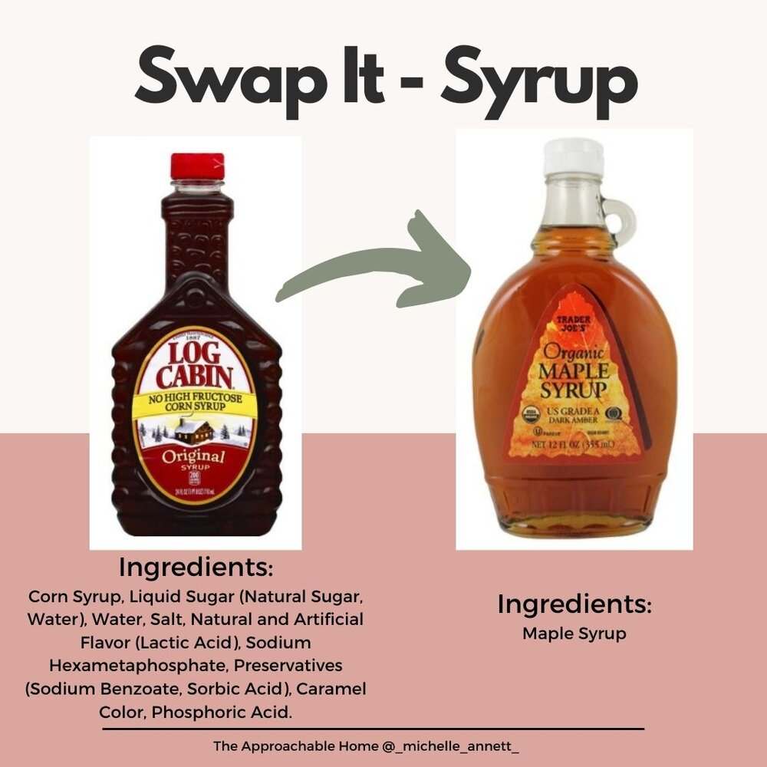
Labels help consumers make buying decisions - decide which product(s) to buy

Slide 14
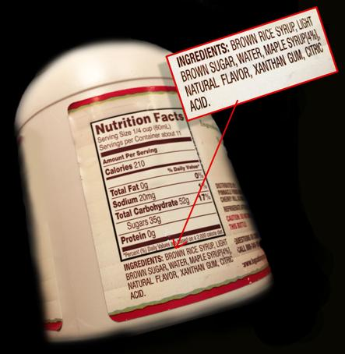
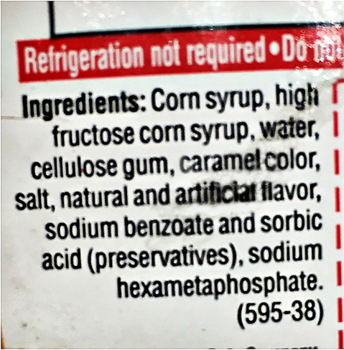
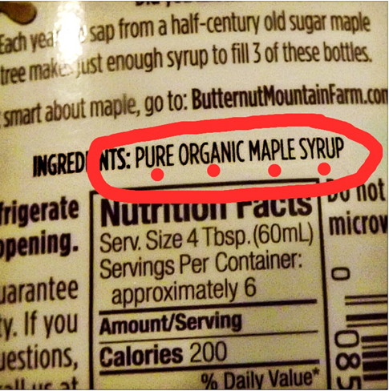
Some examples of ingredient lists included in table syrup labels

Slide 15
4. Statement of Responsibility
Shall include:
  Business name
  Street address
  City, State, Zip Code
Must be continuous…..can’t be split up into different areas of the label
If the business name is listed in the phone directory, physical address can be omitted*
* After Jan. 1, 2026, additional business directory options will be offered by FDA
Notes:
Marketing thought—telephone numbers, web-site address and e-mail addresses are permitted but not required; how can a customer re/order your product?

Slide 16
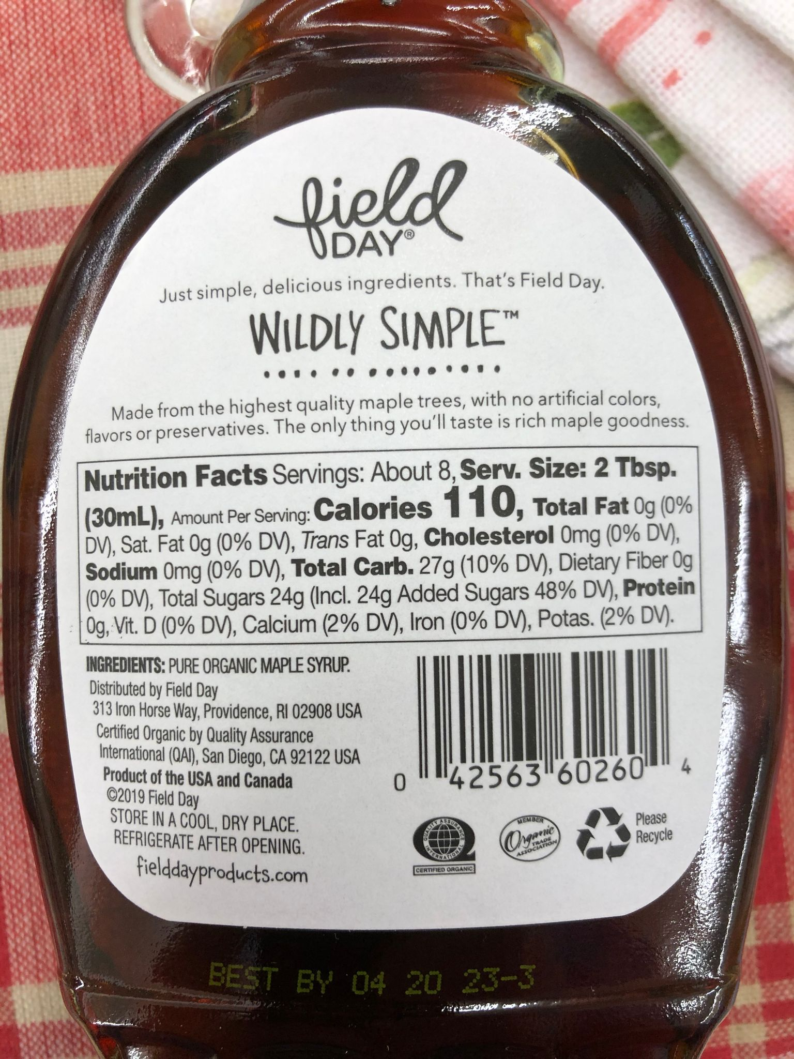
A typical store label for a generic brand will include information on the syrup, but little information on its origin (place of production). Such a label might include “product of Canada and the US”

Slide 17
Intrastate Commerce v. Interstate Commerce
Intrastate Commerce
Interstate Commerce
Transactions (or transportation) that occur solely within a state’s borders
Example: Direct sales of maple products at festivals or on farms
Refer to state labeling requirements (in resource folder)
Transactions (or transportation) between a seller located in one state and a buyer located in another state
Example: Online sales shipped to a customer in another state
Refer to FDA labeling guidelines (in resource folder)
Notes:
Important to know difference to determine which labeling requirements apply. Many states have different/modified requirements for intrastate commerce. Interstate commerce label guidelines following the FDA document. If a firm is doing both types of sales, their label must consistently be FDA compliant.

Slide 18
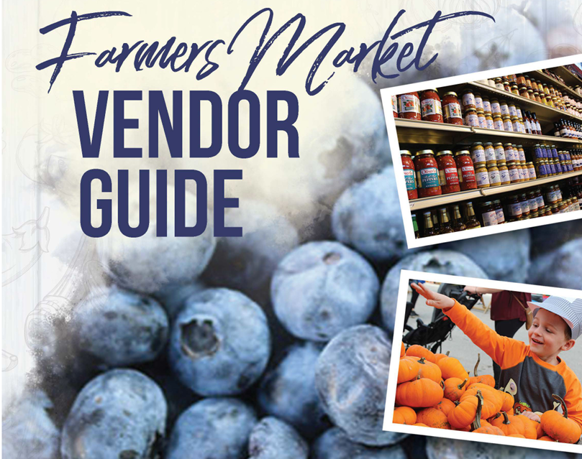
West Virginia Farmers Market Vendor Guide
Labeling requirements:
  different for potentially hazardous and non-potentially hazardous food products
West Virginia Manual linked here: https://agriculture.wv.gov/wp-content/uploads/2023/02/Farmers-Market-Vendor-Guide.pdf
  see page 5 for note about net weight statement specific to maple syrup
  see page 9 for tree syrups
Virginia information is in the module
There is variation between states

Slide 19
Labeling When Bottling and Before Shipping
Labels need to be put on straight, with consistent positioning
A batch code may need to be placed on the bottom of the bottle referencing the barrel which is keyed to production data on record (check your local regulations)
Bottles to be shipped in the boxes they came in need to be sealed with packing tape around the entire box.
Be sure bottles are not sticky. Syrup residue on the outside of the bottle needs to be washed off.
Based on guidance to syrup producers provided by Future Generations University

Slide 20
Label requirements for value-added products
Value-added products such as maple sugar, cotton candy, crème, and candy - all made from maple syrup
Label requirements still apply (home-based and interstate commerce)
If maple syrup is the only ingredient; then the value-added product is still considered non-potentially hazardous
ANY other ingredient and form change requires a determination of hazard level at both the state and federal level
COMING SOON---Future Generations University will be developing tools and resources to enter the maple value-added “world”
Notes:
Resources: https://www.vdacs.virginia.gov/pdf/homefdapplication.pdf
https://www.vdacs.virginia.gov/pdf/kitchenbillfaq.pdf Change of form through processing of a food product
Includes sap to maple syrup, however, non-potentially hazardous product based on high sugar content
https://agriculture.wv.gov/wp-content/uploads/2023/02/Farmers-Market-Vendor-Guide.pdf

Slide 21
References
CFR 21, Part 101.7; FPLA, Title 15-Chapter 39, 1453(a) (2)
Source: Ohio Department of Agriculture Division of Food Safety “Maple Syrup” Fact Sheet—UPDATED—July 2019
Note: Liquid maple syrup weighs more than water; you must convert to metric based on the actual product weight
CFR 21, Part 101.4
Source: Ohio Department of Agriculture Division of Food Safety “Maple Syrup” Fact Sheet—UPDATED—July 2019

Slide 22
Next steps
Find and note labels on other maple syrups or products
What text or illustrations will you include in your label?
Put together a mock label for your maple syrup product
Have your team review and give feedback on your mock label
Review the resources posted for this module
Notes:
FGU conducted a shelf survey that included pricing and labeling of maple suryp. The report is available through FGU.

Slide 23
Did I learn what I needed to know?
Please complete the Evaluation Form for this module
This will help us make sure that your needs have been met, and that future training modules will be useful
Are there any other topics in this area for which you would like information?
Thank you for for your participation
Notes:
Your feedback will help us provide useful sessions on topics that are important to you and others working in the maple syrup sector.

